Slide 1
Chapter 10 Object-Oriented Programming: Polymorphism

Slide 2
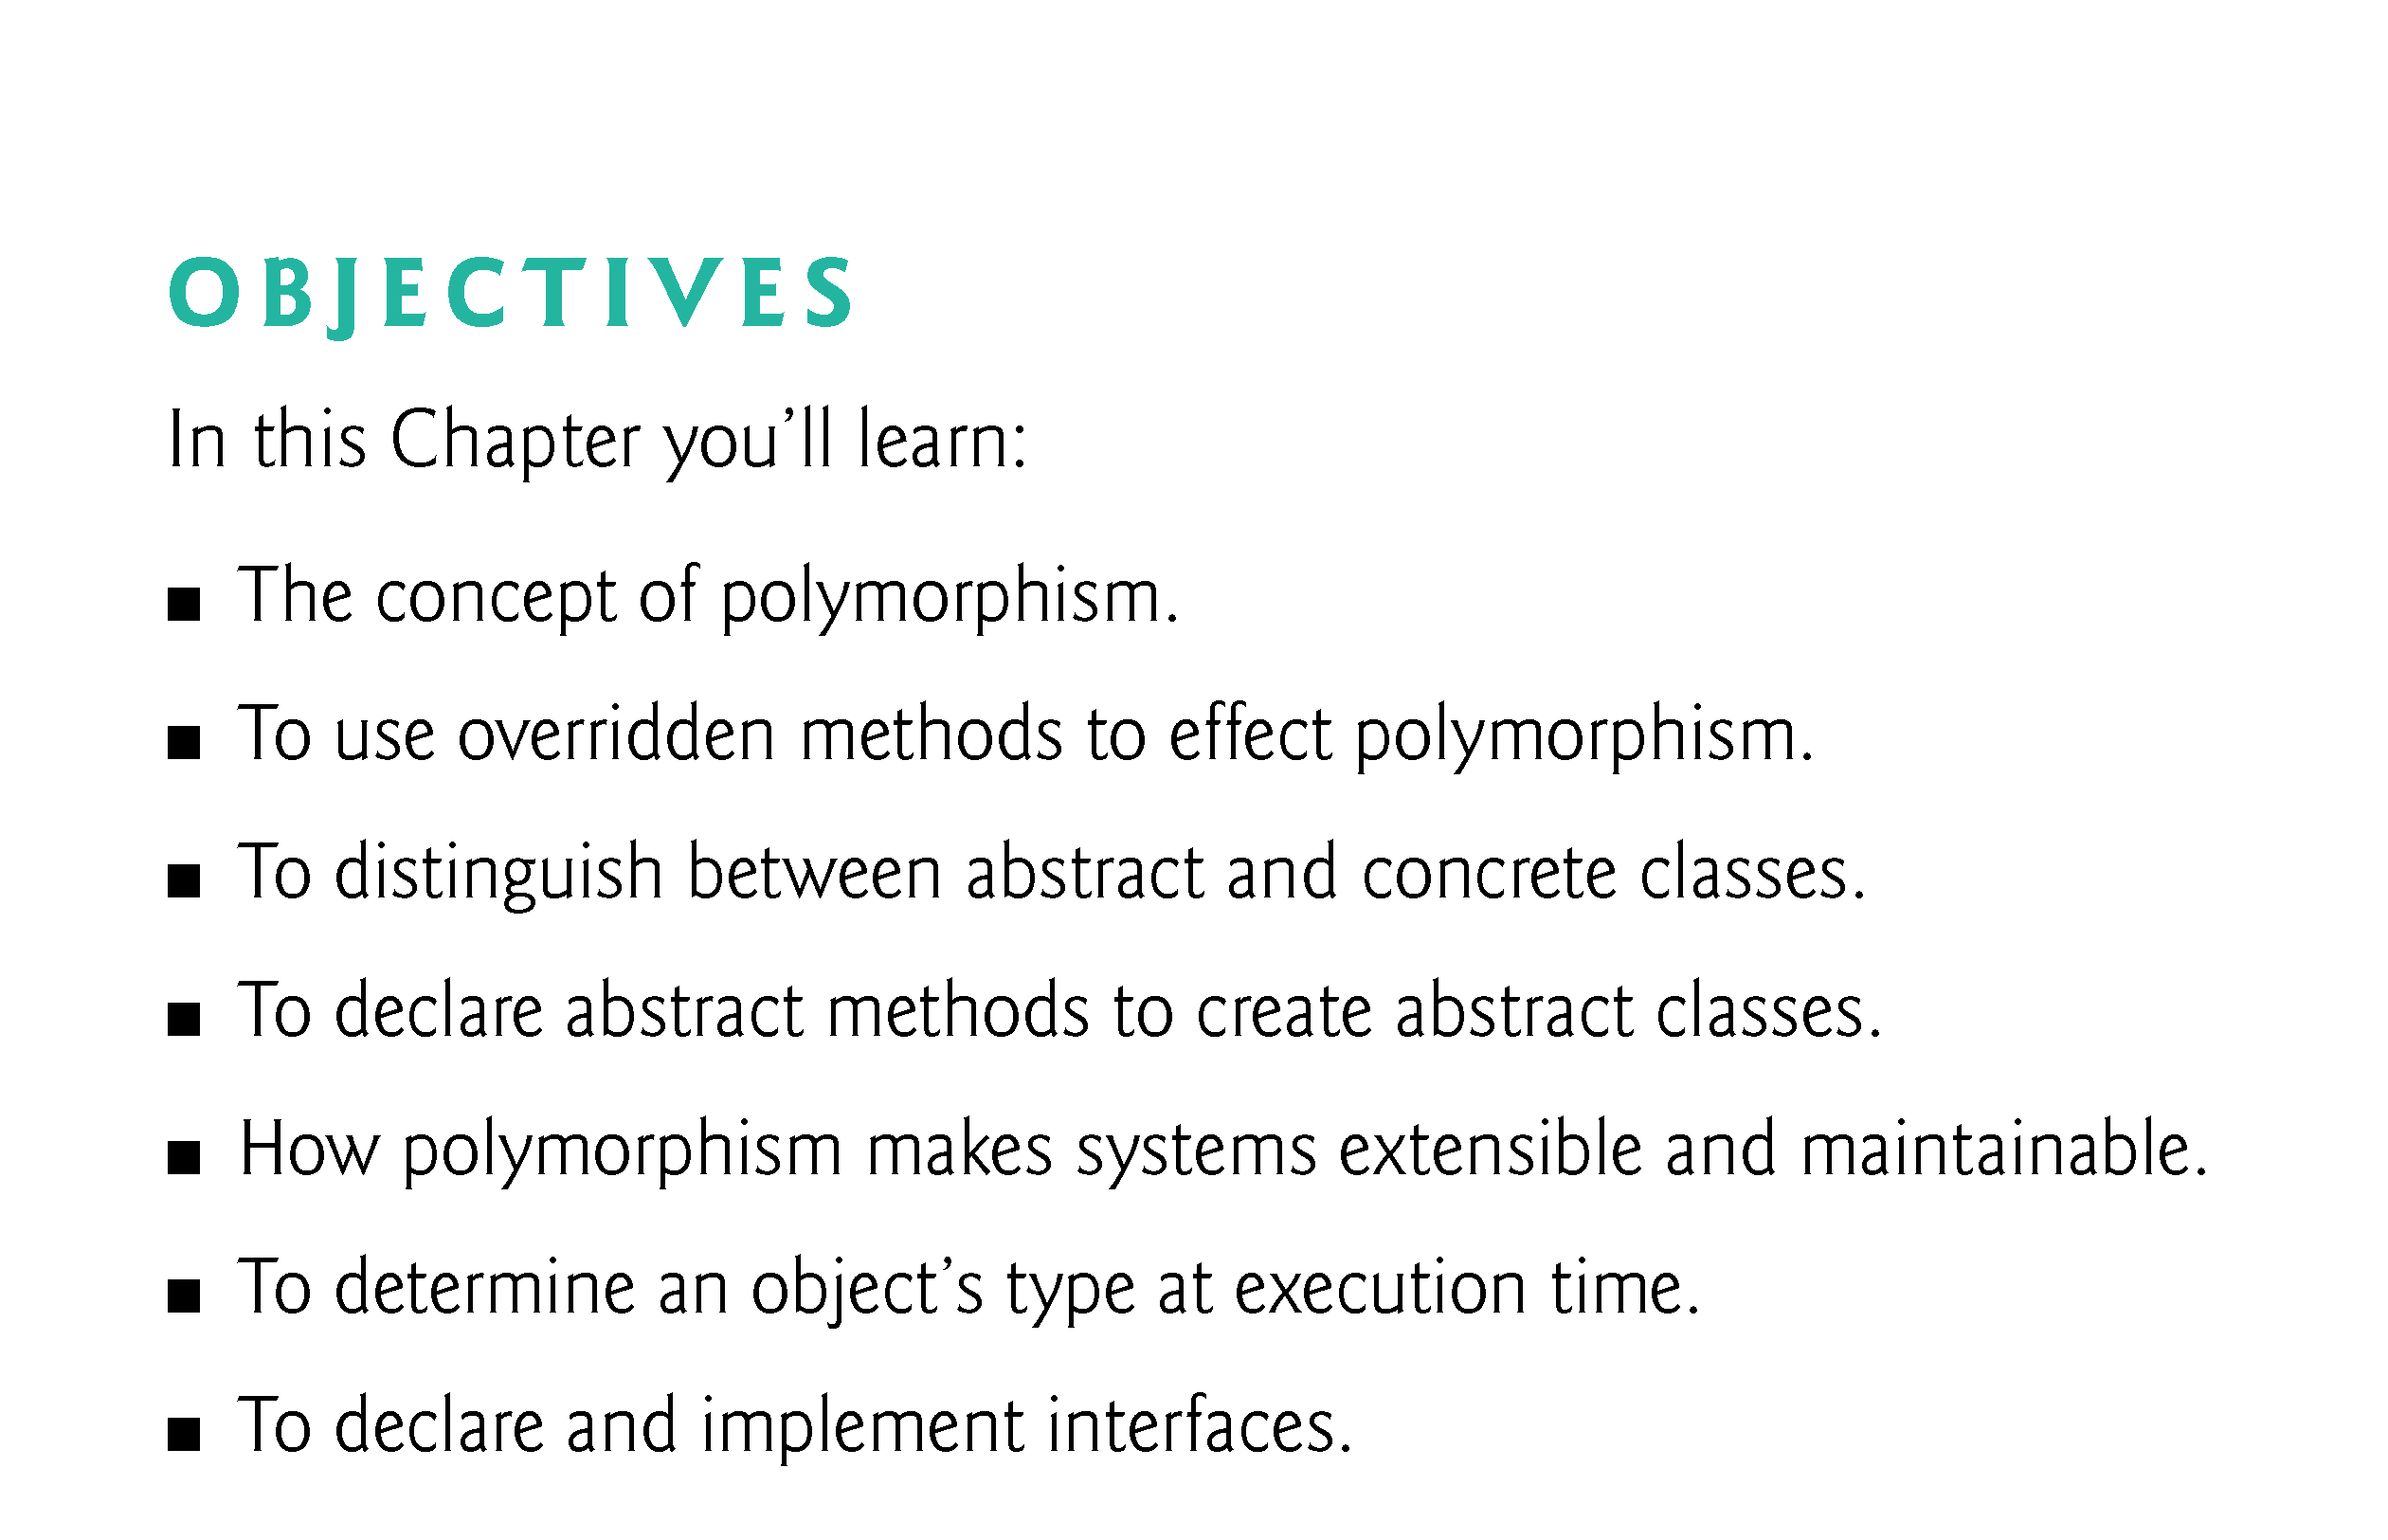

Slide 3
10.1 Introduction
Polymorphism
Enables you to “program in the general” rather than “program in the specific.”
Polymorphism enables you to write programs that process objects that share the same superclass as if they’re all objects of the superclass; this can simplify programming.

Slide 4
10.1 Introduction (Cont.)
Example: Suppose we create a program that simulates the movement of several types of animals for a biological study. Classes Fish, Frog and Bird represent the three types of animals under investigation.
Each class extends superclass Animal, which contains a method move and maintains an animal’s current location as x-y coordinates. Each subclass implements method move.
A program maintains an Animal array containing references to objects of the various Animal subclasses. To simulate the animals’ movements, the program sends each object the same message once per second—namely, move.

Slide 5
10.1 Introduction (Cont.)
Each specific type of Animal responds to a move message in a unique way:
a Fish might swim three feet
a Frog might jump five feet
a Bird might fly ten feet.
The program issues the same message (i.e., move) to each animal object, but each object knows how to modify its x-y coordinates appropriately for its specific type of movement.
Relying on each object to know how to “do the right thing” in response to the same method call is the key concept of polymorphism.
The same message sent to a variety of objects has “many forms” of results—hence the term polymorphism.

Slide 6
10.1 Introduction (Cont.)
With polymorphism, we can design and implement systems that are easily extensible
New classes can be added with little or no modification to the general portions of the program, as long as the new classes are part of the inheritance hierarchy that the program processes generically.
The only parts of a program that must be altered to accommodate new classes are those that require direct knowledge of the new classes that we add to the hierarchy.

Slide 7
10.1 Introduction (Cont.)
Once a class implements an interface, all objects of that class have an is-a relationship with the interface type, and all objects of the class are guaranteed to provide the functionality described by the interface.
Interfaces are particularly useful for assigning common functionality to possibly unrelated classes.
Allows objects of unrelated classes to be processed polymorphically—objects of classes that implement the same interface can respond to all of the interface method calls.

Slide 8
10.1 Introduction (Cont.)
An interface describes a set of methods that can be called on an object, but does not provide concrete implementations for all the methods.
You can declare classes that implement (i.e., provide concrete implementations for the methods of) one or more interfaces.
Each interface method must be declared in all the classes that explicitly implement the interface.

Slide 9
10.2 Polymorphism Examples
Example: Quadrilaterals(四边形)
If Rectangle is derived from Quadrilateral, then a Rectangle object is a more specific version of a Quadrilateral.
Any operation that can be performed on a Quadrilateral can also be performed on a Rectangle.
These operations can also be performed on other Quadrilaterals, such as Squares, Parallelograms（平行四边形) and Trapezoids(菱形）.
Polymorphism occurs when a program invokes a method through a superclass Quadrilateral variable—at execution time, the correct subclass version of the method is called, based on the type of the reference stored in the superclass variable.

Slide 10
10.2 Polymorphism Examples (Cont.)
Example: Space Objects in a Video Game
A video game manipulates objects of classes Martian(火星）, Venusian（金星）, Plutonian（冥王星）, SpaceShip（宇宙飞船） and LaserBeam. Each inherits from SpaceObject and overrides its draw method.
A screen manager maintains a collection of references to objects of the various classes and periodically sends each object the same message—namely, draw.
Each object responds in a unique way.
A Martian object might draw itself in red with green eyes and the appropriate number of antennae.
A SpaceShip object might draw itself as a bright silver flying saucer.
A LaserBeam object might draw itself as a bright red beam across the screen.
The same message (in this case, draw) sent to a variety of objects has “many forms” of results.

Slide 11
10.2 Polymorphism Examples (Cont.)
A screen manager might use polymorphism to facilitate adding new classes to a system with minimal modifications to the system’s code.
To add new objects to our video game:
Build a class that extends SpaceObject and provides its own draw method implementation.
When objects of that class appear in the SpaceObject collection, the screen manager code invokes method draw, exactly as it does for every other object in the collection, regardless of its type.
So the new objects simply “plug right in” without any modification of the screen manager code by the programmer.

Slide 12
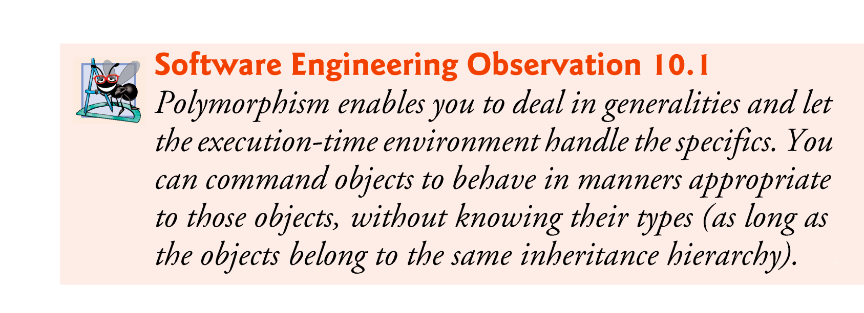

Slide 13
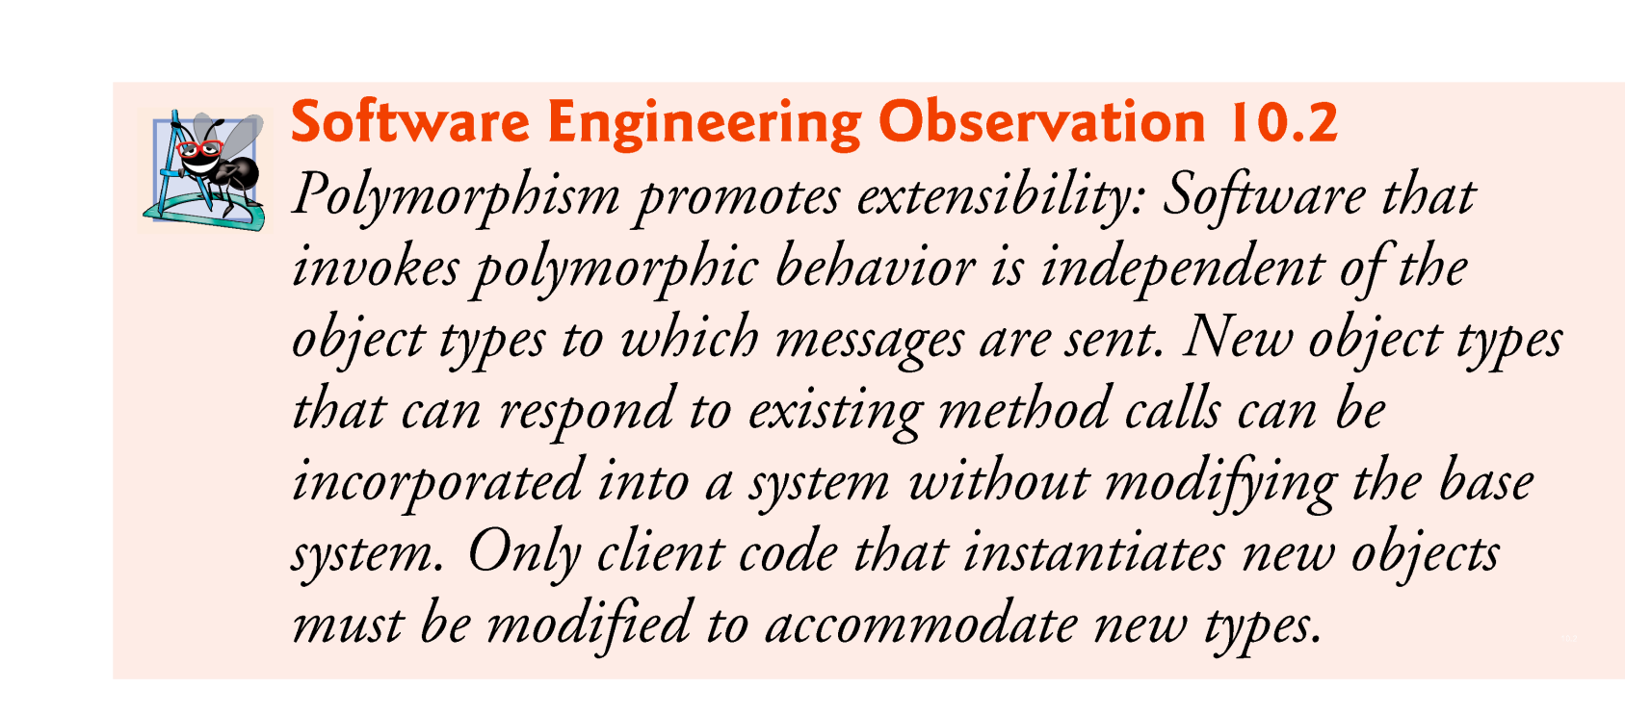

Slide 14
10.3 Demonstrating Polymorphic Behavior
In the next example, we aim a superclass reference at a subclass object.
Invoking a method on a subclass object via a superclass reference invokes the subclass functionality
The type of the referenced object, not the type of the variable, determines which method is called

Slide 15
10.3 Demonstrating Polymorphic Behavior (Cont.)
This example demonstrates that an object of a subclass can be treated as an object of its superclass, enabling various interesting manipulations.
A program can create an array of superclass variables that refer to objects of many subclass types.
Allowed because each subclass object is an object of its superclass.

Slide 16
10.3 Demonstrating Polymorphic Behavior (Cont.)
A superclass object cannot be treated as a subclass object, because a superclass object is not an object of any of its subclasses.
The is-a relationship applies only up the hierarchy from a subclass to its direct (and indirect) superclasses, and not down the hierarchy.
The Java compiler does allow the assignment of a superclass reference to a subclass variable if you explicitly cast the superclass reference to the subclass type
A technique known as downcasting that enables a program to invoke subclass methods that are not in the superclass.

Slide 17
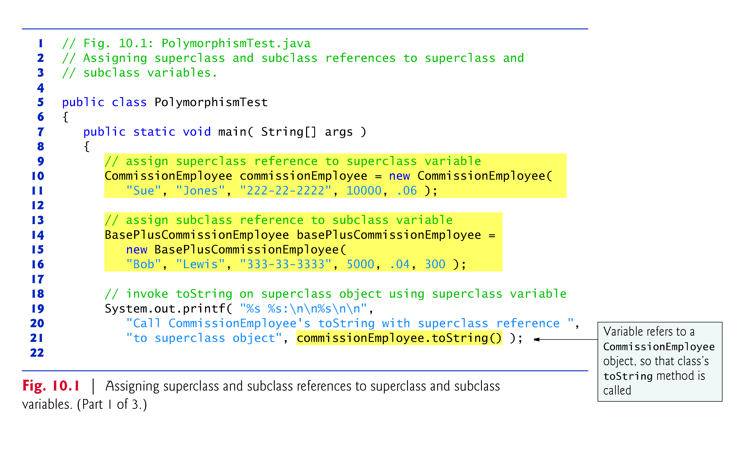

Slide 18
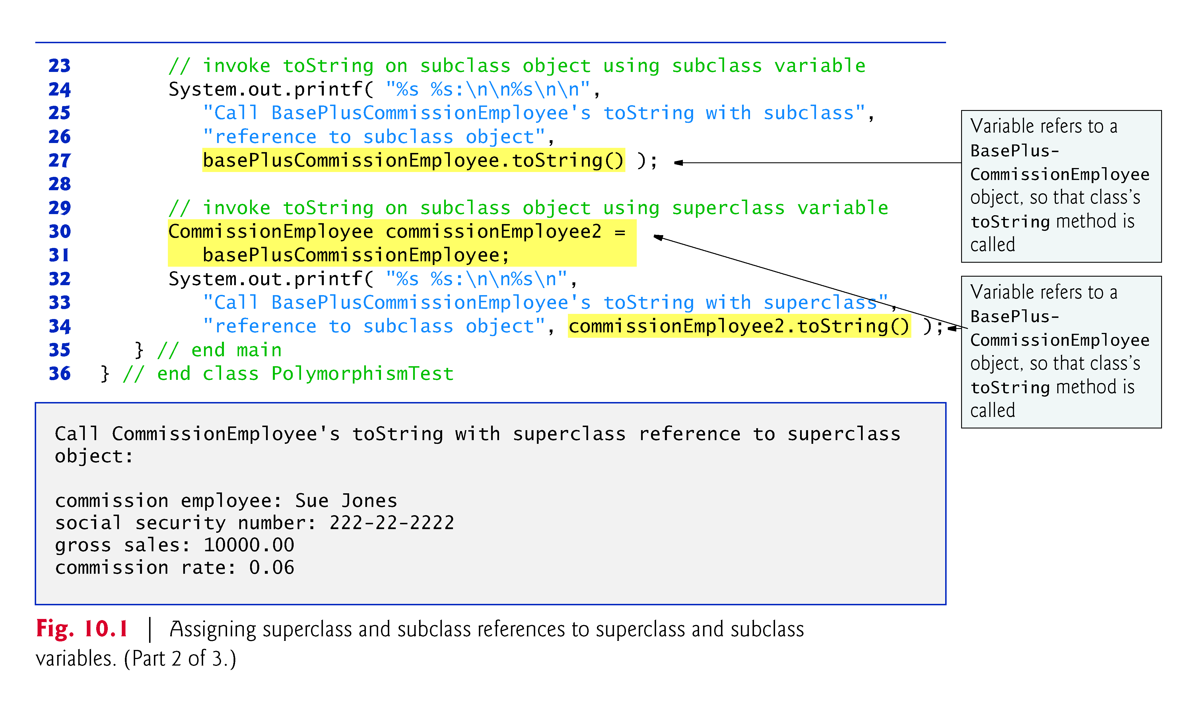

Slide 19
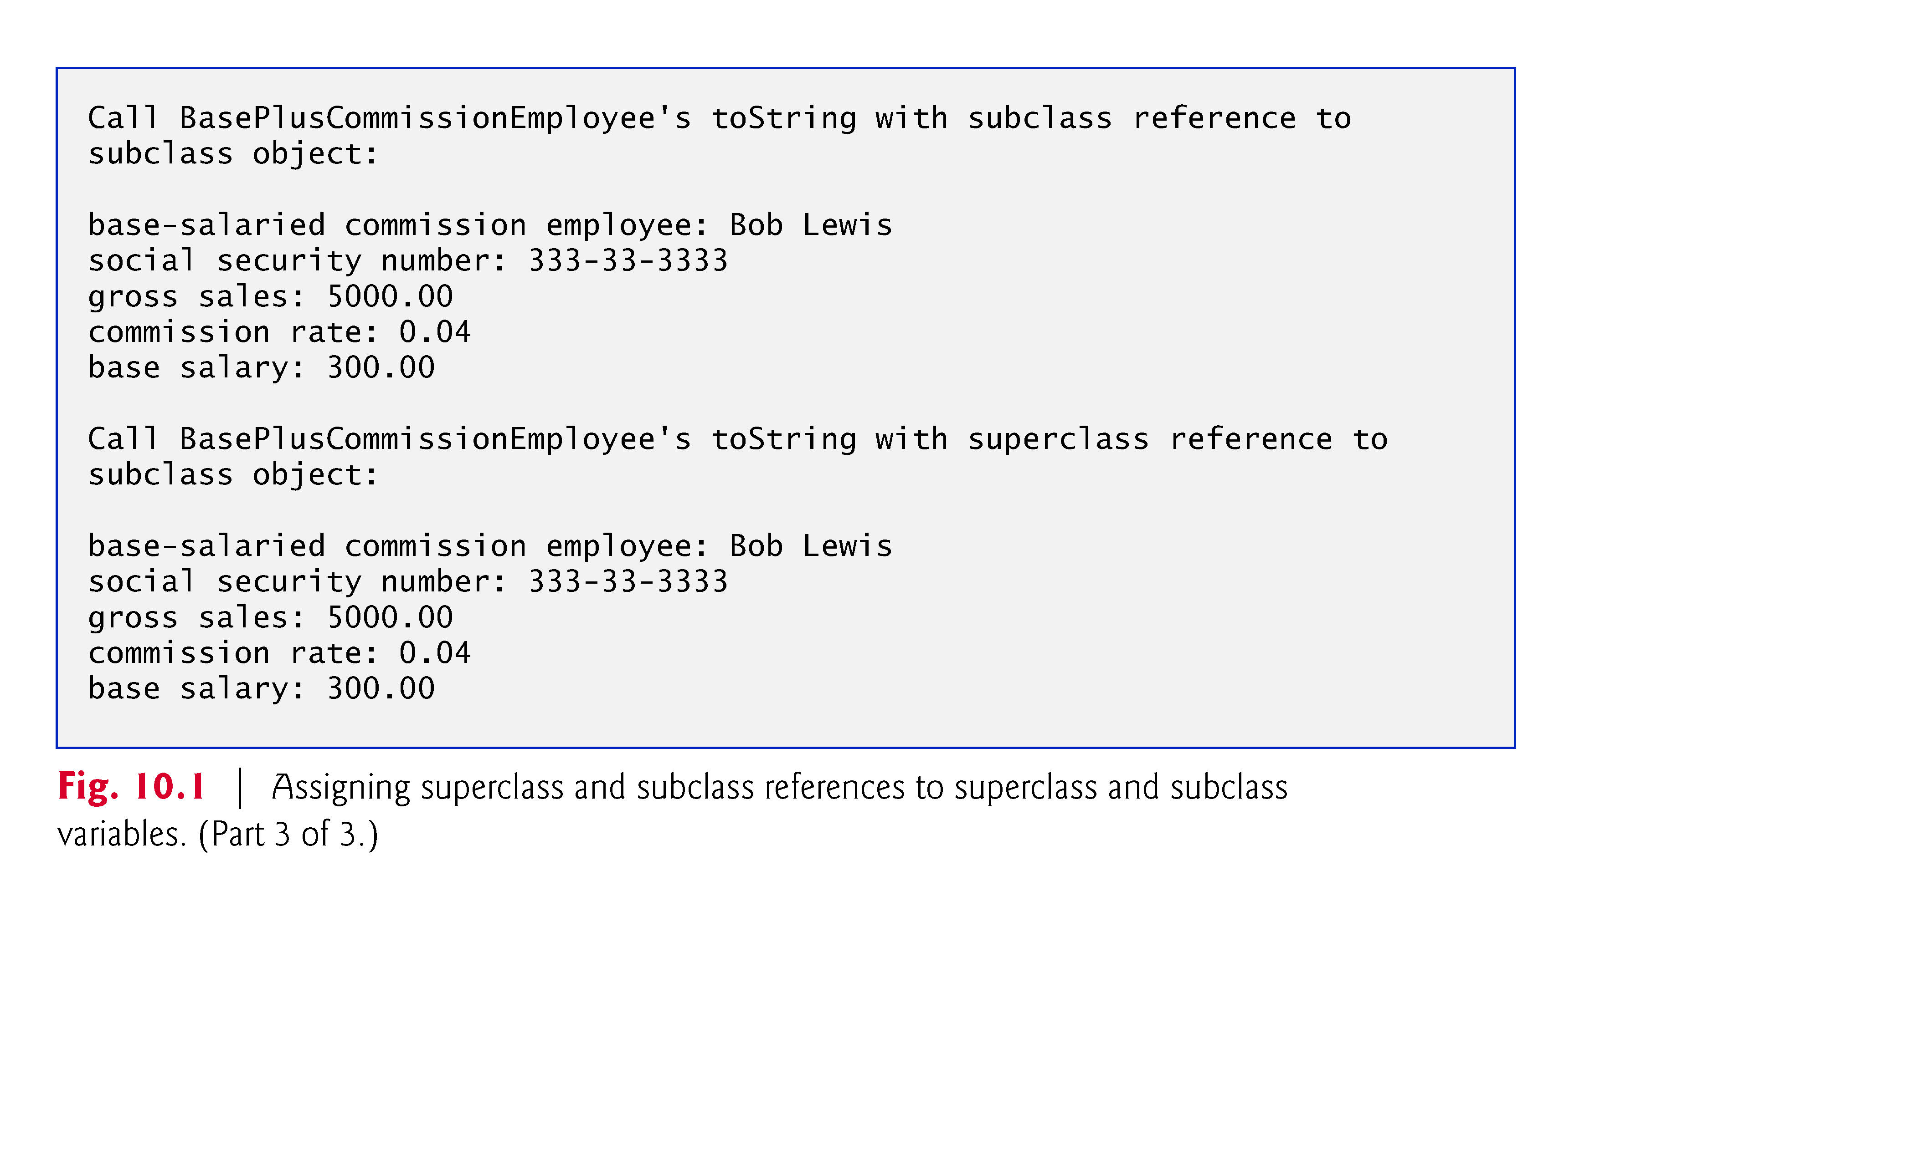

Slide 20
10.3 Demonstrating Polymorphic Behavior (Cont.)
When the compiler encounters a method call made through a variable, the compiler determines if the method can be called by checking the variable’s class type.
At execution time, the type of the object to which the variable refers determines the actual method to use.
This process is called dynamic binding.

Slide 21
10.4 Abstract Classes and Methods
Abstract classes
Sometimes it’s useful to declare classes for which you never intend to create objects.
Used only as superclasses in inheritance hierarchies, so they are sometimes called abstract superclasses.
Cannot be used to instantiate objects—abstract classes are incomplete.
Subclasses must declare the “missing pieces” to become “concrete” classes, from which you can instantiate objects; otherwise, these subclasses, too, will be abstract.
An abstract class provides a superclass from which other classes can inherit and thus share a common design.

Slide 22
10.4 Abstract Classes and Methods (Cont.)
Classes that can be used to instantiate objects are called concrete classes.
Such classes provide implementations of every method they declare (some of the implementations can be inherited).
Abstract superclasses are too general to create real objects—they specify only what is common among subclasses.
Concrete classes provide the specifics that make it reasonable to instantiate objects.
Not all hierarchies contain abstract classes.

Slide 23
10.4 Abstract Classes and Methods (Cont.)
Programmers often write client code that uses only abstract superclass types to reduce client code’s dependencies on a range of subclass types.
You can write a method with a parameter of an abstract superclass type.
When called, such a method can receive an object of any concrete class that directly or indirectly extends the superclass specified as the parameter’s type.
Abstract classes sometimes constitute several levels of a hierarchy.

Slide 24
10.4 Abstract Classes and Methods (Cont.)
You make a class abstract by declaring it with keyword abstract.
An abstract class normally contains one or more abstract methods.
An abstract method is one with keyword abstract in its declara-tion, as in
public abstract void draw(); // abstract method
Abstract methods do not provide implementations.
A class that contains abstract methods must be an abstract class.
Each concrete subclass of an abstract superclass also must provide concrete implementations of each of the superclass’s abstract methods.
Constructors and static methods cannot be declared abstract.

Slide 25


Slide 26
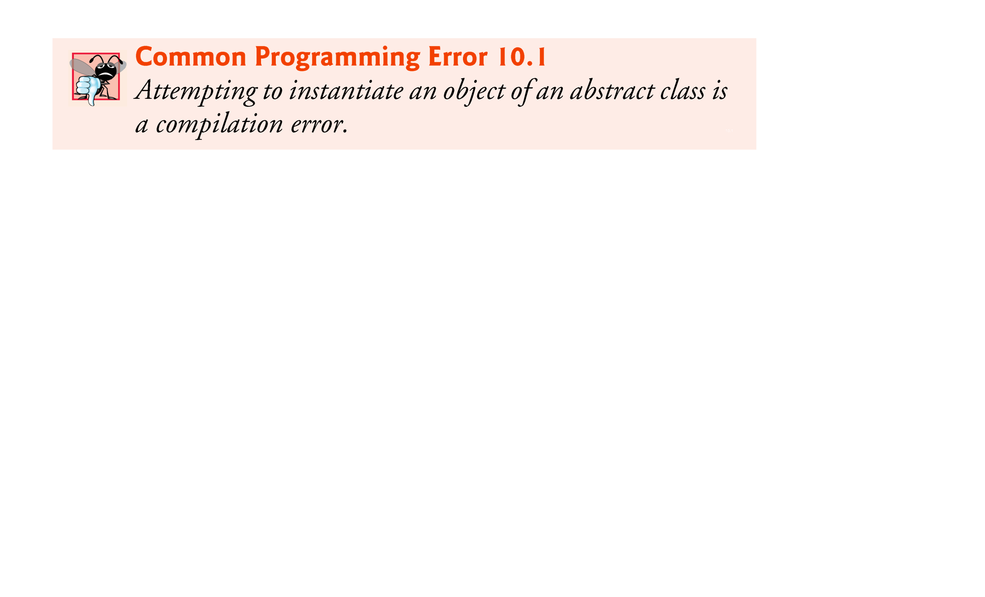

Slide 27
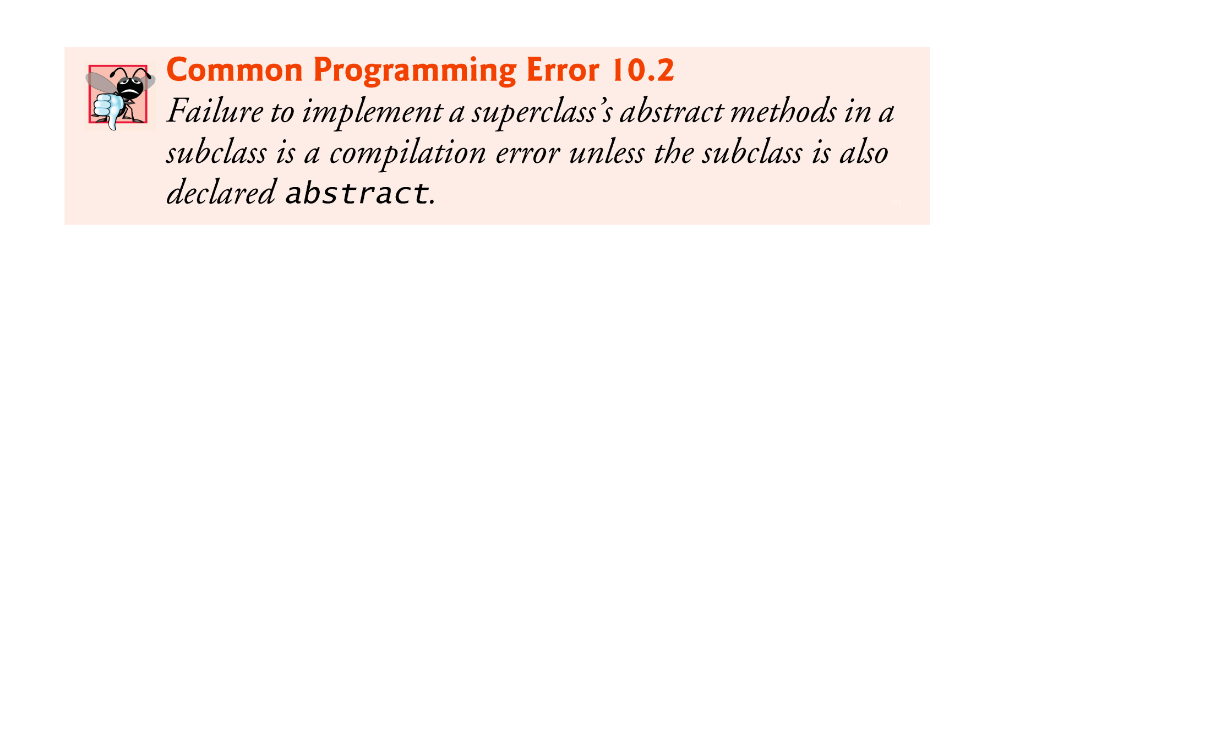

Slide 28
10.4 Abstract Classes and Methods (Cont.)
Cannot instantiate objects of abstract superclasses, but you can use abstract superclasses to declare variables
These can hold references to objects of any concrete class derived from those abstract superclasses.
Programs typically use such variables to manipulate subclass objects polymorphically.
Can use abstract superclass names to invoke static methods declared in those abstract superclasses.

Slide 29
10.5 Case Study: Payroll System Using Polymorphism
Enhanced employee inheritance hierarchy requirements:
A company pays its employees on a weekly basis. The employees are of four types:
Salaried employees are paid a fixed weekly salary regardless of the number of hours worked,
hourly employees are paid by the hour and receive overtime pay (i.e., 1.5 times their hourly salary rate) for all hours worked in excess of 40 hours,
commission employees are paid a percentage of their sales
base-salaried commission employees receive a base salary plus a percentage of their sales.
For the current pay period, the company has decided to reward salaried-commission employees by adding 10% to their base salaries.
The company wants to write a Java application that performs its payroll calculations polymorphically.

Slide 30
10.5 Case Study: Payroll System Using Polymorphism (Cont.)
abstract class Employee represents the general concept of an employee.
Subclasses: SalariedEmployee, CommissionEmployee , HourlyEmployee and BasePlusCommissionEmployee (an indirect subclass)
Fig. 10.2 shows the inheritance hierarchy for our polymorphic employee-payroll application.
Abstract class names are italicized in the UML.

Slide 31
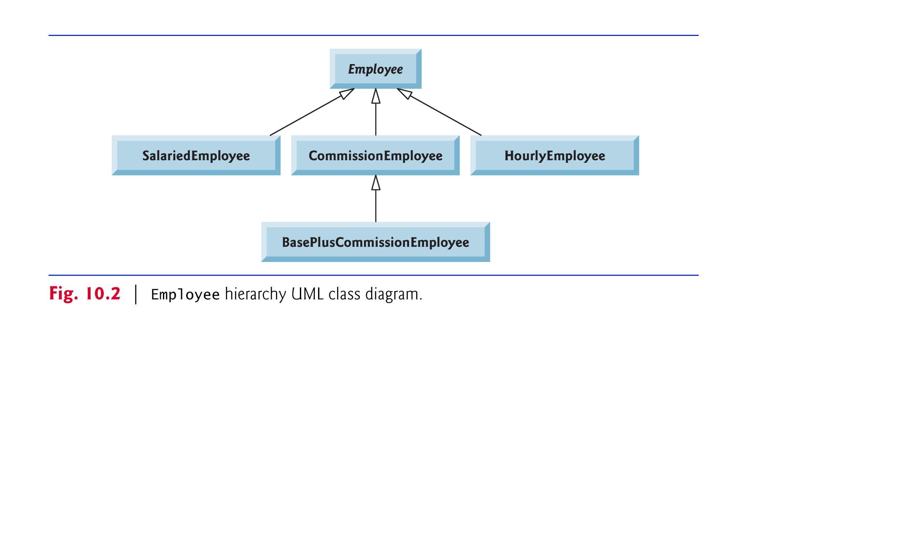

Slide 32
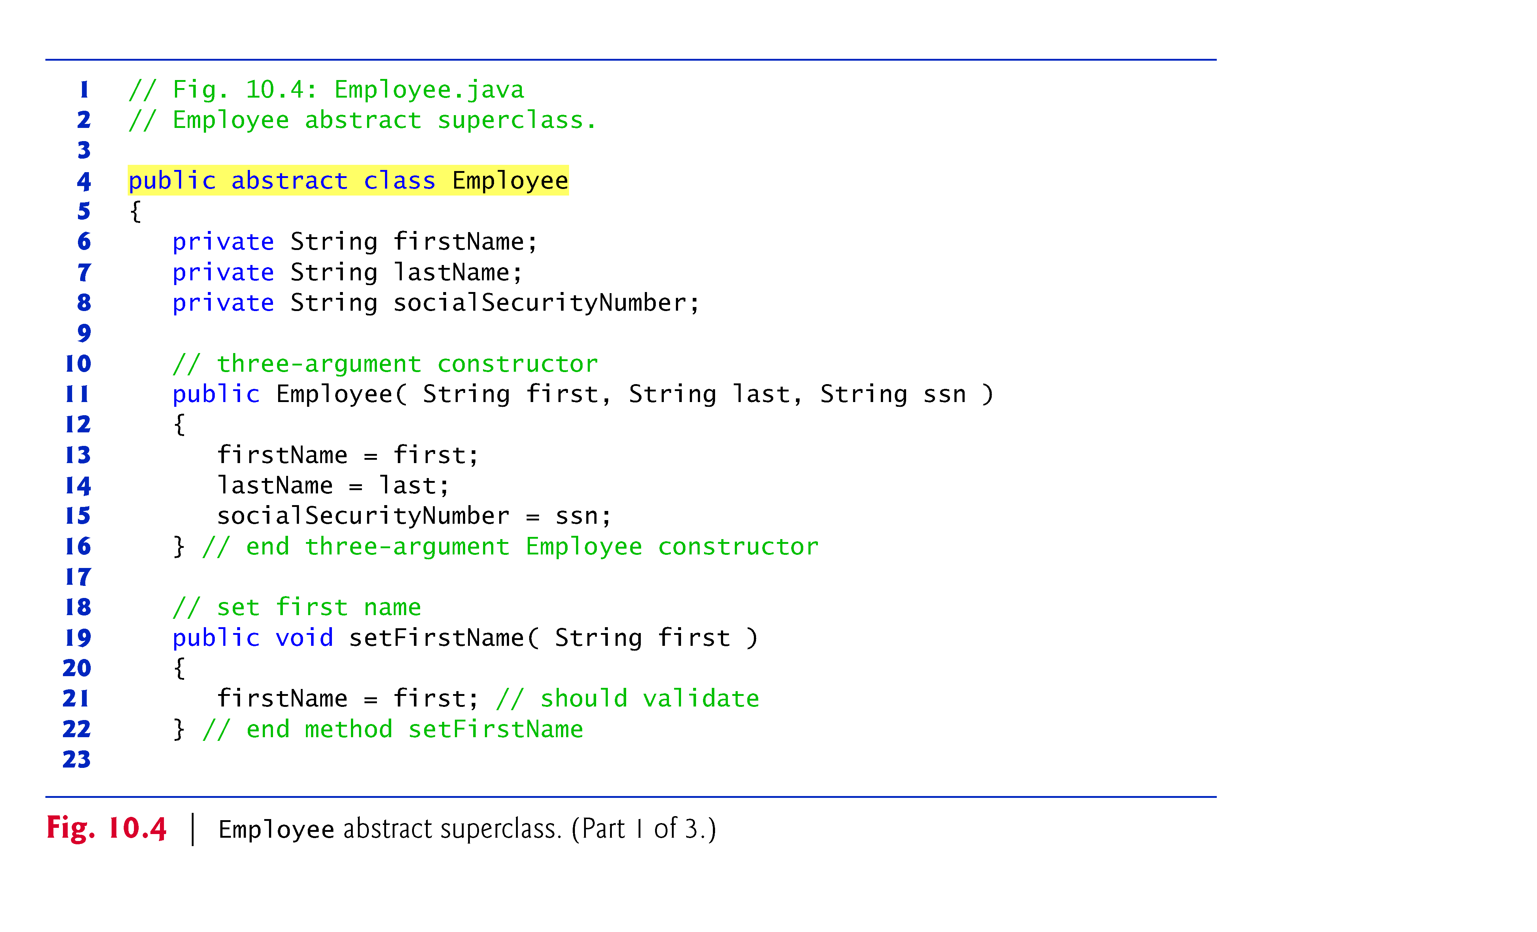

Slide 33
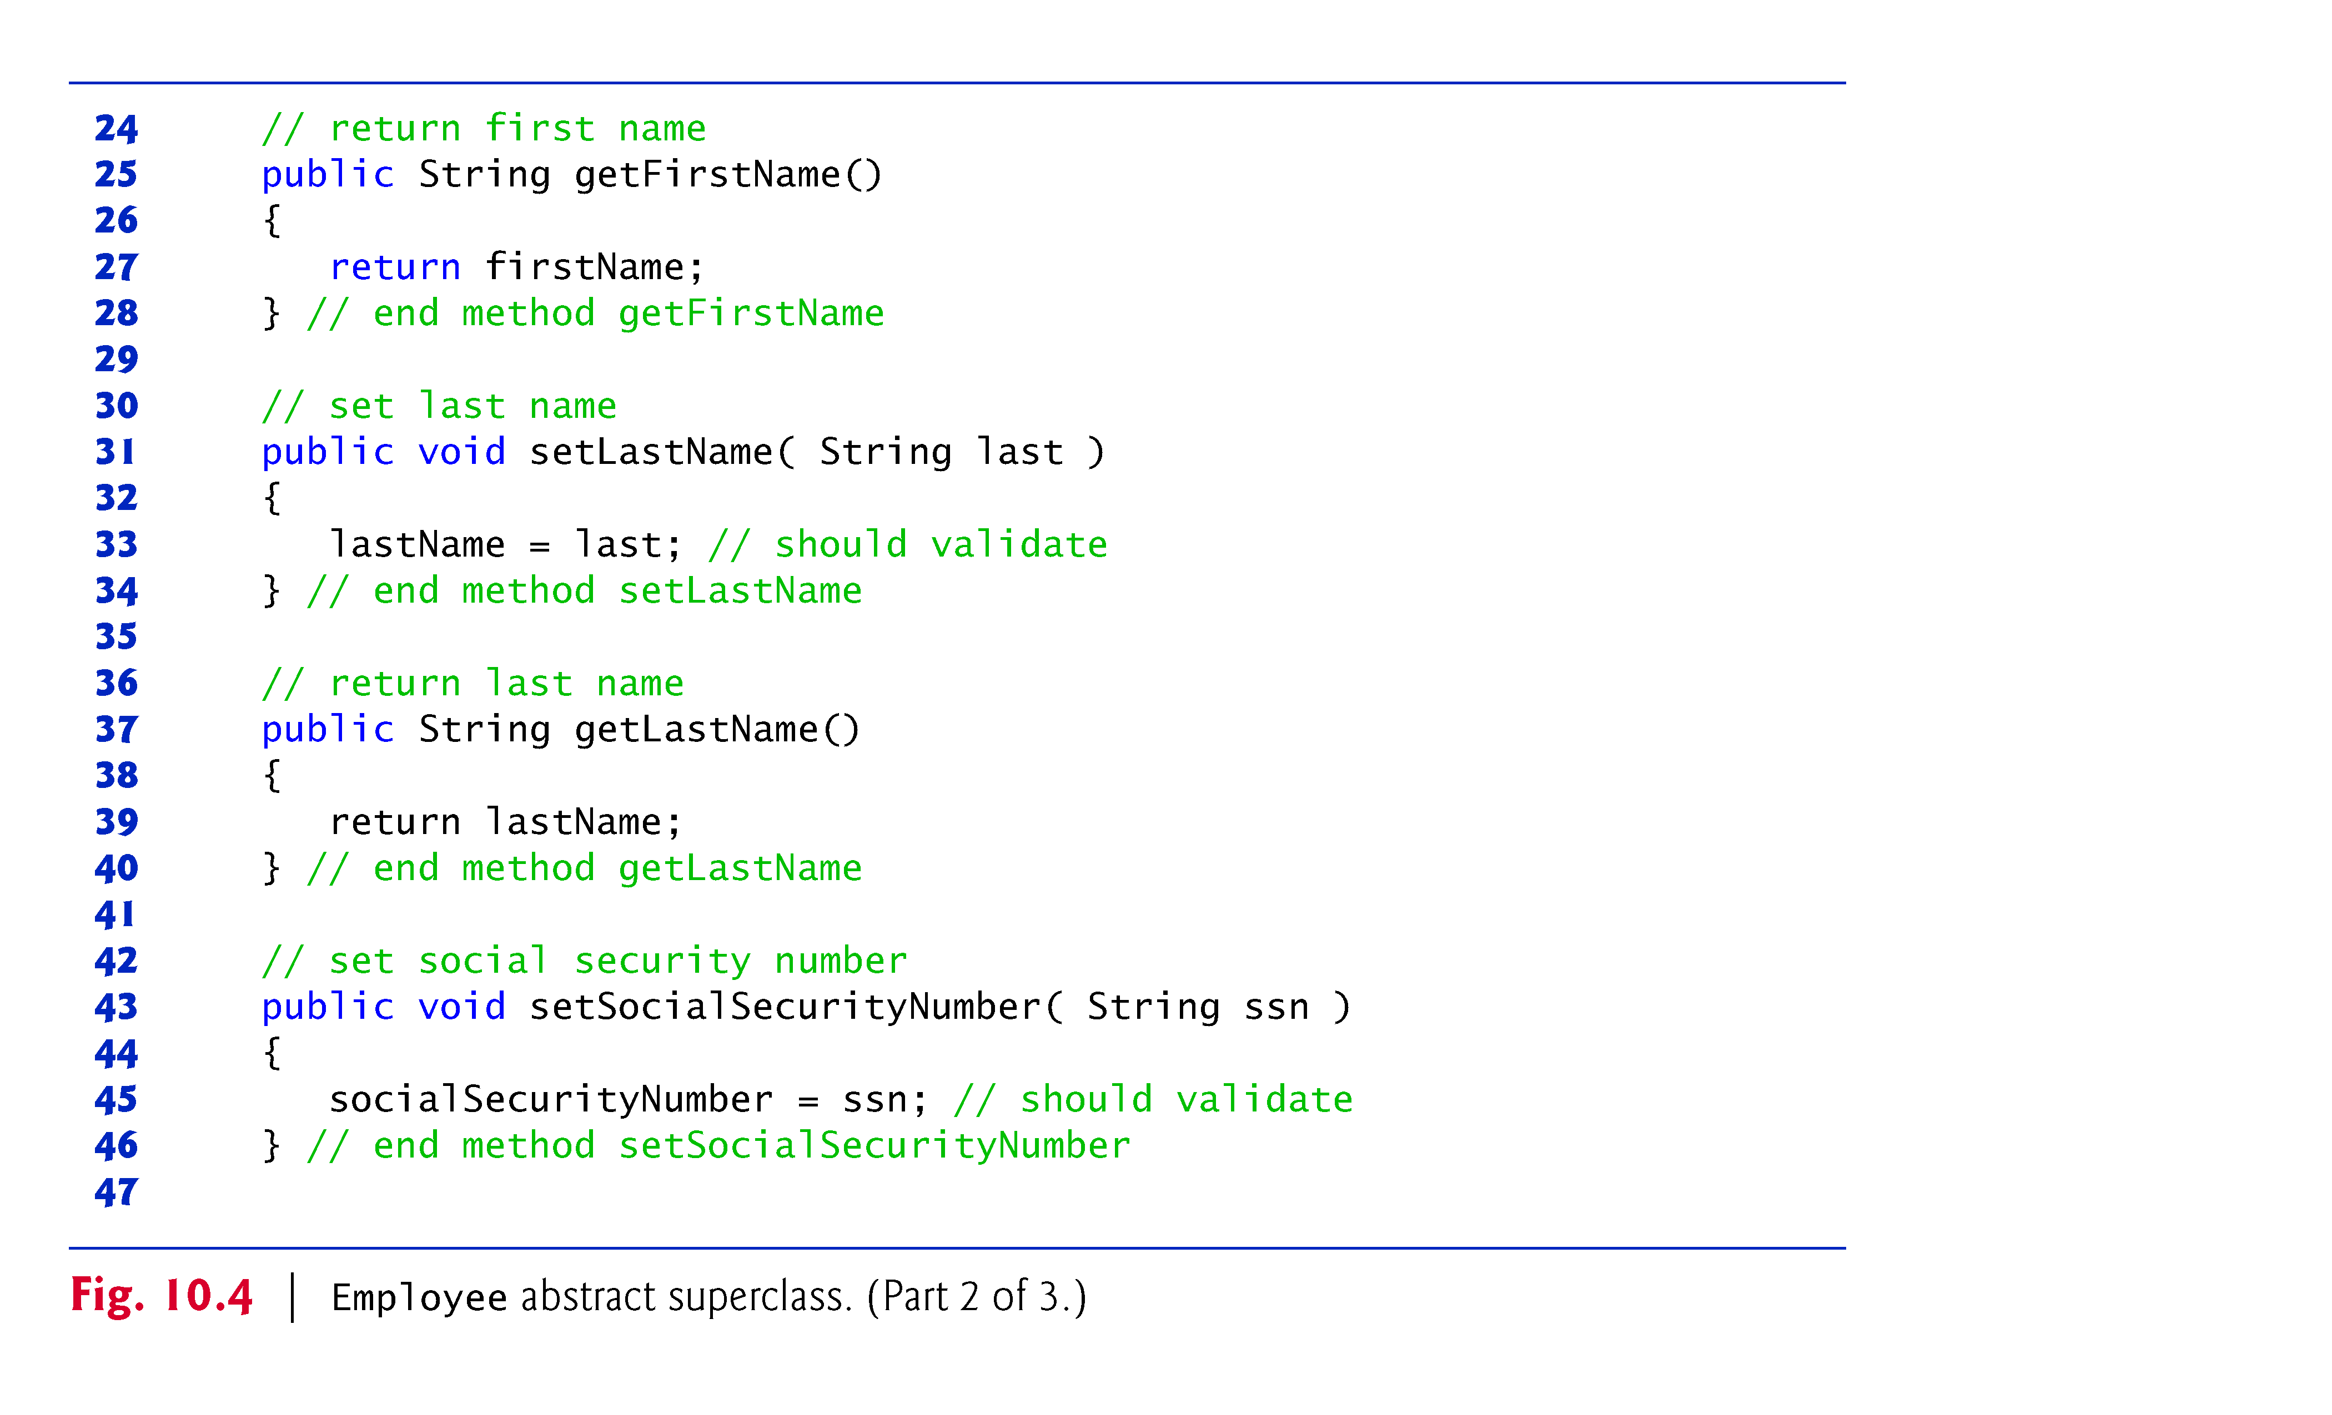

Slide 34
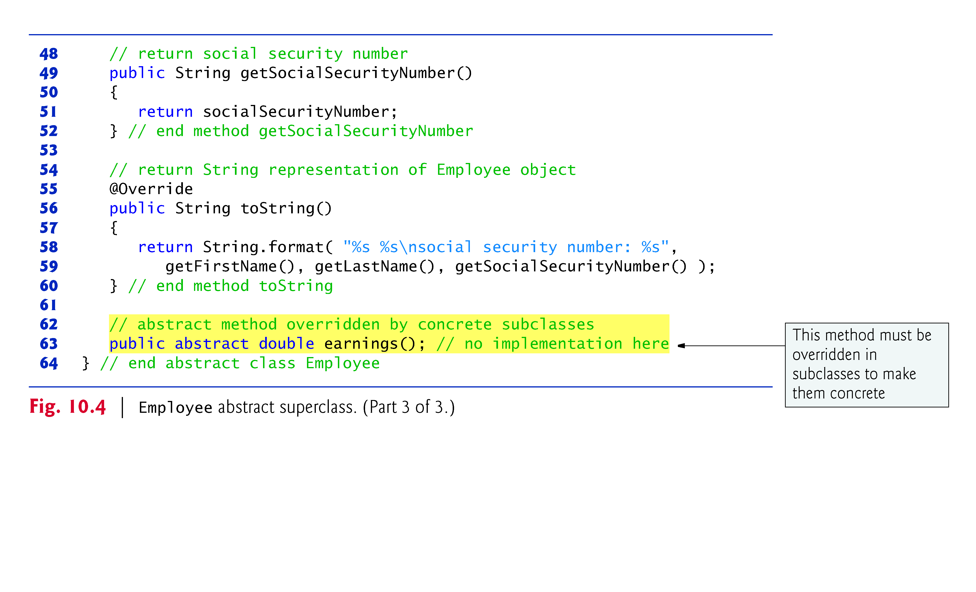

Slide 35
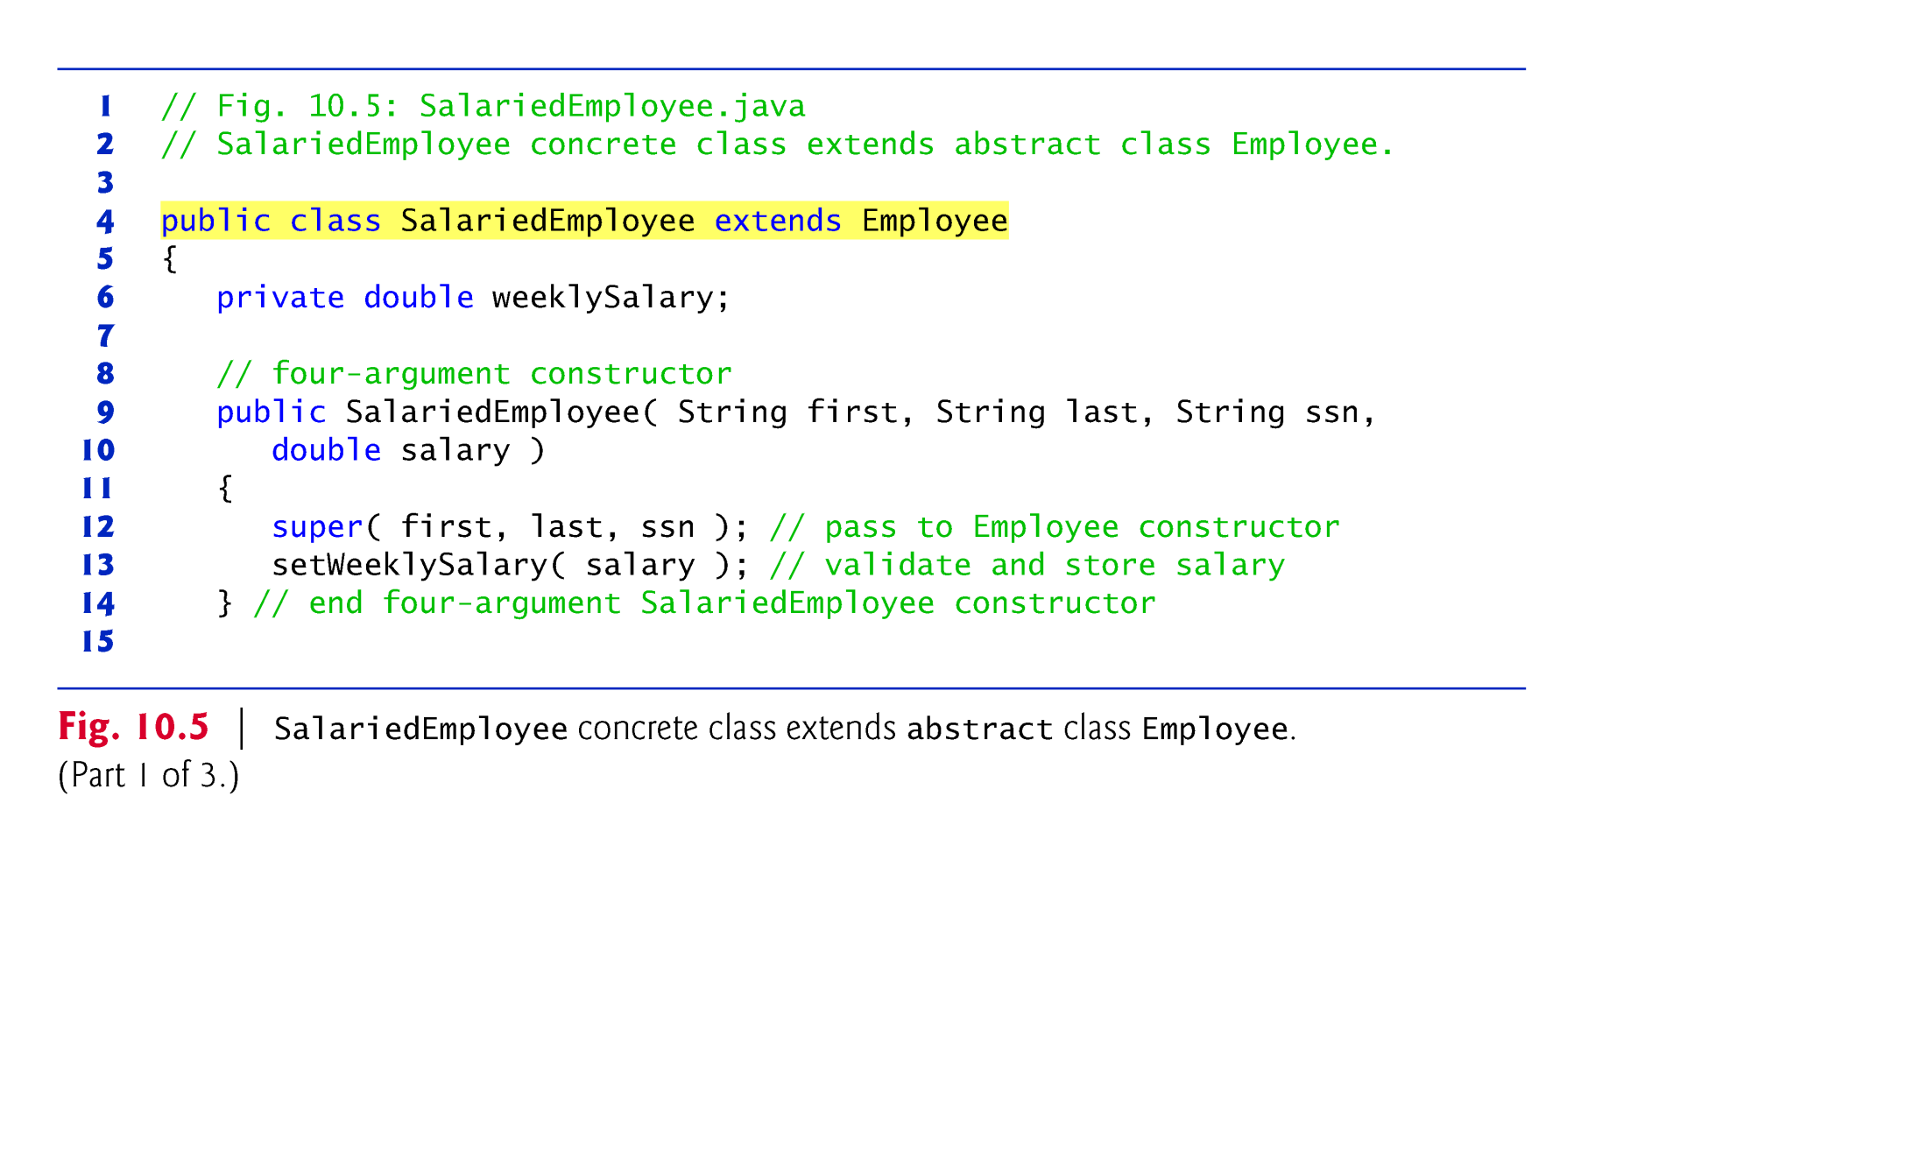

Slide 36
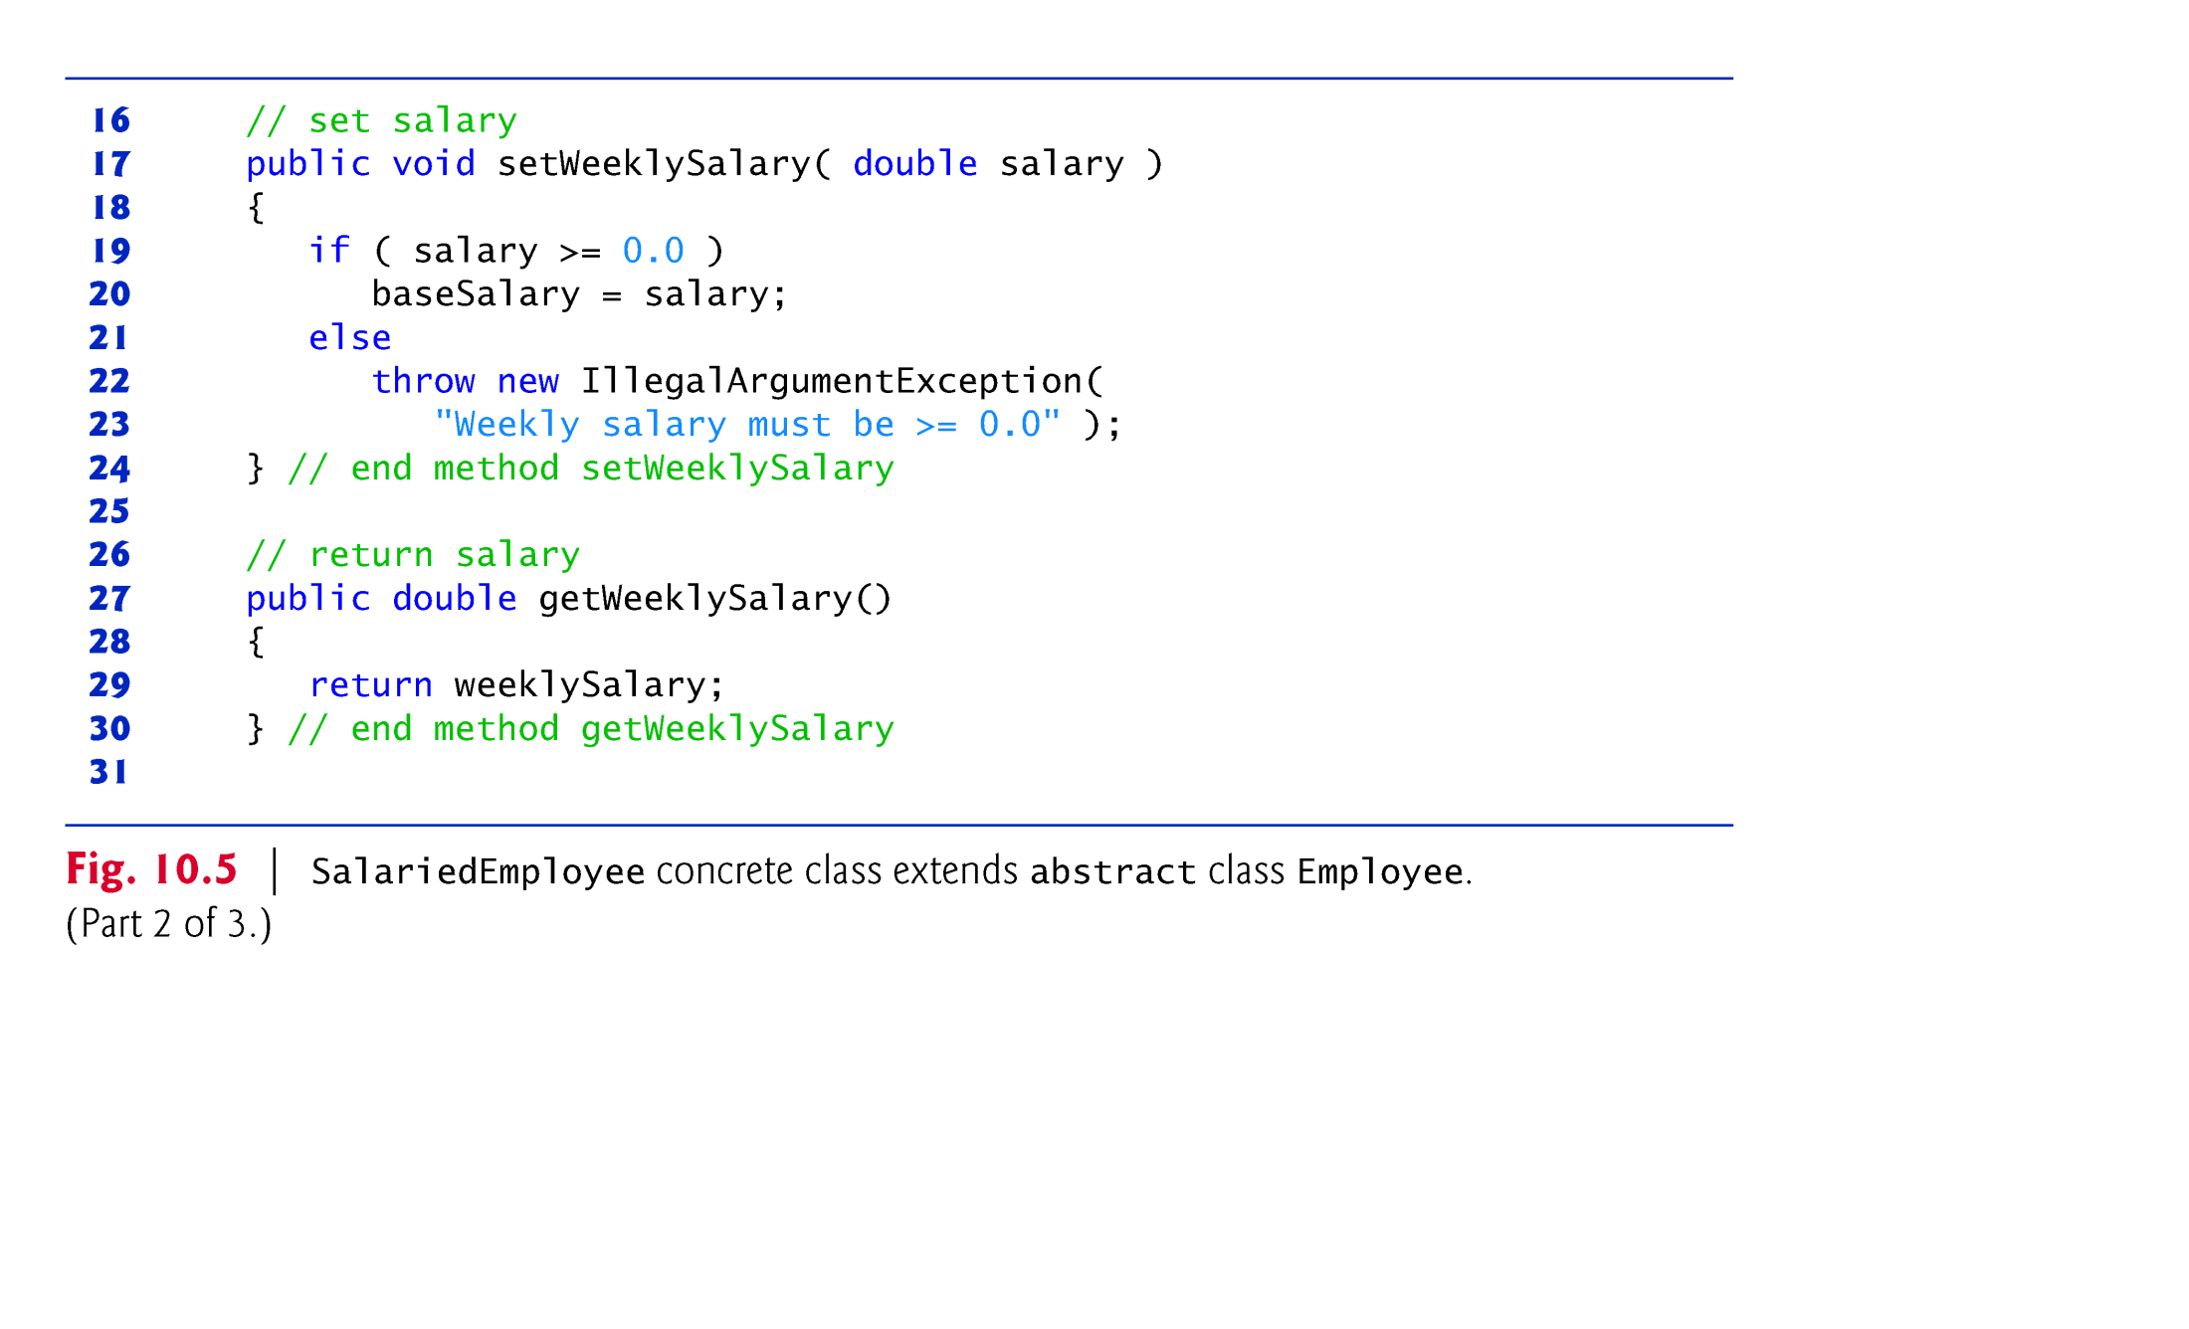

Slide 37
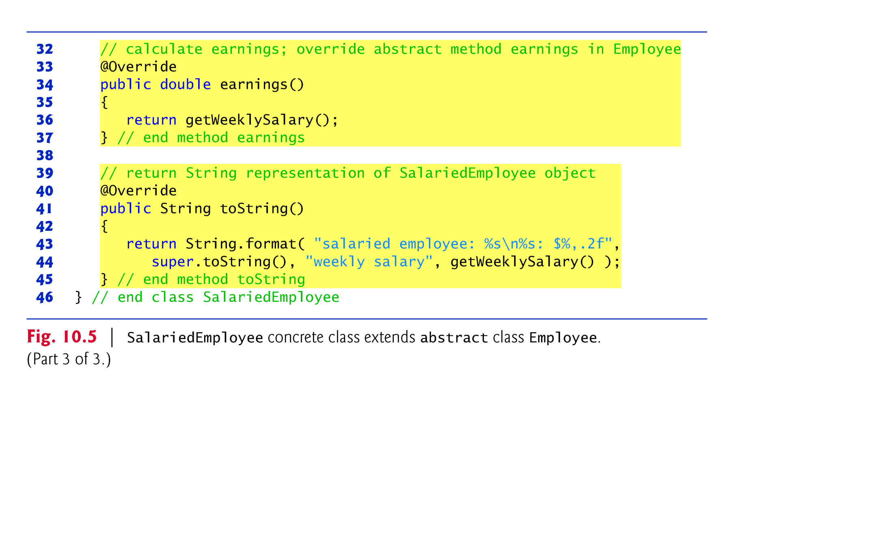

Slide 38
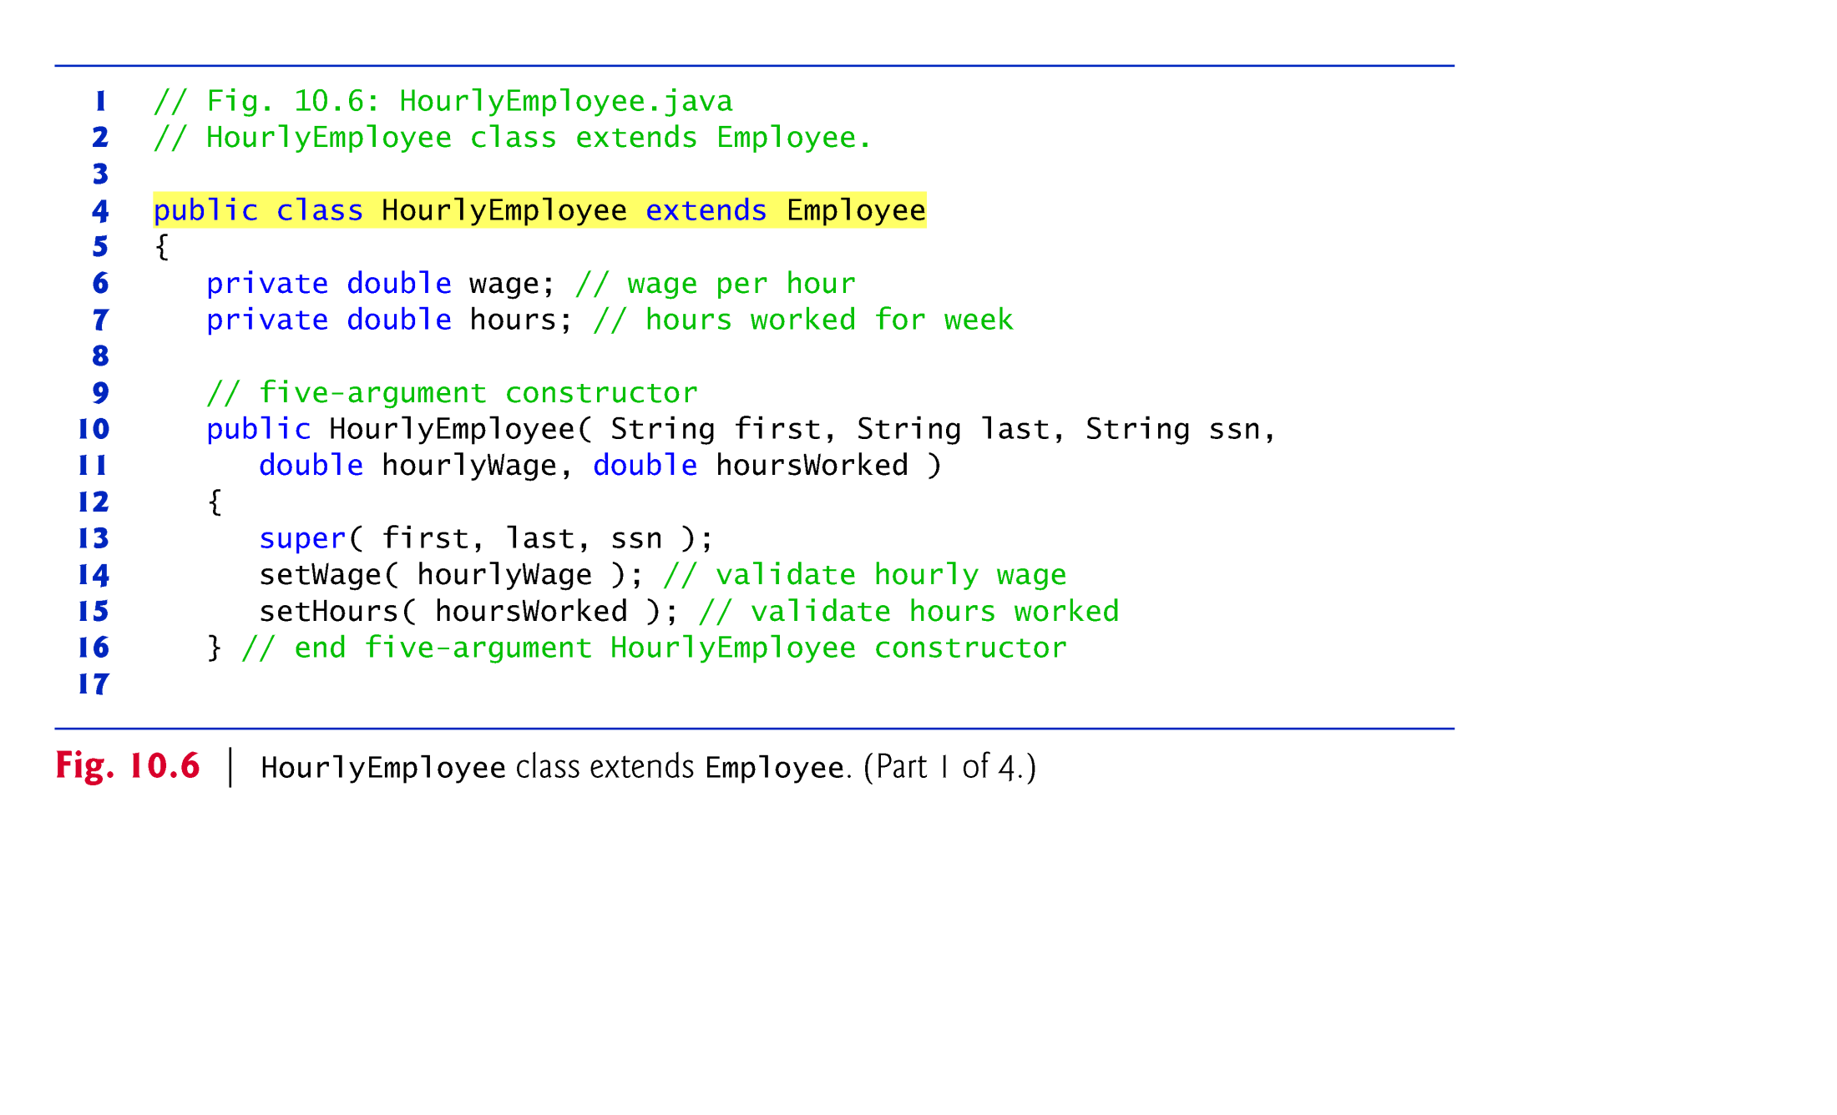

Slide 39
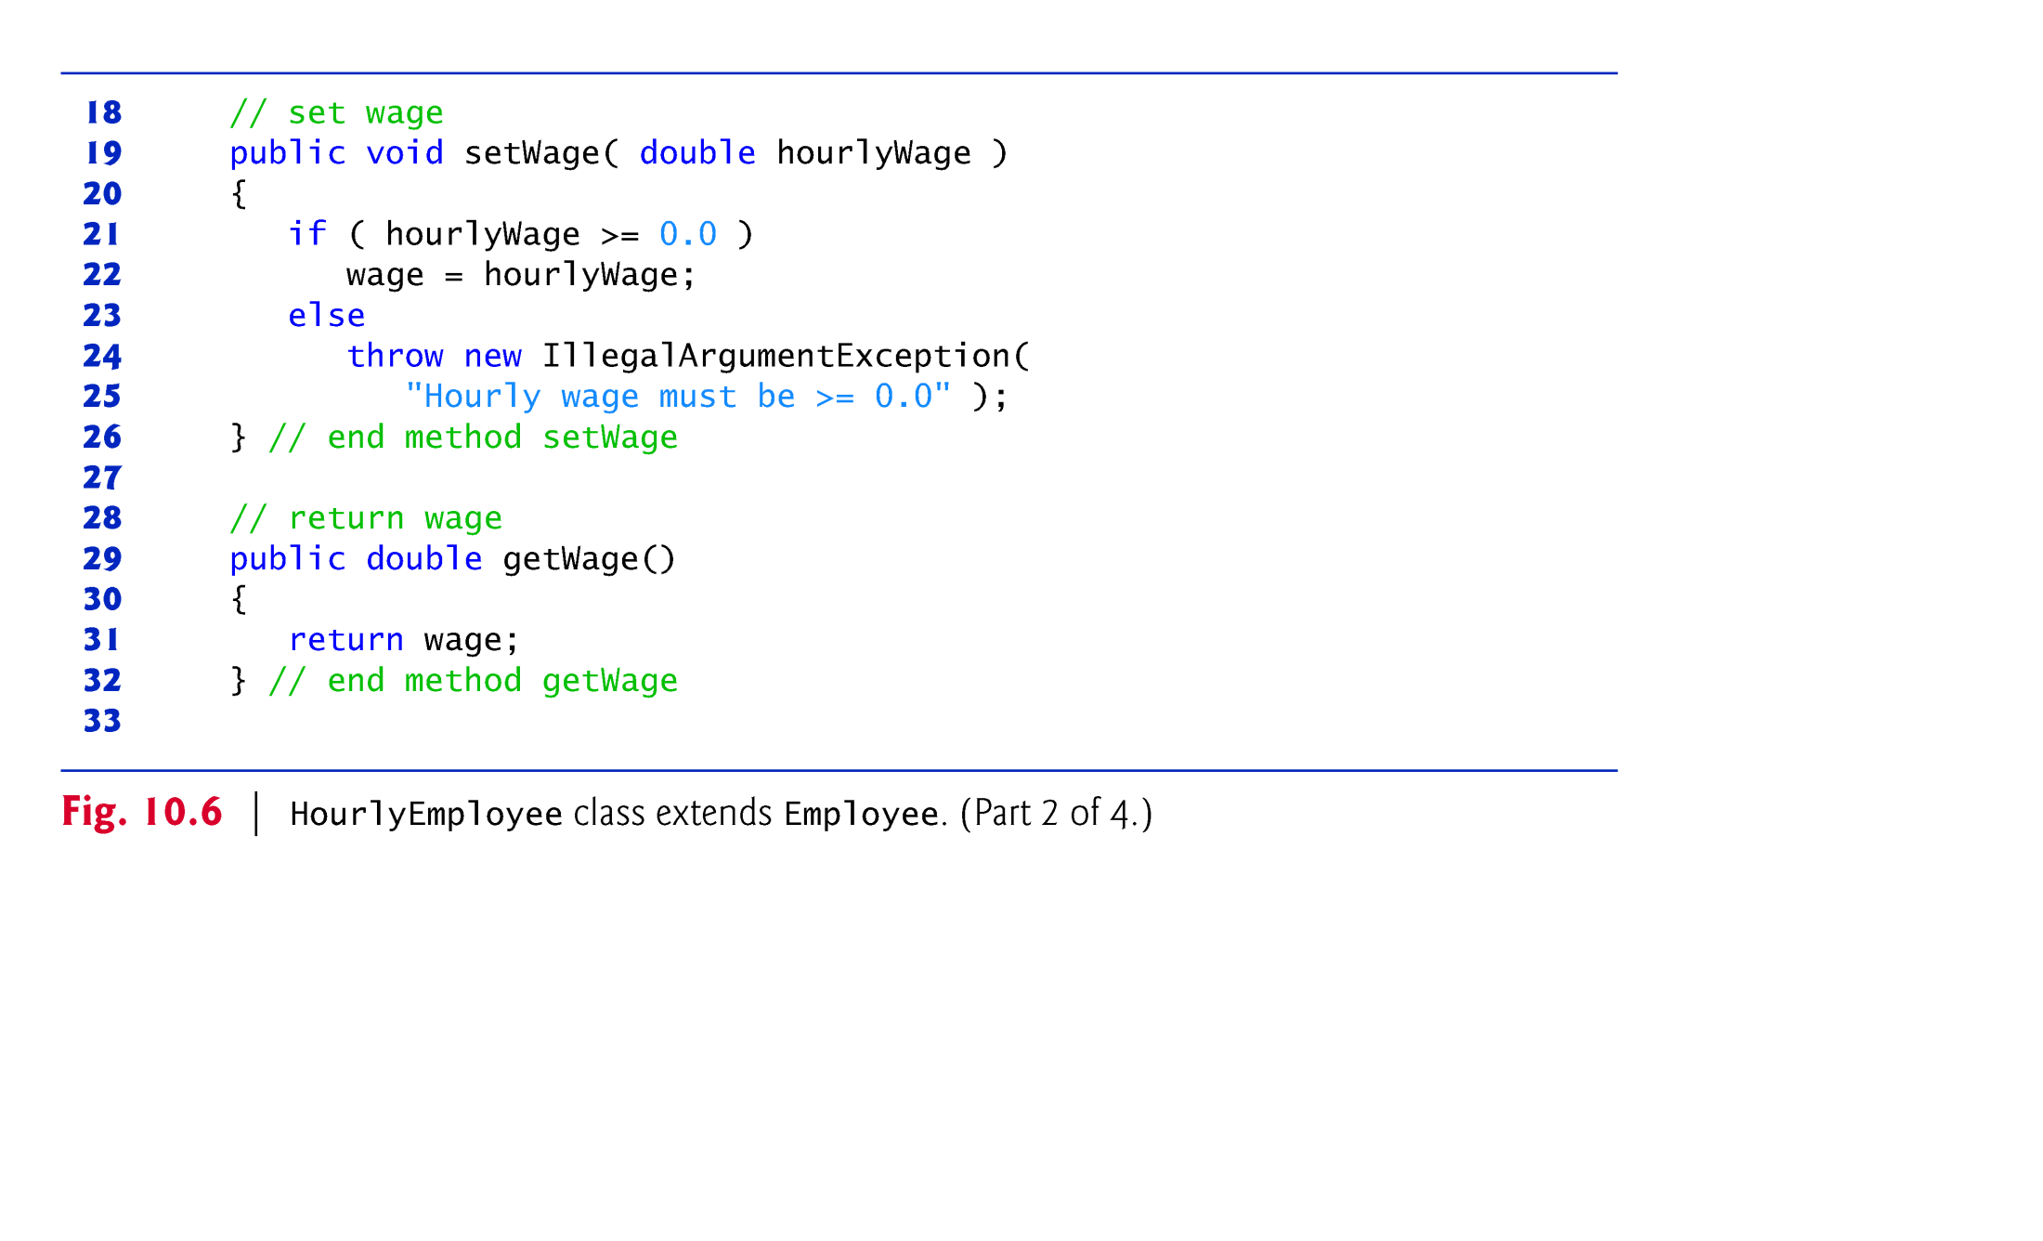

Slide 40
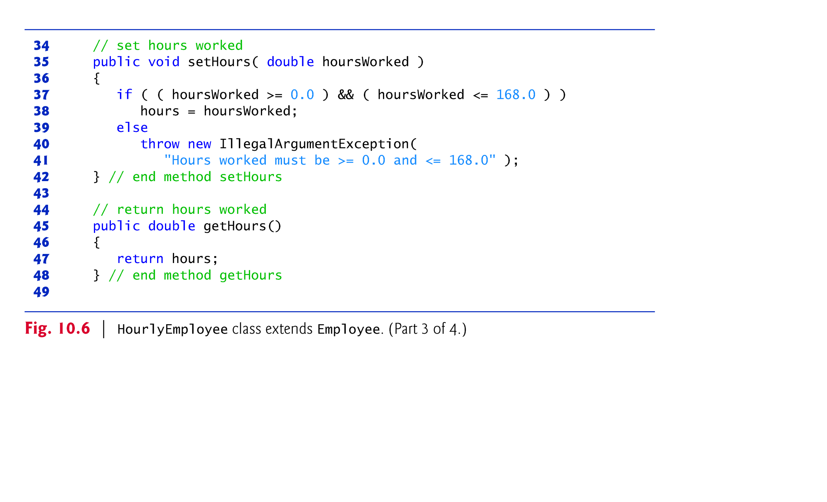

Slide 41
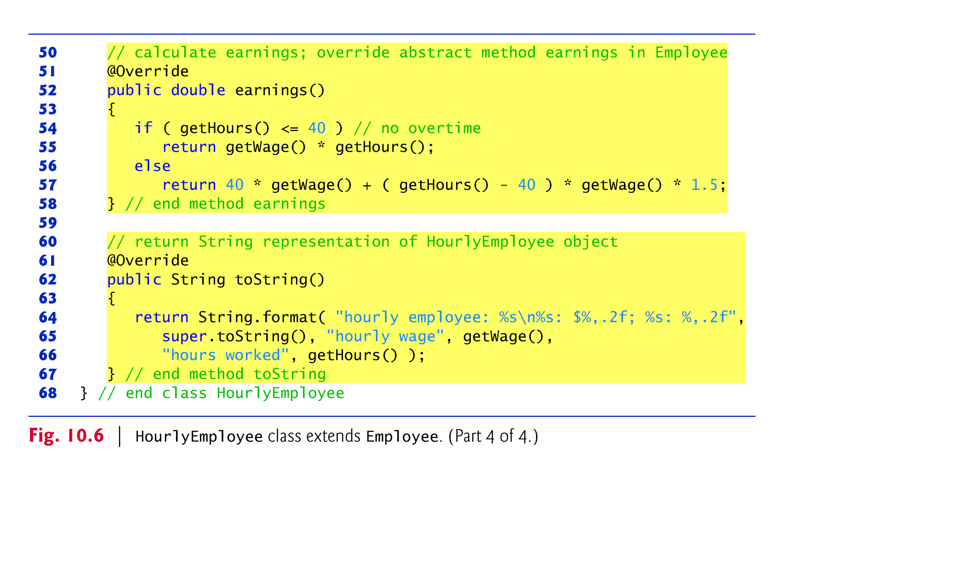

Slide 42
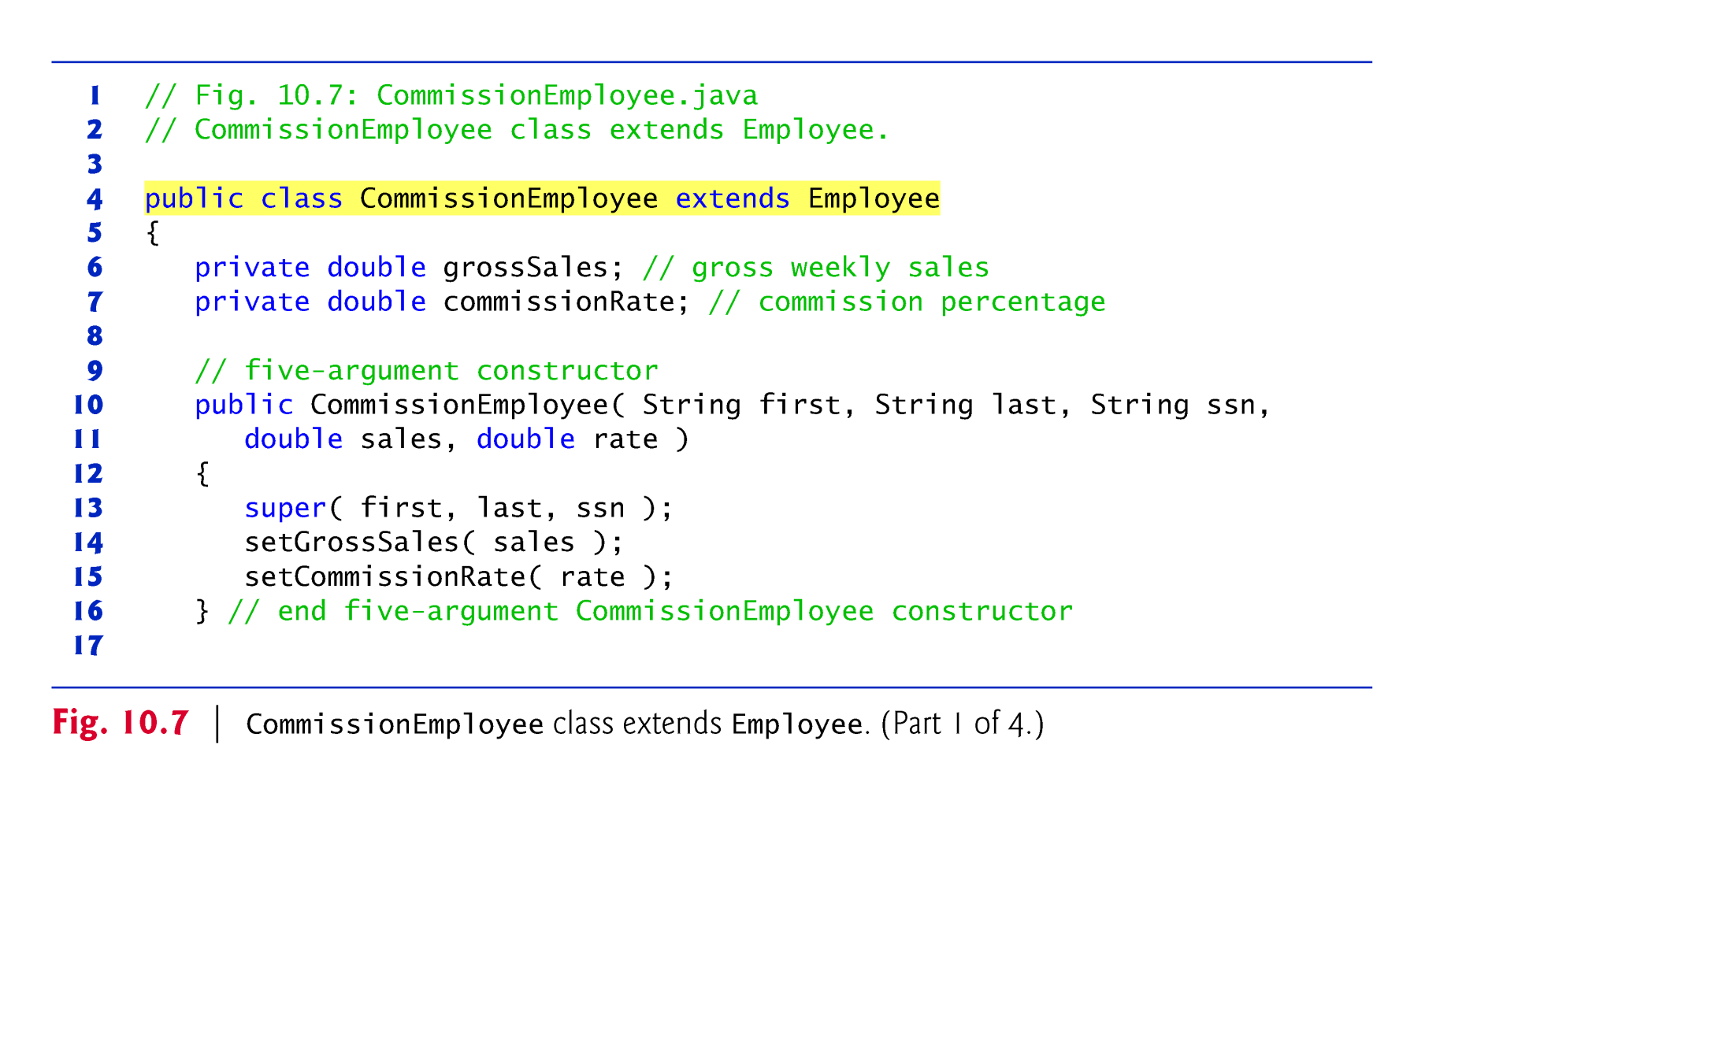

Slide 43
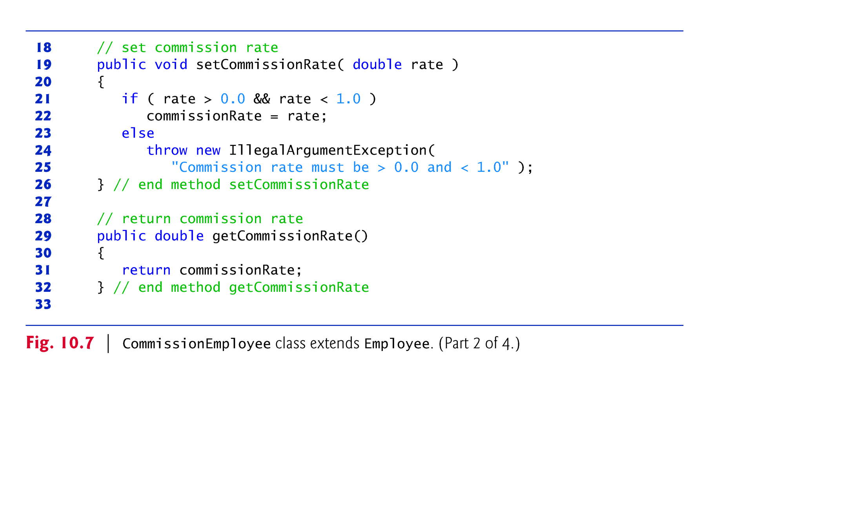

Slide 44
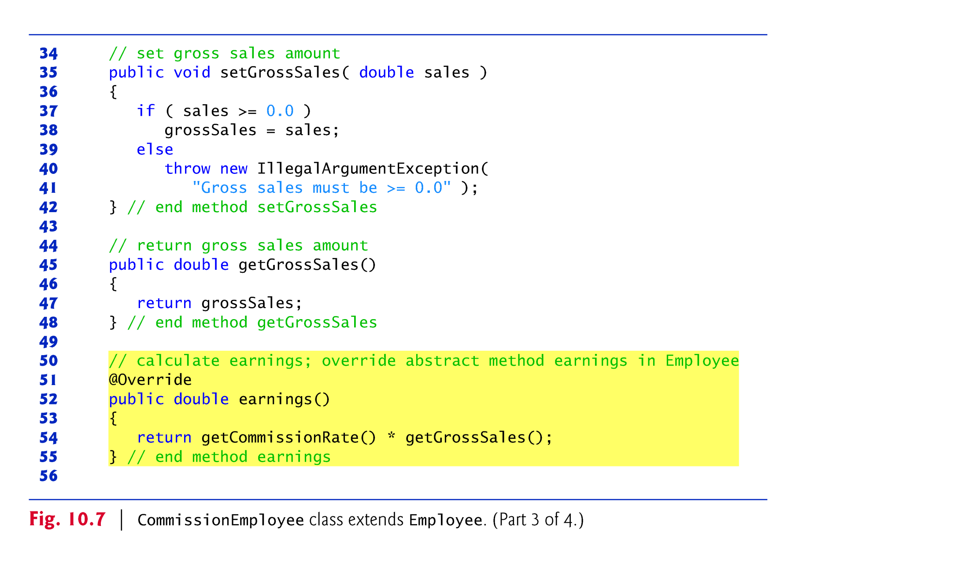

Slide 45
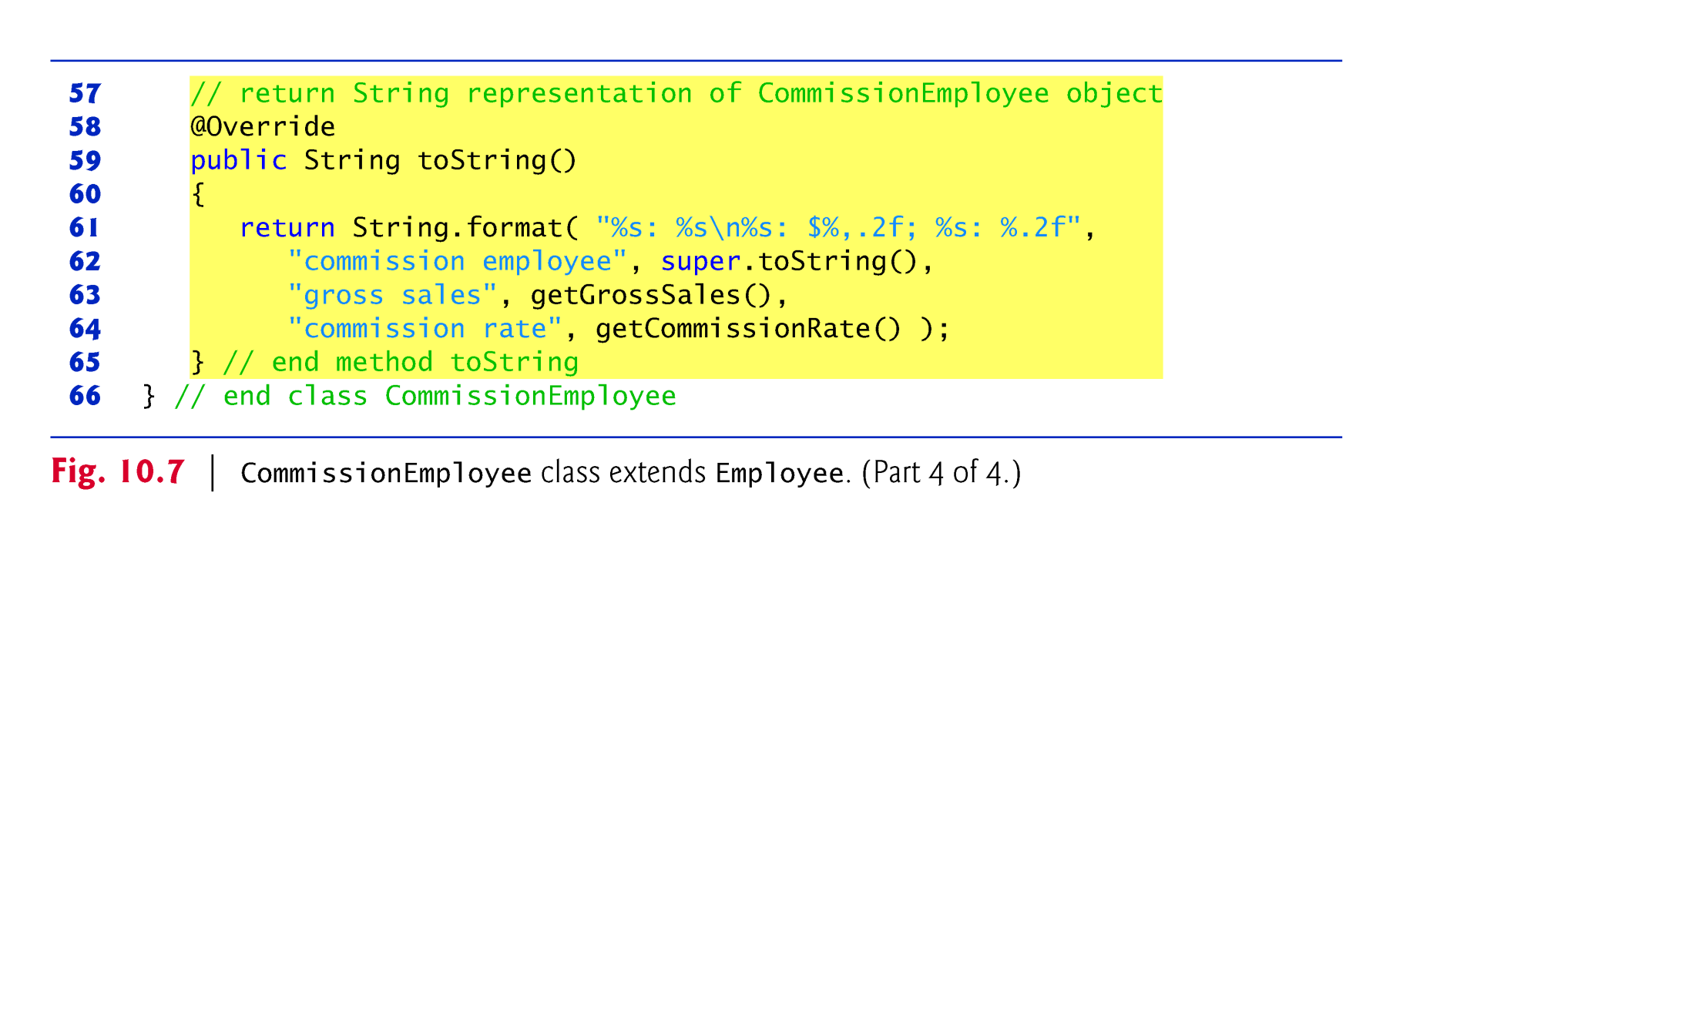

Slide 46
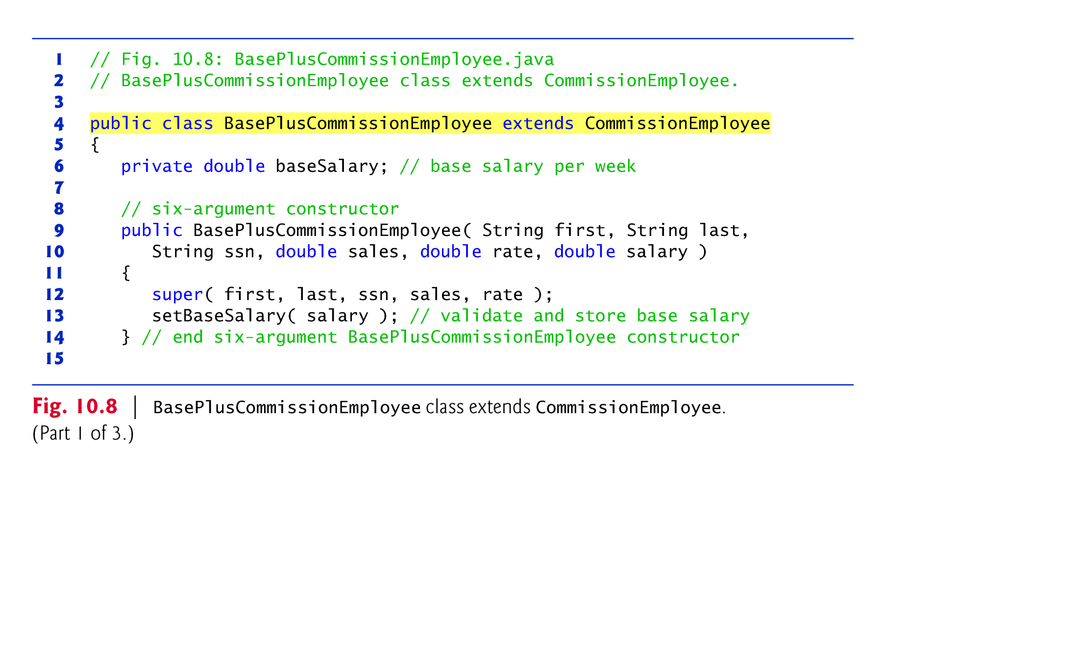

Slide 47
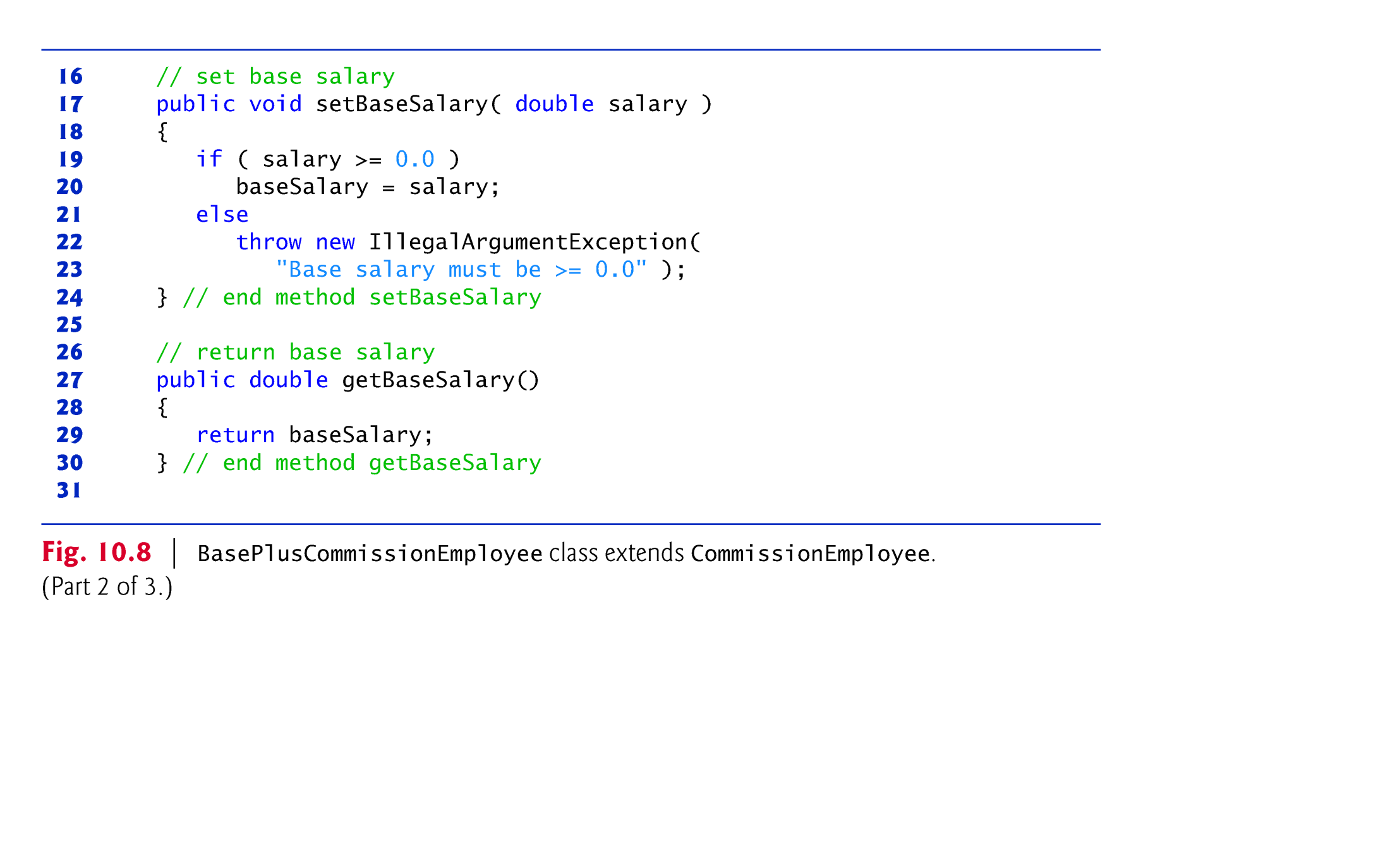

Slide 48
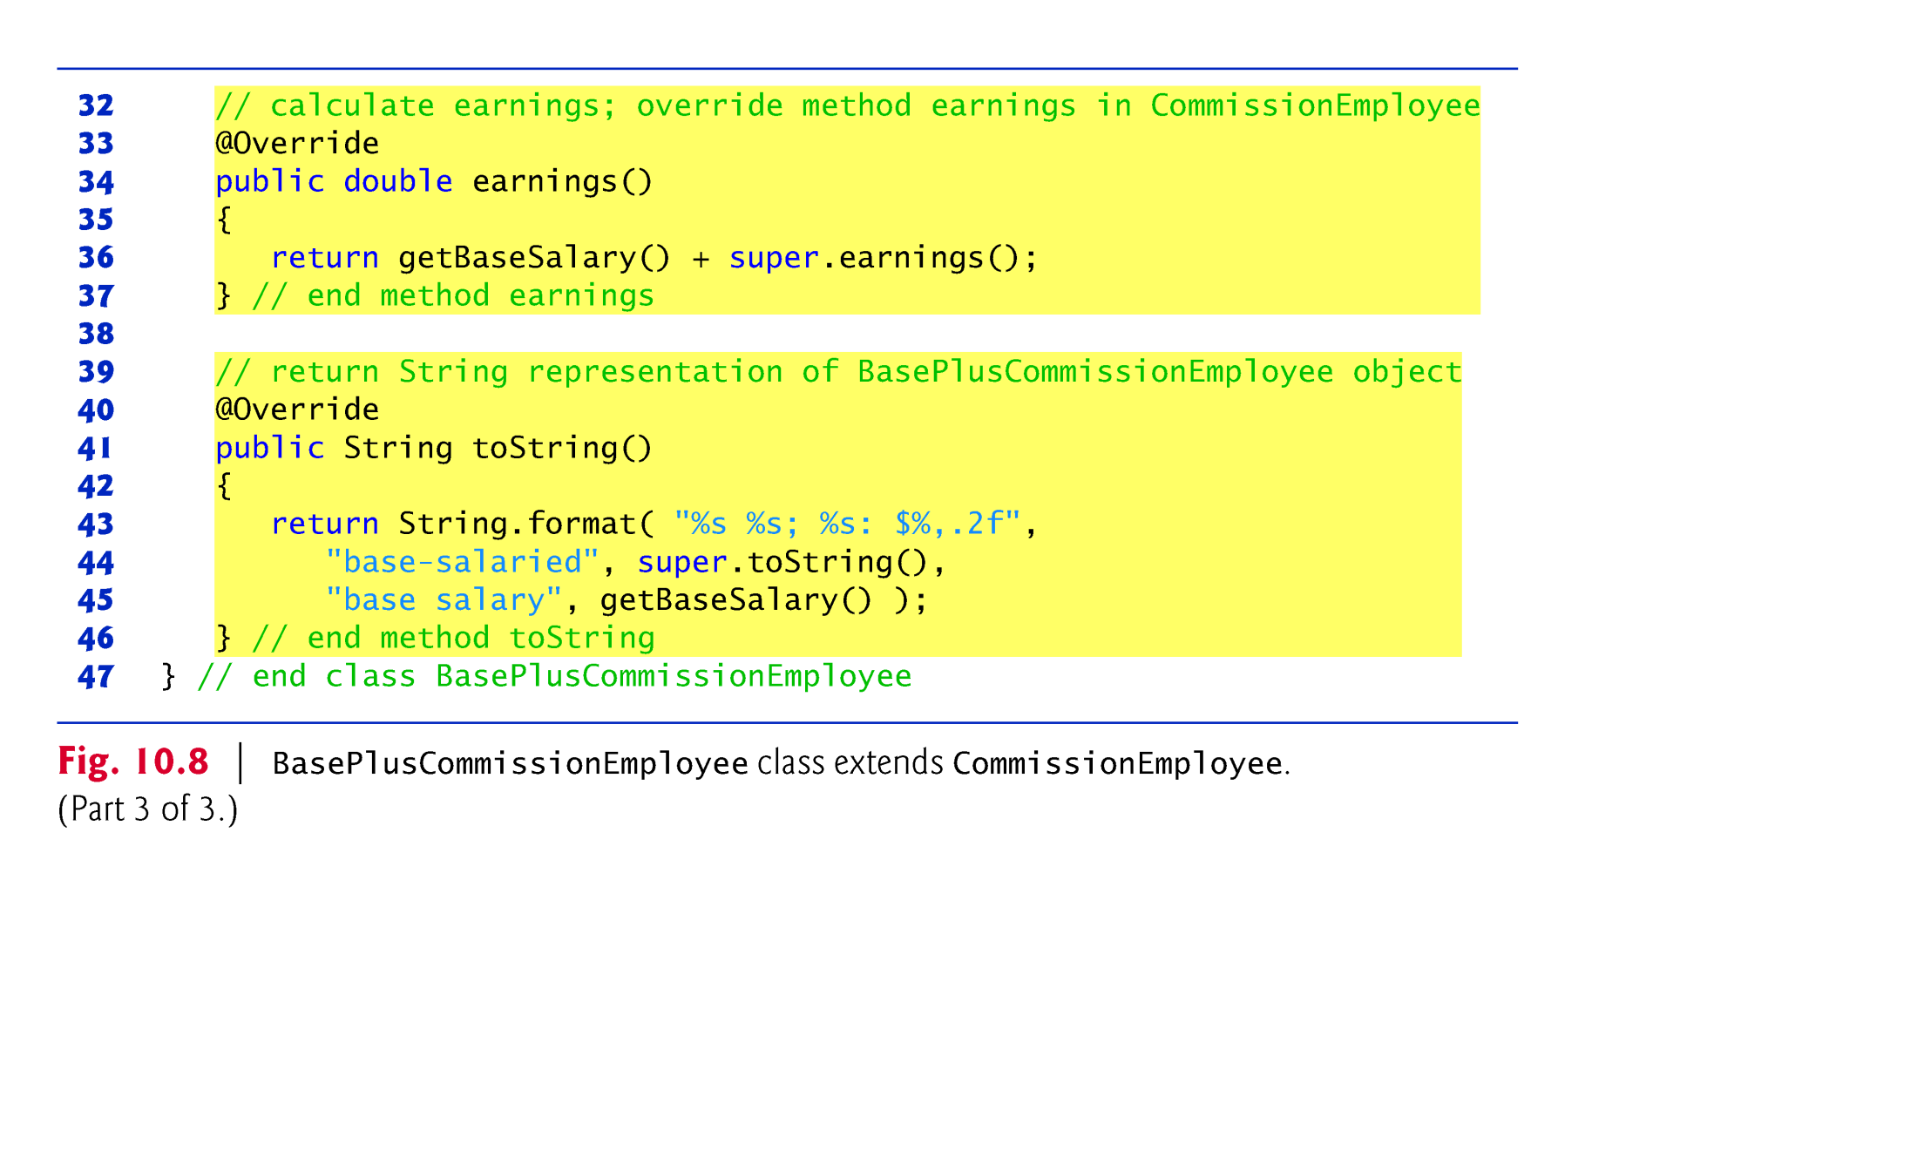

Slide 49
10.5.6 Polymorphic Processing, Operator instanceof and Downcasting
Fig. 10.9 creates an object of each of the four concrete.
Manipulates these objects nonpolymorphically, via variables of each object’s own type, then polymorphically, using an array of Employee variables.
While processing the objects polymorphically, the program increases the base salary of each BasePlusCommissionEmployee by 10%
Requires determining the object’s type at execution time.
Finally, the program polymorphically determines and outputs the type of each object in the Employee array.

Slide 50
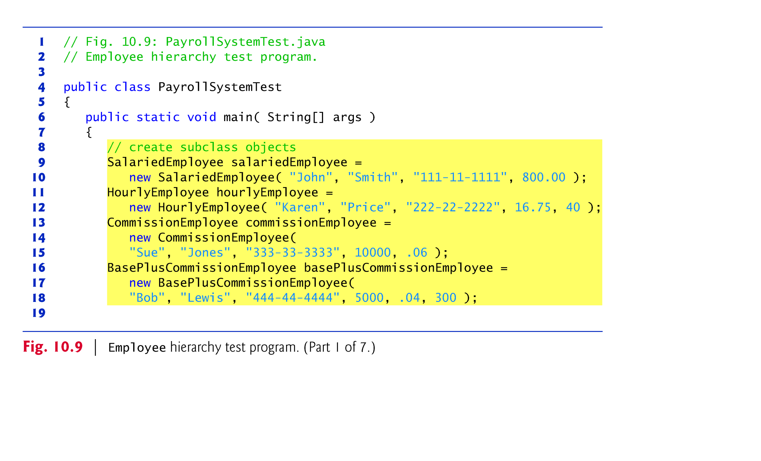

Slide 51
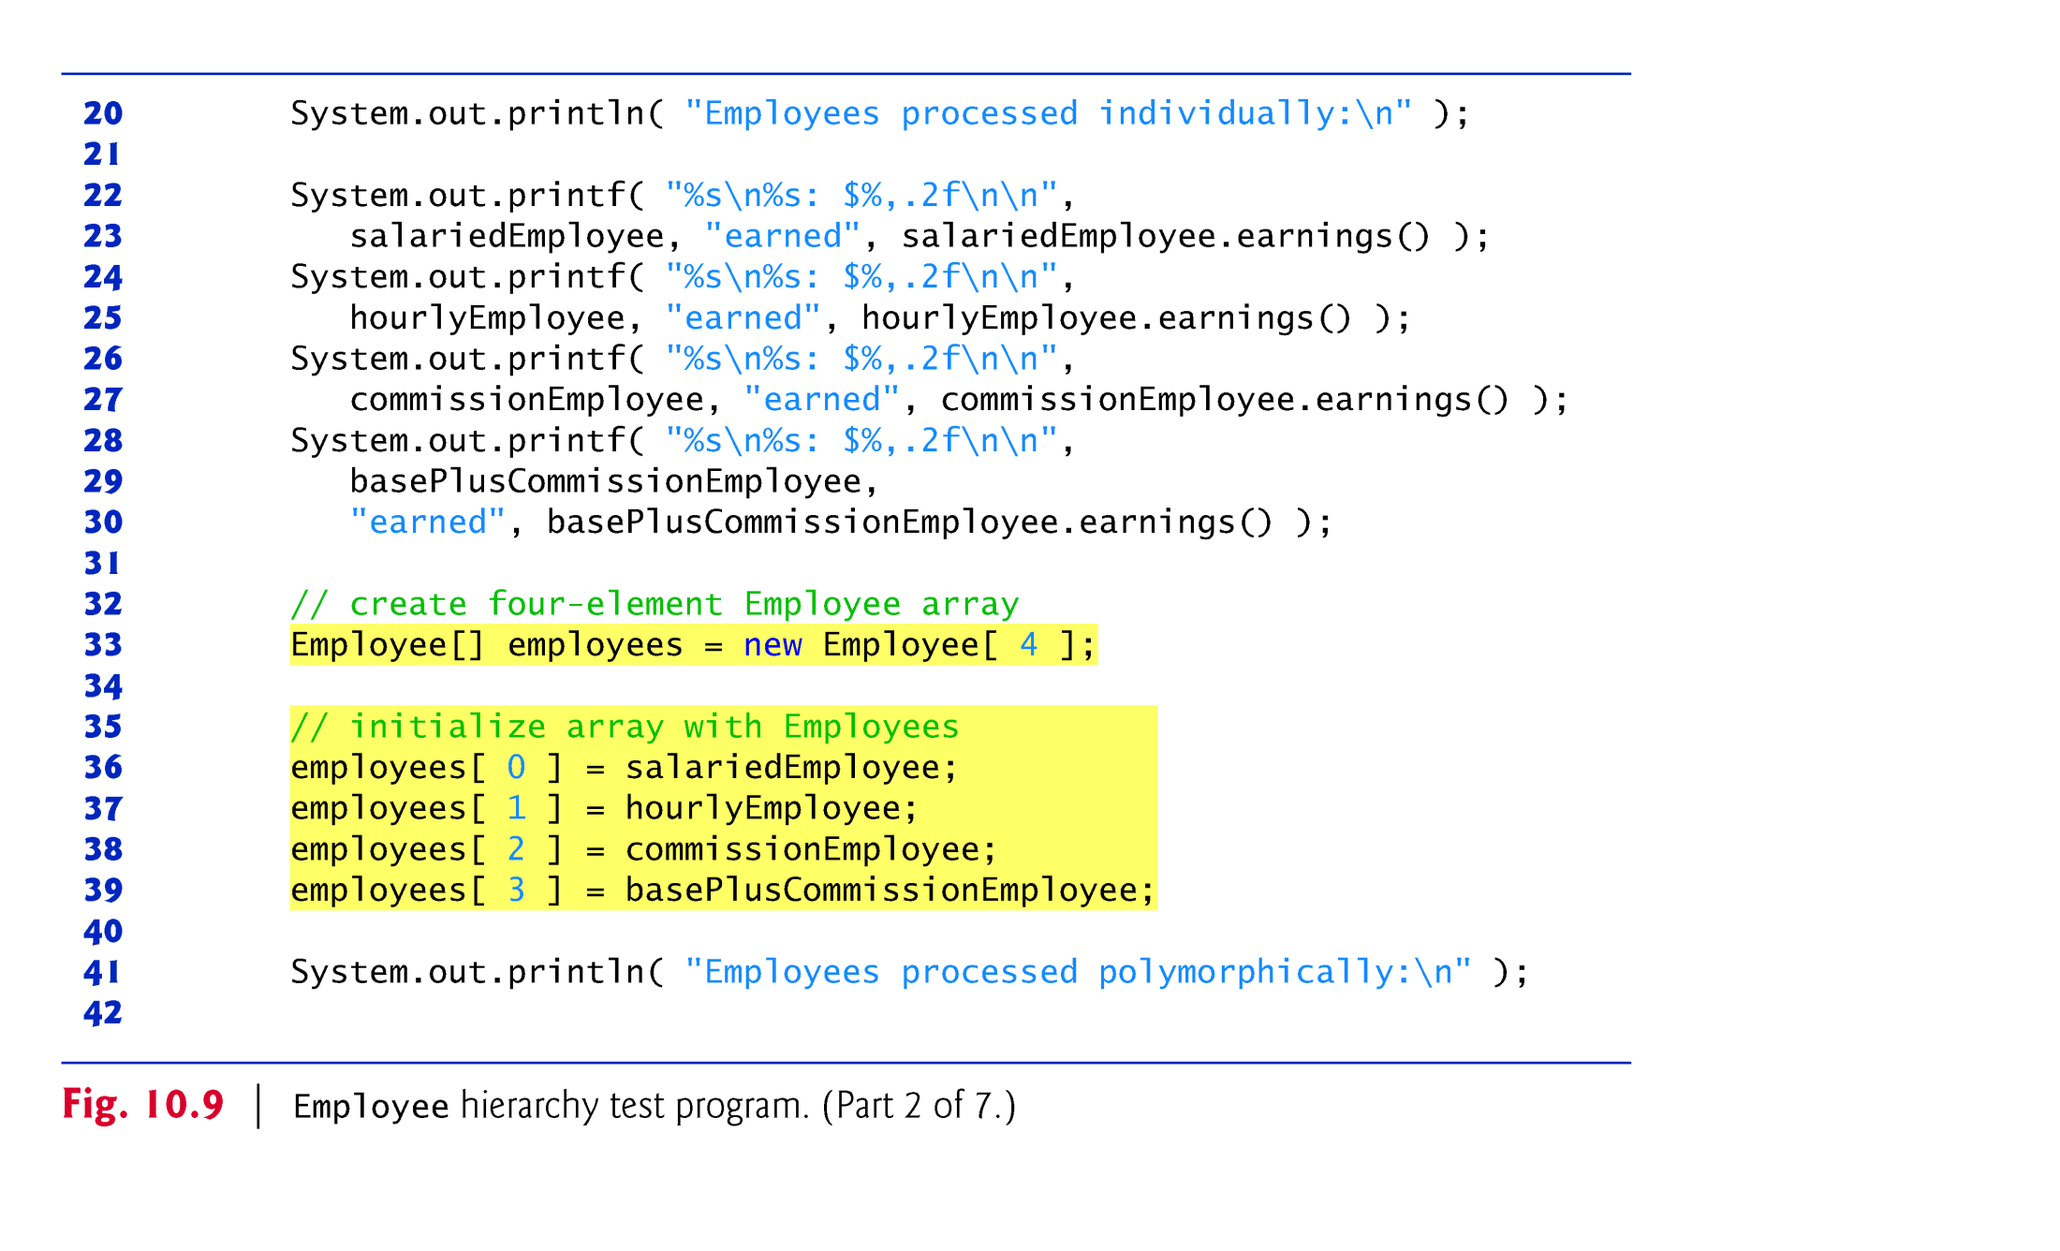

Slide 52
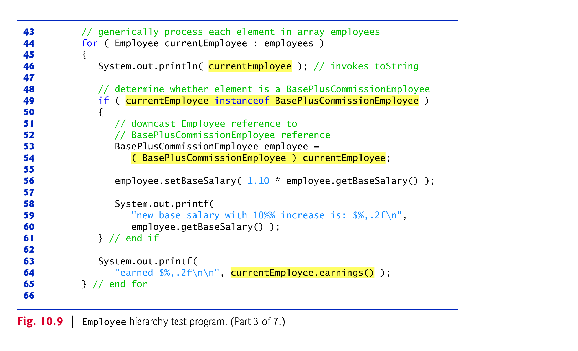

Slide 53
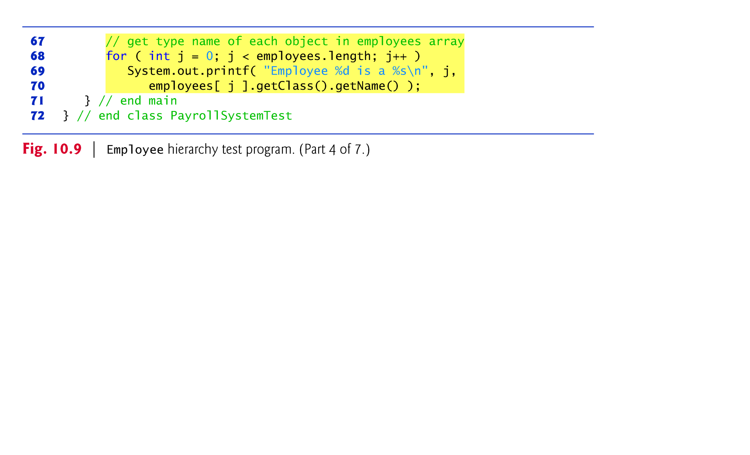

Slide 54
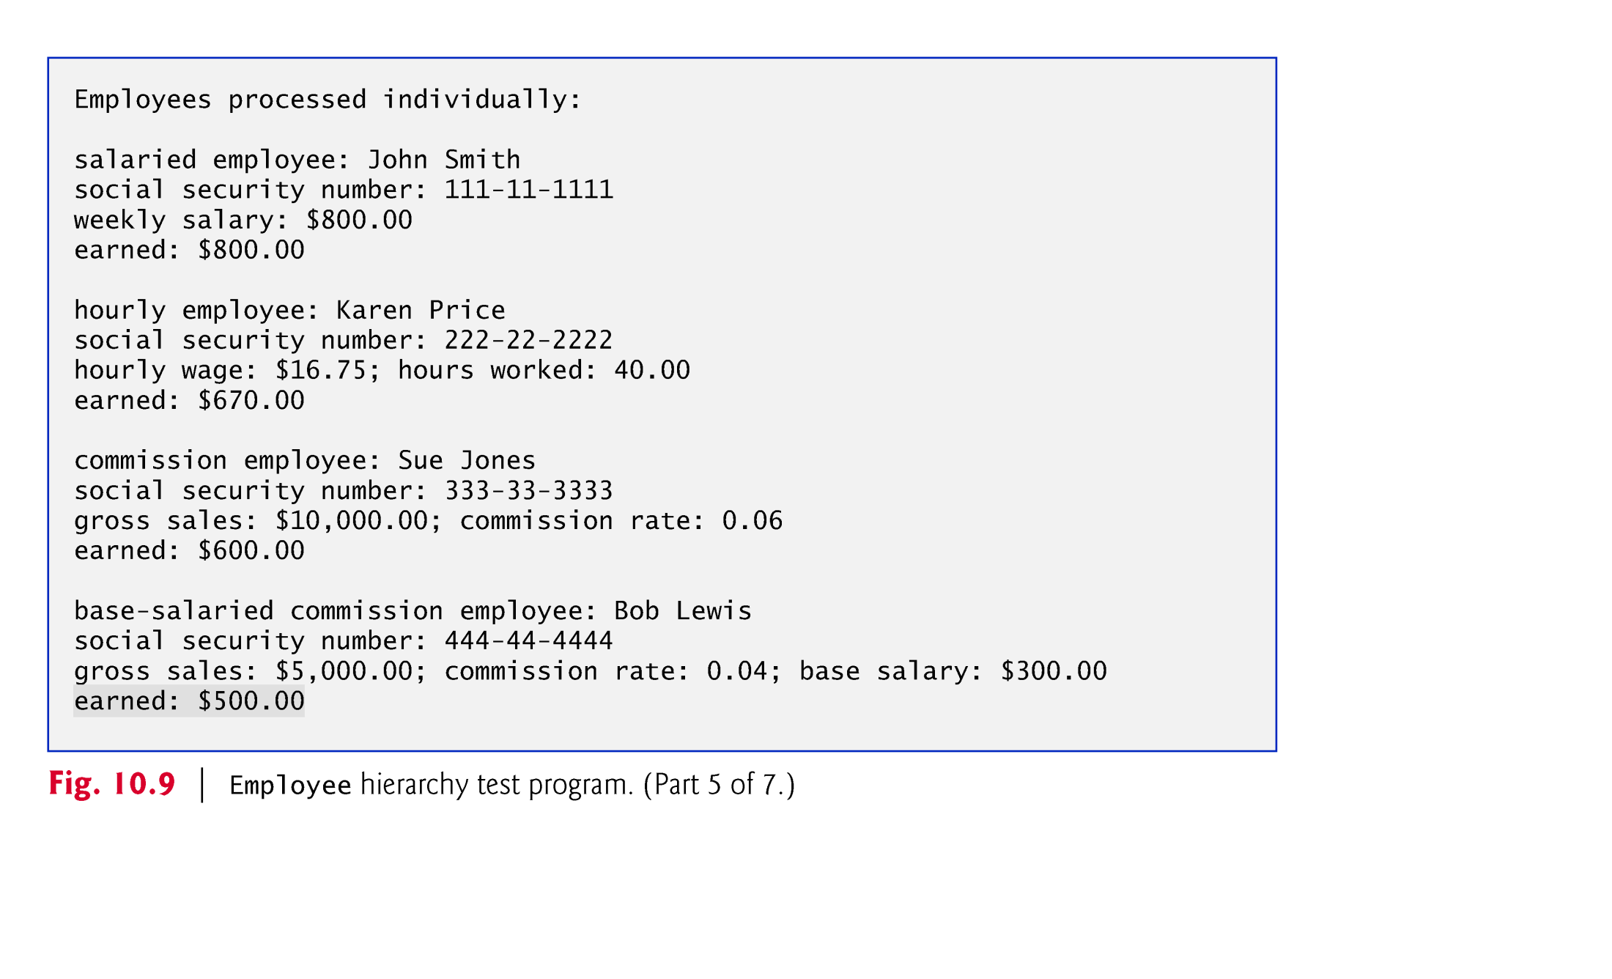

Slide 55
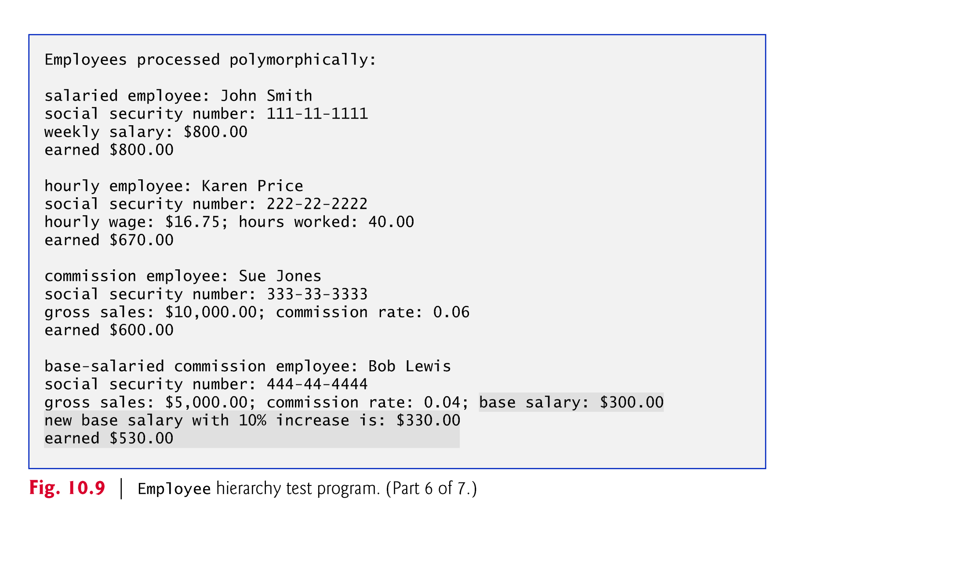

Slide 56
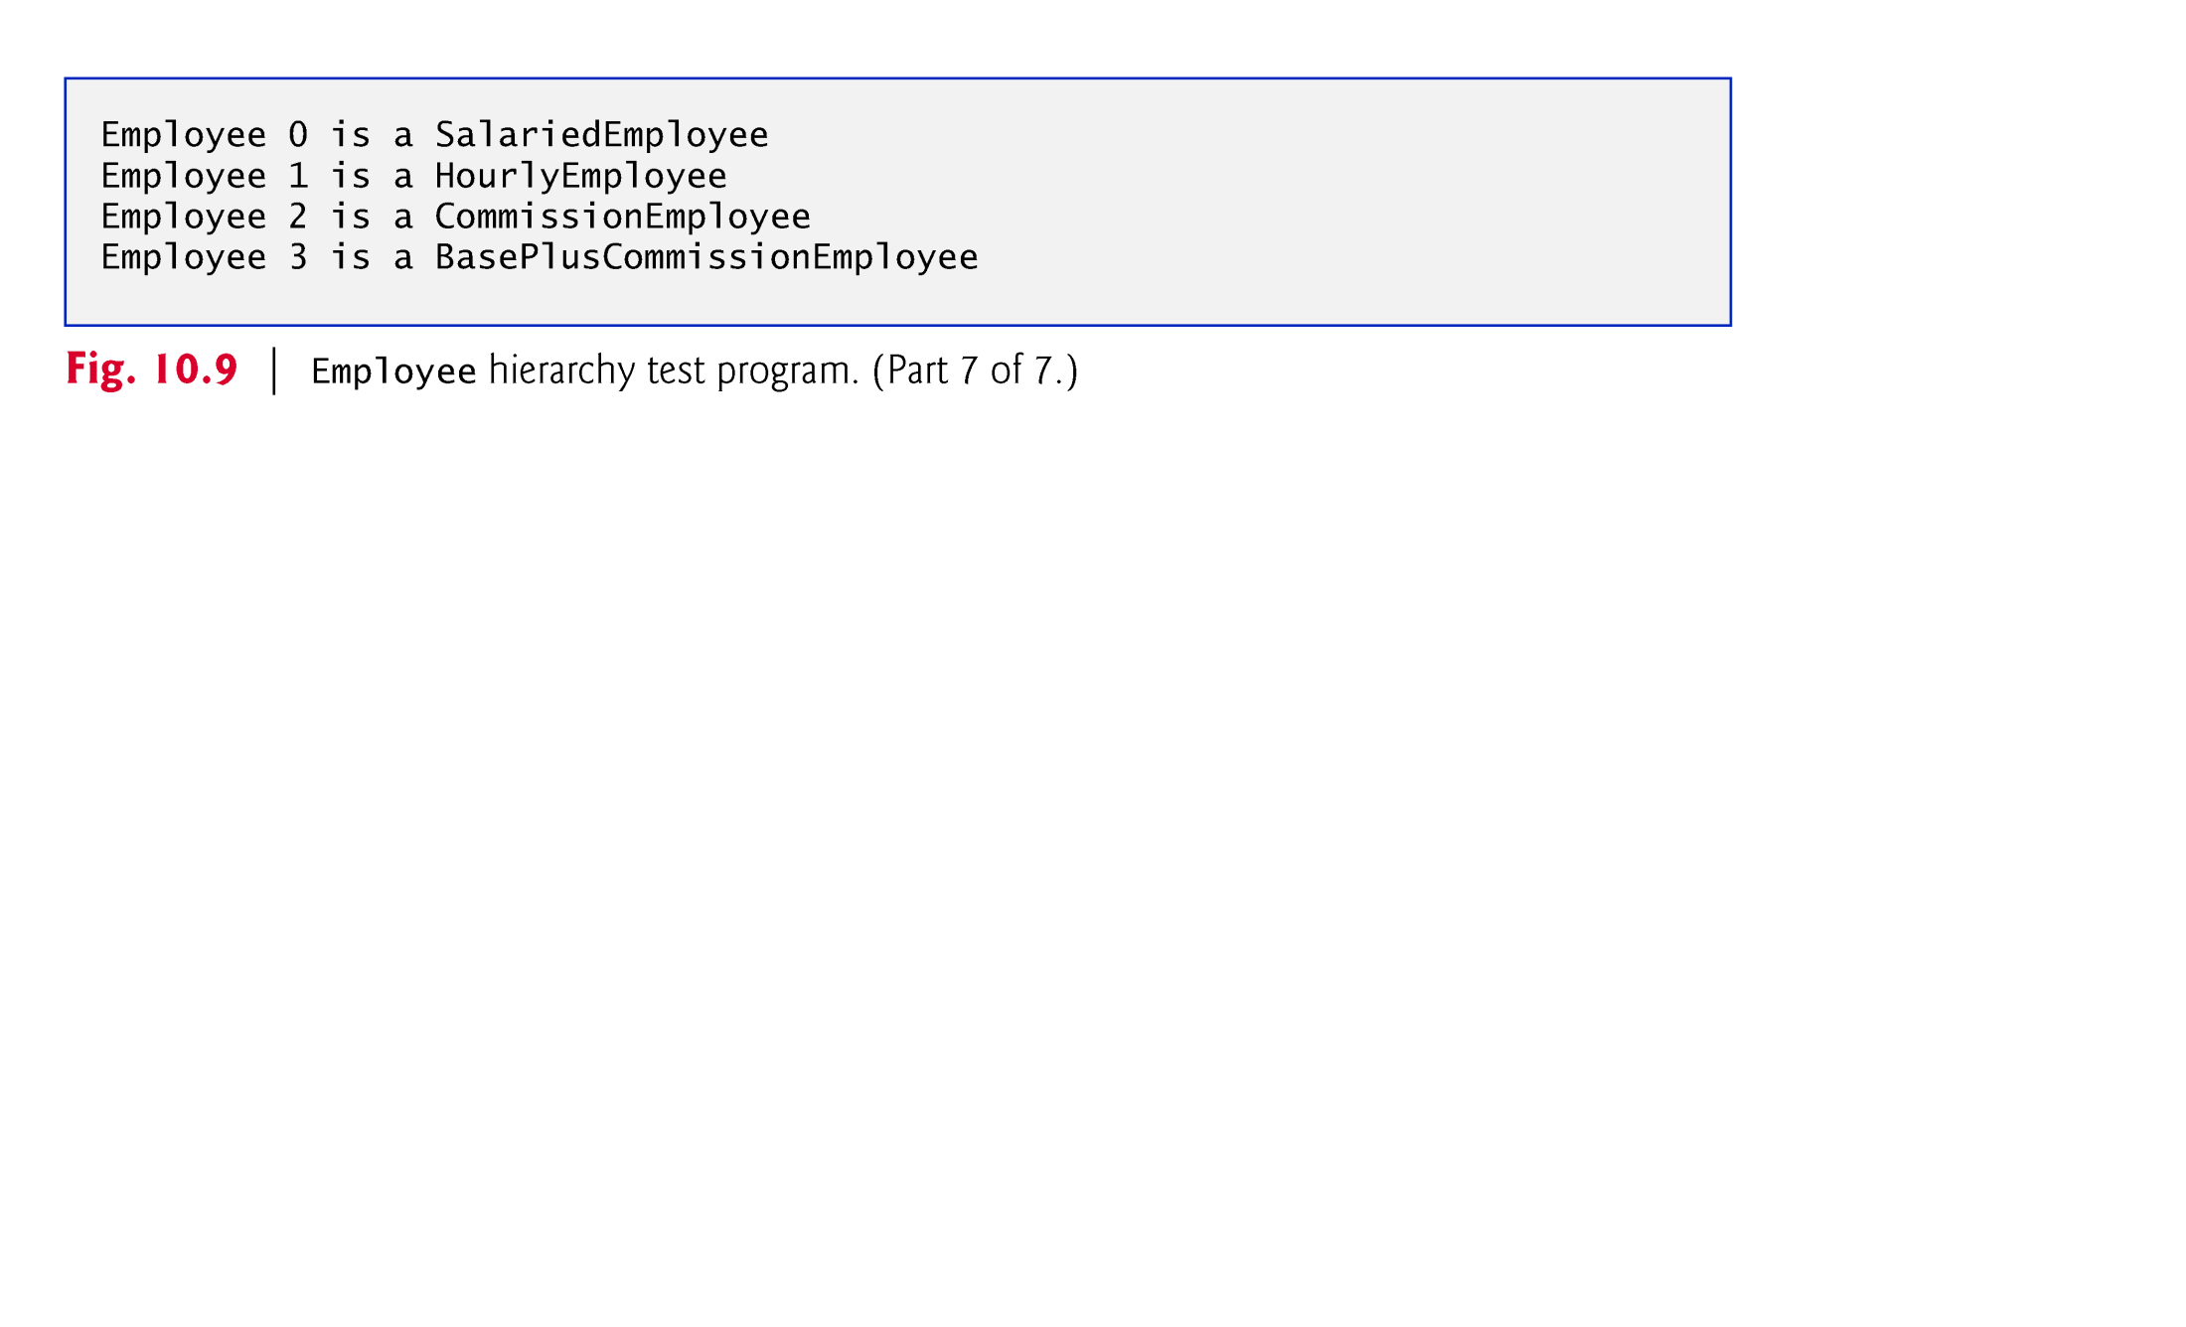

Slide 57
10.5.6 Polymorphic Processing, Operator instanceof and Downcasting (Cont.)
All calls to method toString and earnings are resolved at execution time, based on the type of the object to which currentEmployee refers.
Known as dynamic binding or late binding.
Java decides which class’s toString method to call at execution time rather than at compile time
A superclass reference can be used to invoke only methods of the superclass—the subclass method implementations are invoked polymorphically.
Attempting to invoke a subclass-only method directly on a superclass reference is a compilation error.

Slide 58


Slide 59
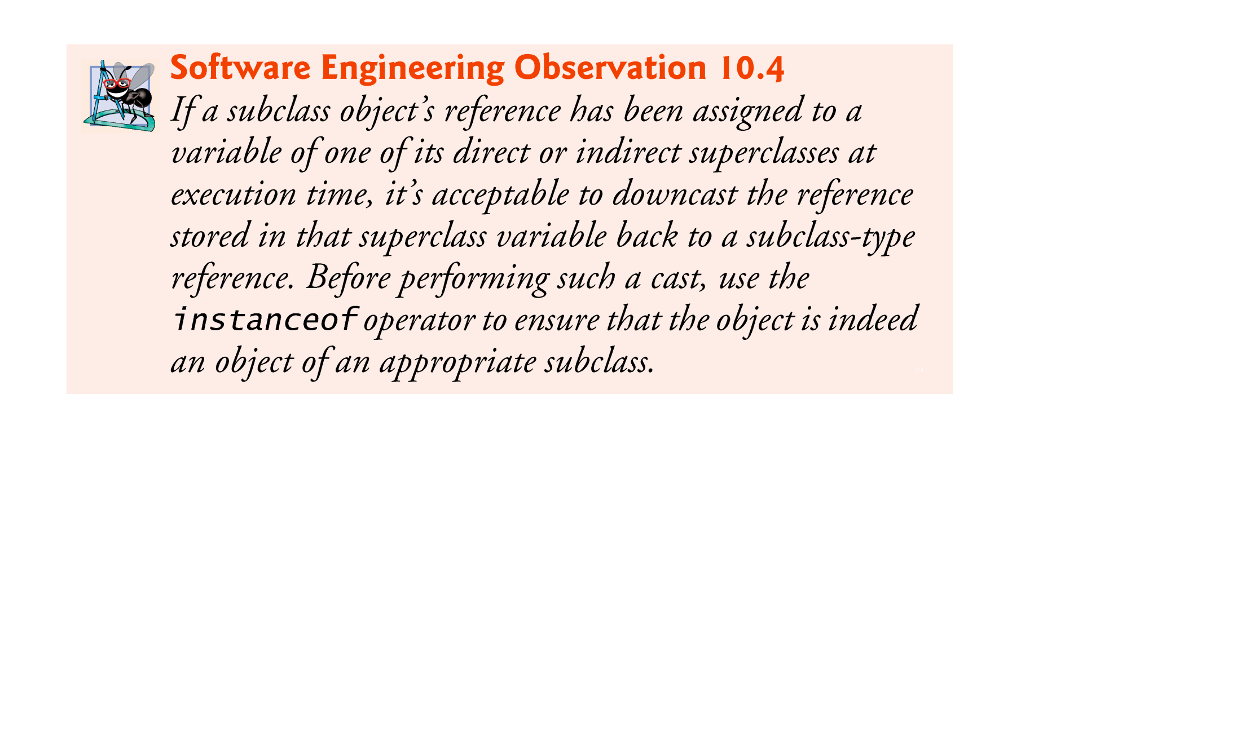

Slide 60
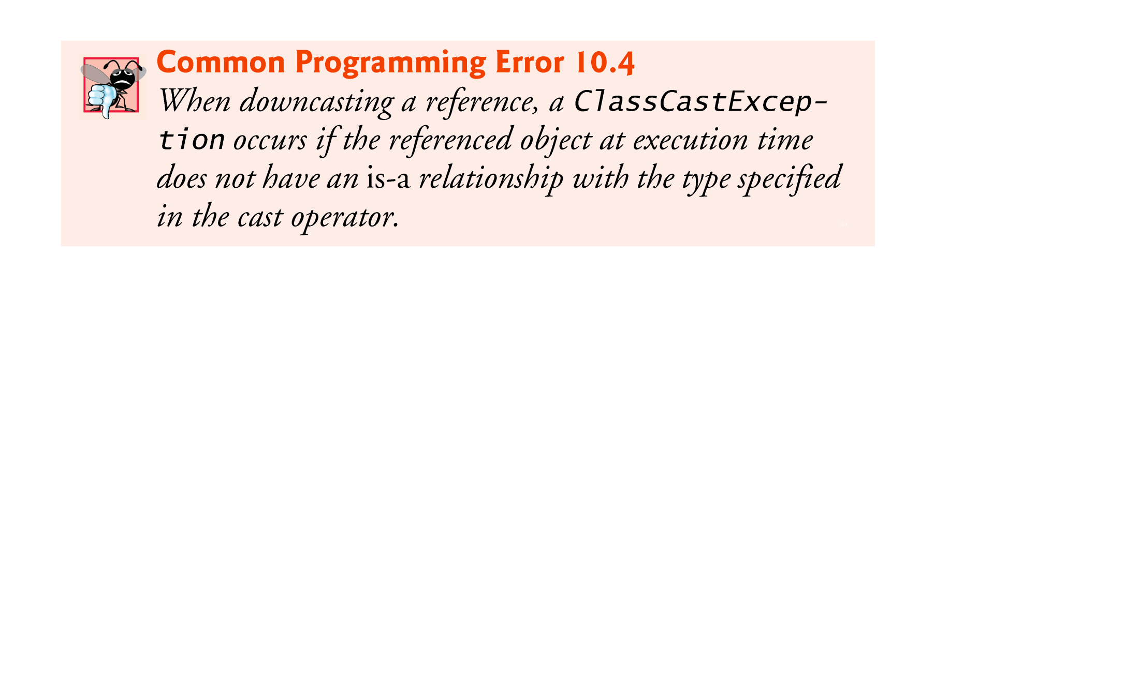

Slide 61
10.5.6 Polymorphic Processing, Operator instanceof and Downcasting (Cont.)
Every object in Java knows its own class and can access this information through the getClass method, which all classes inherit from class Object.
The getClass method returns an object of type Class (from package java.lang), which contains information about the object’s type, including its class name.
The result of the getClass call is used to invoke getName to get the object’s class name.

Slide 62
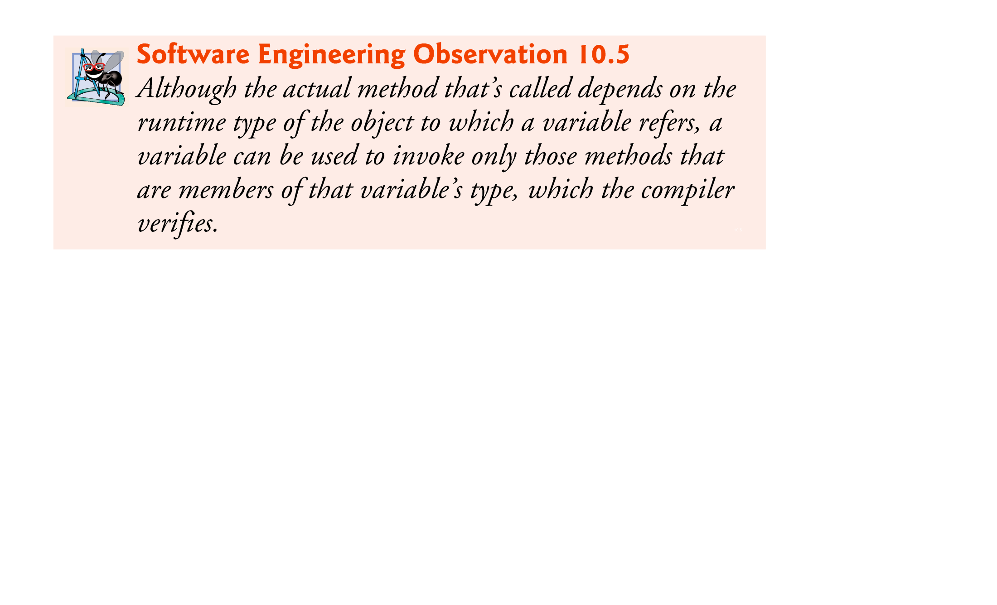

Slide 63
10.5.7 Summary of the Allowed Assignments Between Superclass and Subclass Variables
There are four ways to assign superclass and subclass references to variables of superclass and subclass types.
Assigning a superclass reference to a superclass variable is straightforward.
Assigning a subclass reference to a subclass variable is straightforward.
Assigning a subclass reference to a superclass variable is safe, because the subclass object is an object of its superclass.
The superclass variable can be used to refer only to superclass members.
Attempting to assign a superclass reference to a subclassvariable is a compilation error.

Slide 64
10.6 final Methods and Classes
A final method in a superclass cannot be overridden in a subclass.
Methods that are declared private are implicitly final, because it’s not possible to override them in a subclass.
Methods that are declared static are implicitly final.
A final method’s declaration can never change, so all subclasses use the same method implementation, and calls to final methods are resolved at compile time—this is known as static binding.

Slide 65
10.6 final Methods and Classes (Cont.)
A final class cannot be a superclass (i.e., a class cannot extend a final class).
All methods in a final class are implicitly final.
Class String is an example of a final class.
If you were allowed to create a subclass of String, objects of that subclass could be used wherever Strings are expected.
Since class String cannot be extended, programs that use Strings can rely on the functionality of String objects as specified in the Java API.
Making the class final also prevents programmers from creating subclasses that might bypass security restrictions.

Slide 66


Slide 67
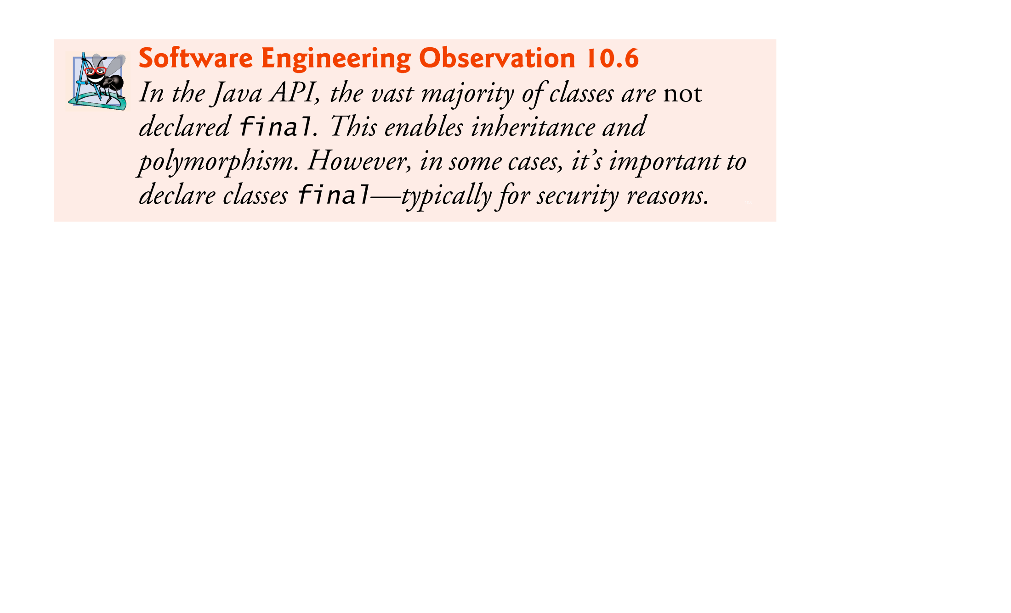

Slide 68
10.7 Case Study: Creating and Using Interfaces
Interfaces offer a capability requiring that unrelated classes implement a set of common methods.
Interfaces define and standardize the ways in which things such as people and systems can interact with one another.
Example: The controls on a radio serve as an interface between radio users and a radio’s internal components.
Can perform only a limited set of operations (e.g., change the station, adjust the volume, choose between AM and FM)
Different radios may implement the controls in different ways (e.g., using push buttons, dials, voice commands).

Slide 69
10.7 Case Study: Creating and Using Interfaces (Cont.)
The interface specifies what operations a radio must permit users to perform but does not specify how the operations are performed.
A Java interface describes a set of methods that can be called on an object.

Slide 70
10.7 Case Study: Creating and Using Interfaces (Cont.)
An interface declaration begins with the keyword interface and contains only constants and abstract methods.
All interface members must be public.
Interfaces may not specify any implementation details, such as concrete method declarations and instance variables.
All methods declared in an interface are implicitly public abstract methods.
All fields are implicitly public, static and final.

Slide 71
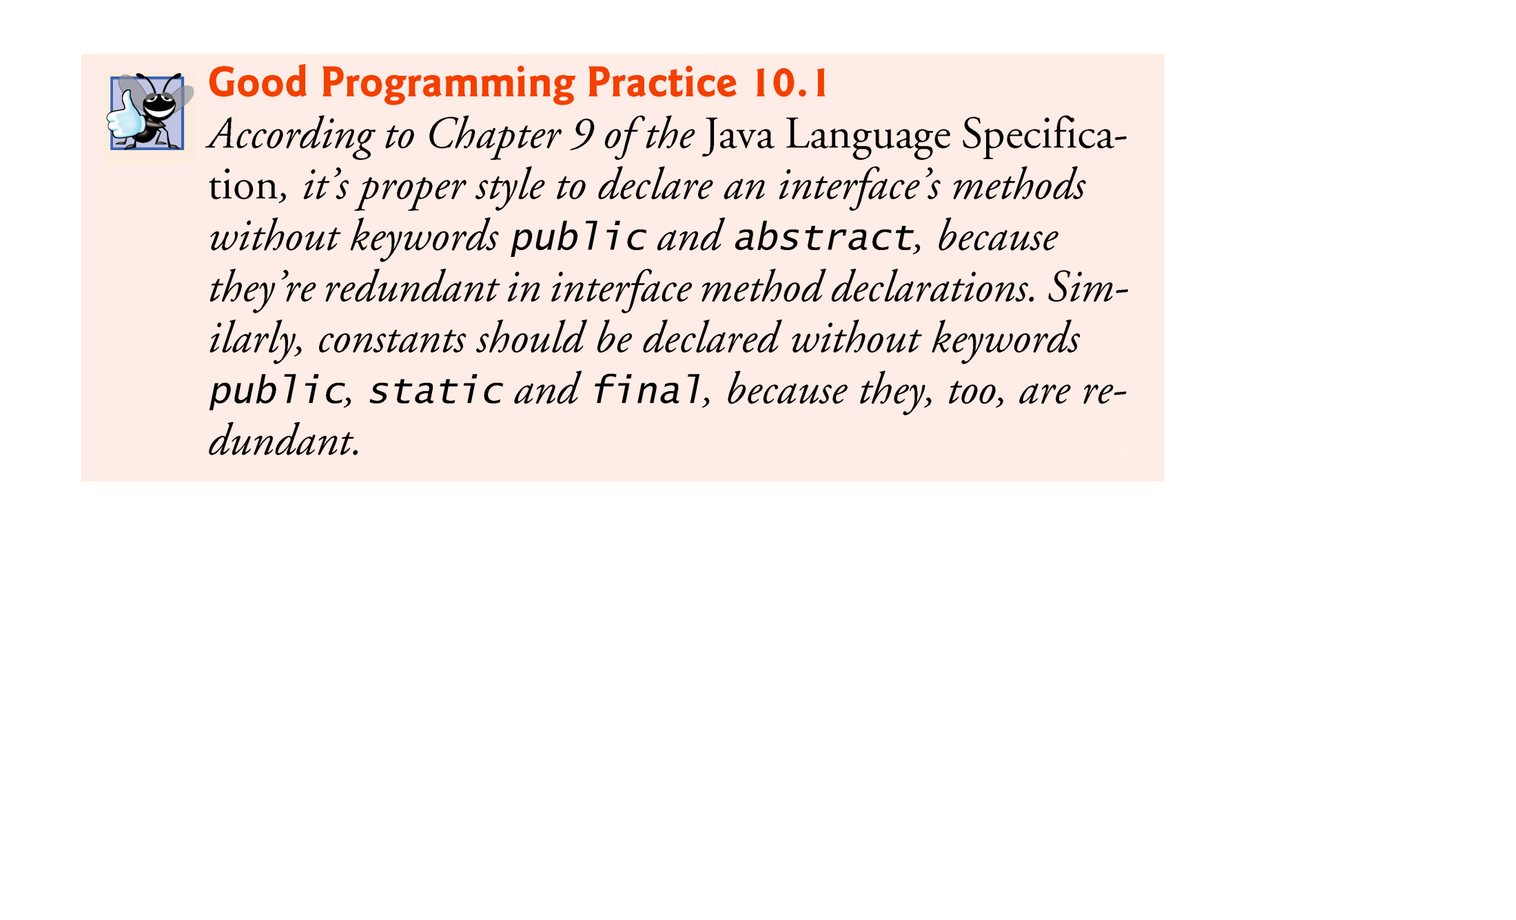

Slide 72
10.7 Case Study: Creating and Using Interfaces (Cont.)
To use an interface, a concrete class must specify that it implements the interface and must declare each method in the interface with specified signature.
Add the implements keyword and the name of the interface to the end of your class declaration’s first line.
A class that does not implement all the methods of the interface is an abstract class and must be declared abstract.

Slide 73
10.7 Case Study: Creating and Using Interfaces (Cont.)
An interface is often used when disparate (i.e., unrelated) classes need to share common methods and constants.
Allows objects of unrelated classes to be processed polymorphically by responding to the same method calls.
You can create an interface that describes the desired functionality, then implement this interface in any classes that require that functionality.

Slide 74
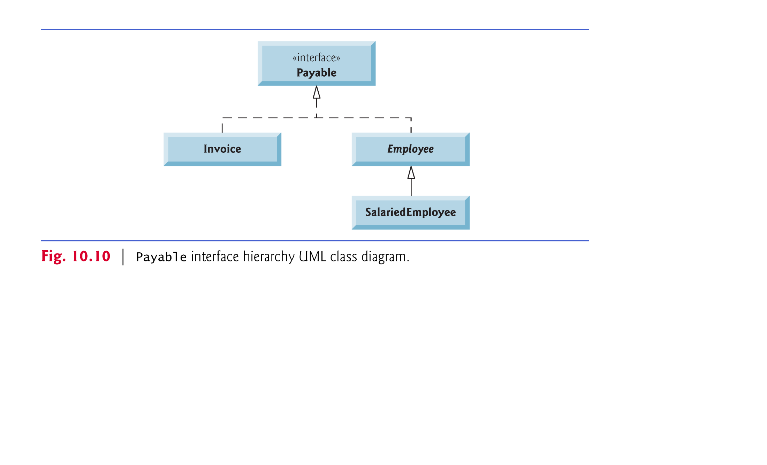

Slide 75
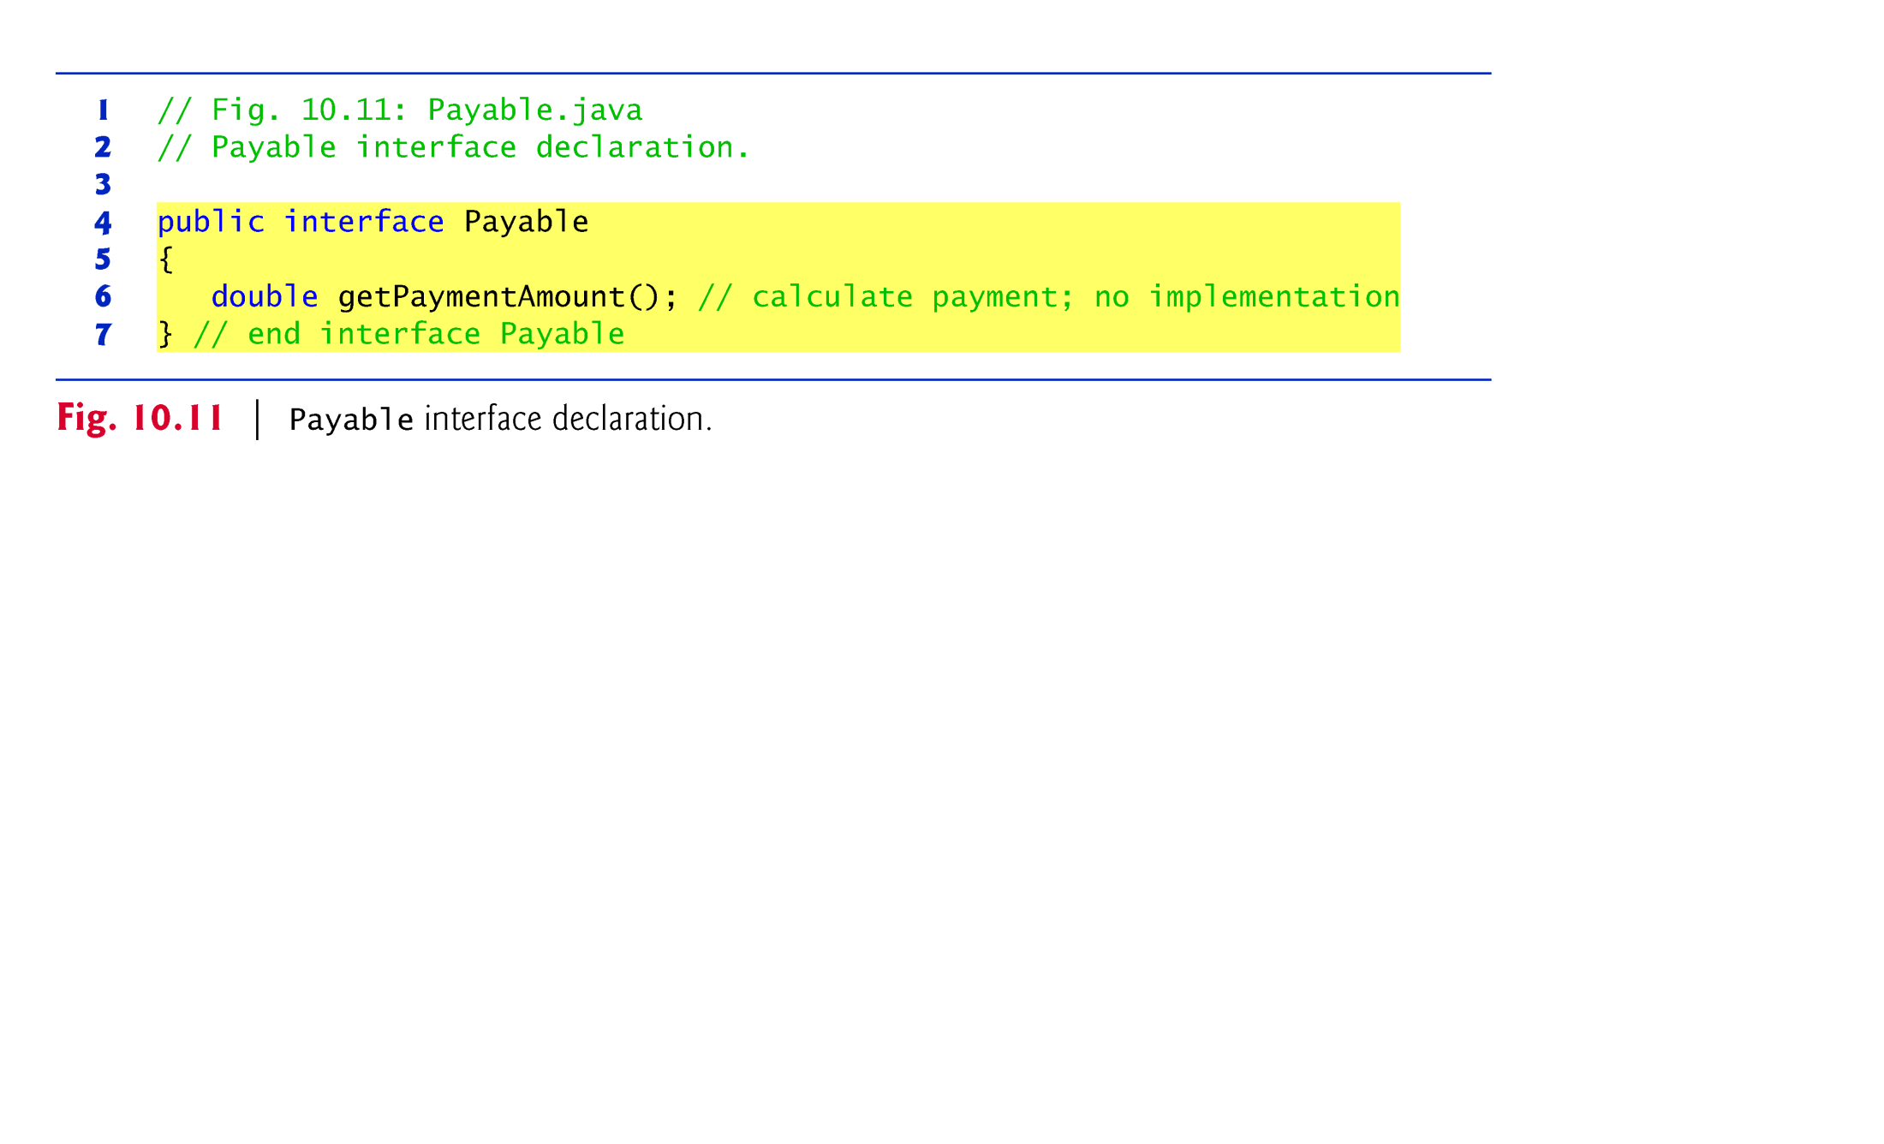

Slide 76
10.7.3 Class Invoice
Java does not allow subclasses to inherit from more than one superclass, but it allows a class to inherit from one superclass and implement as many interfaces as it needs.
To implement more than one interface, use a comma-separated list of interface names after keyword implements in the class declaration, as in:
public class ClassName extends SuperclassName implements FirstInterface, SecondInterface, …

Slide 77
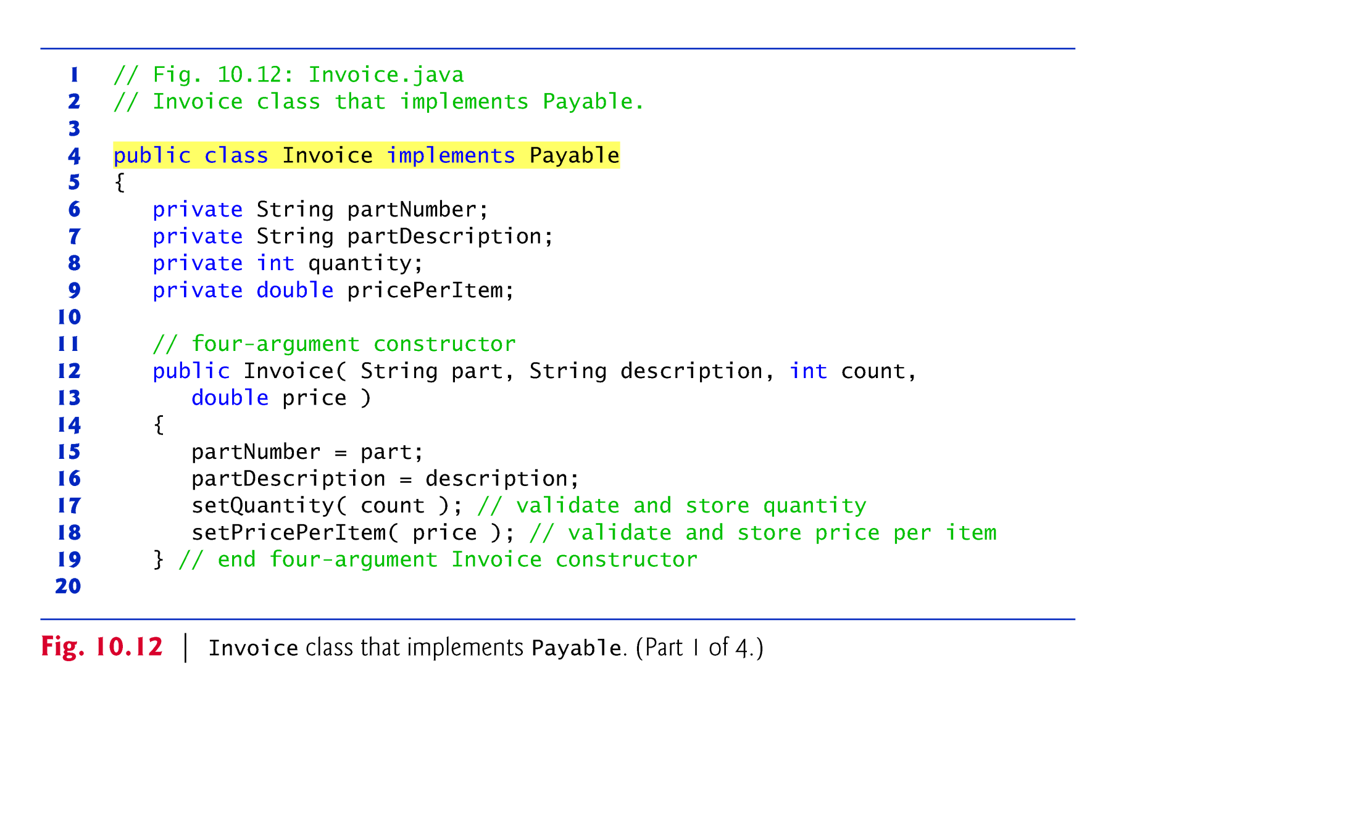

Slide 78
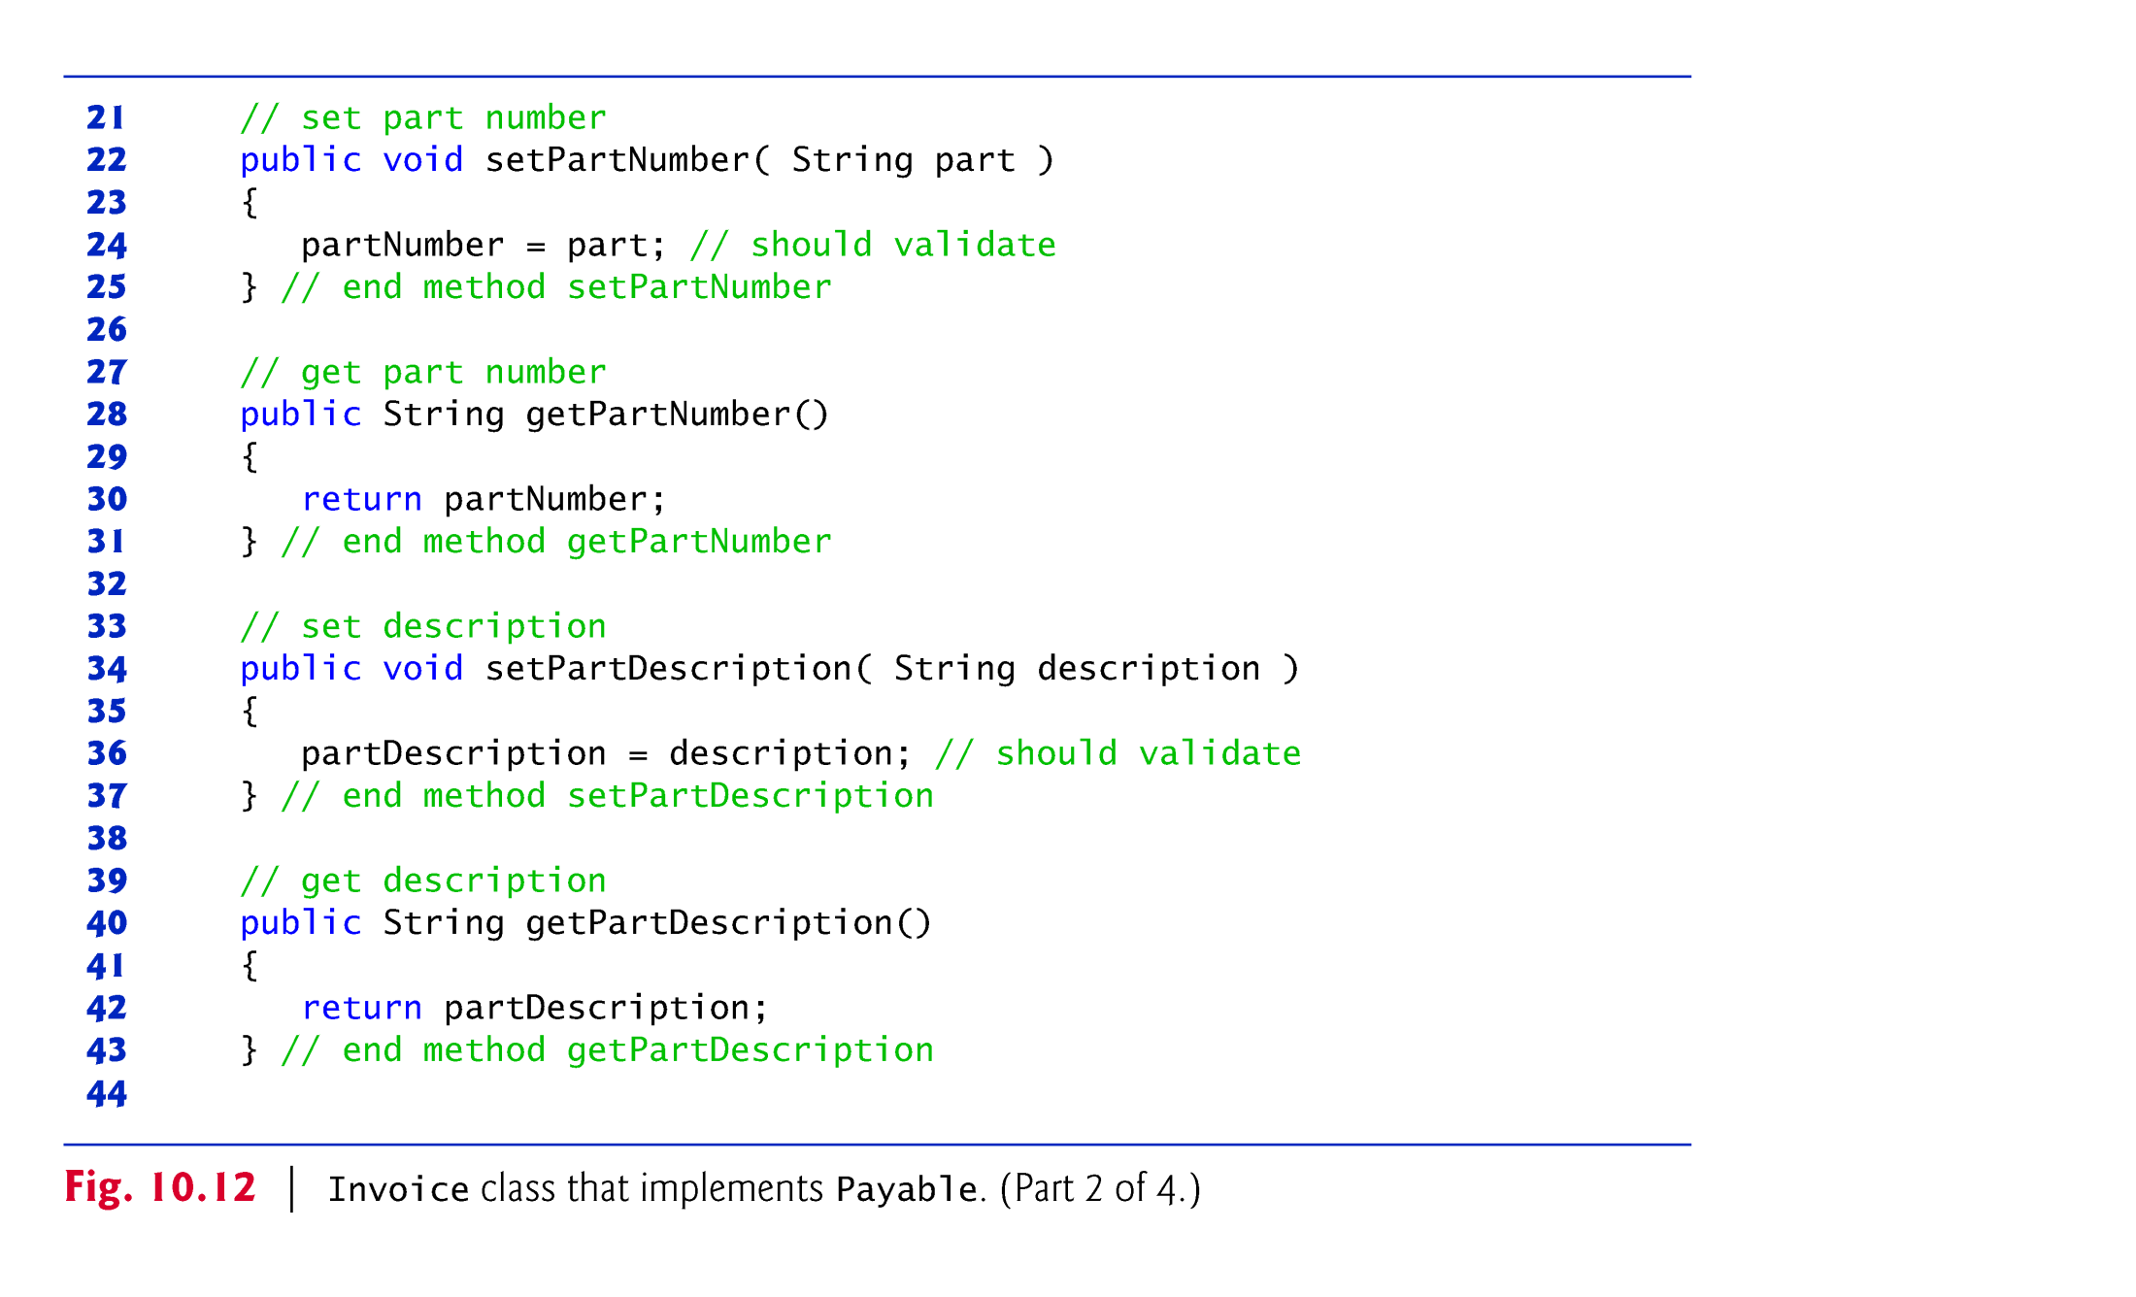

Slide 79
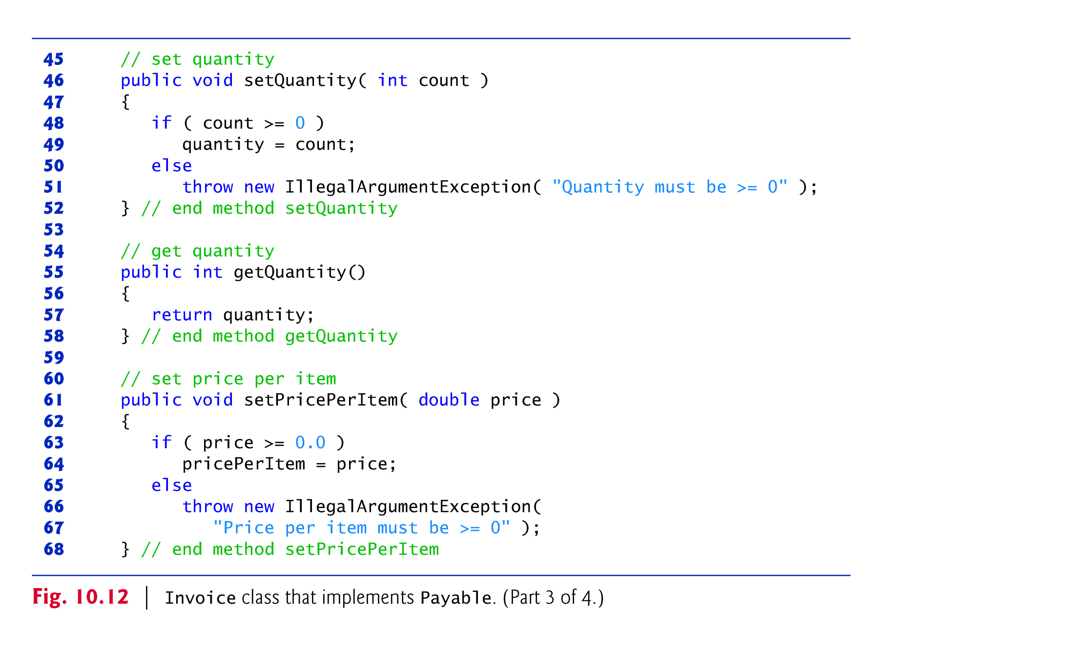

Slide 80
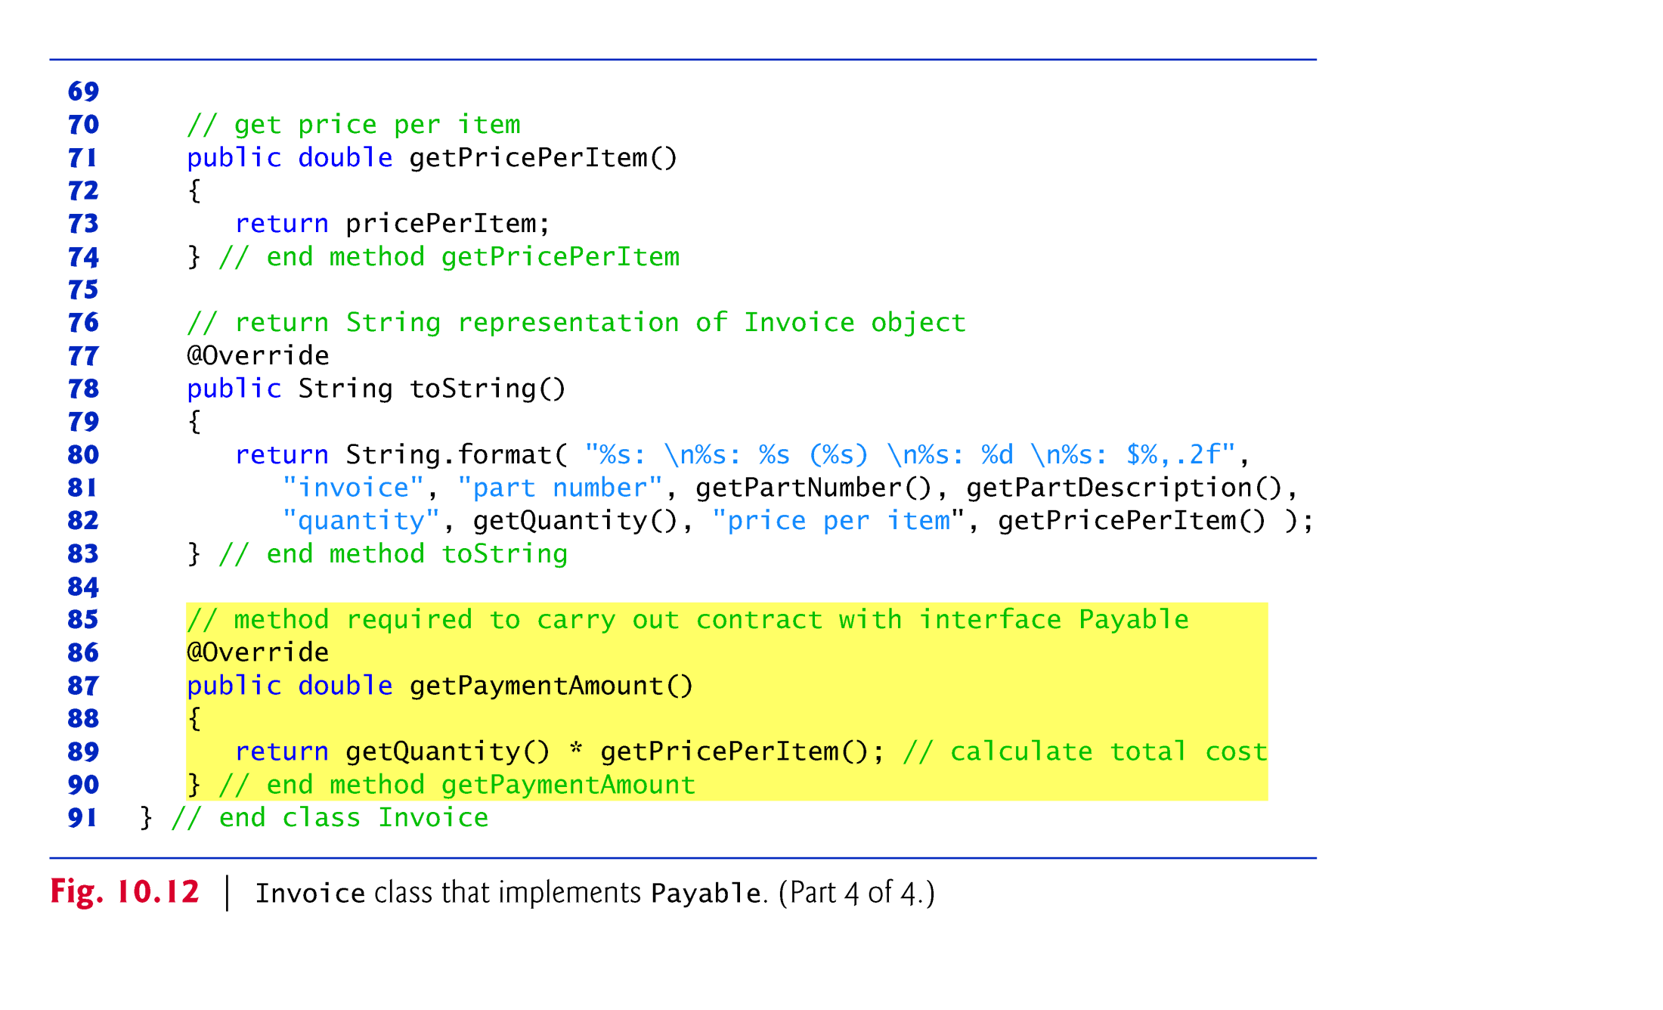

Slide 81


Slide 82
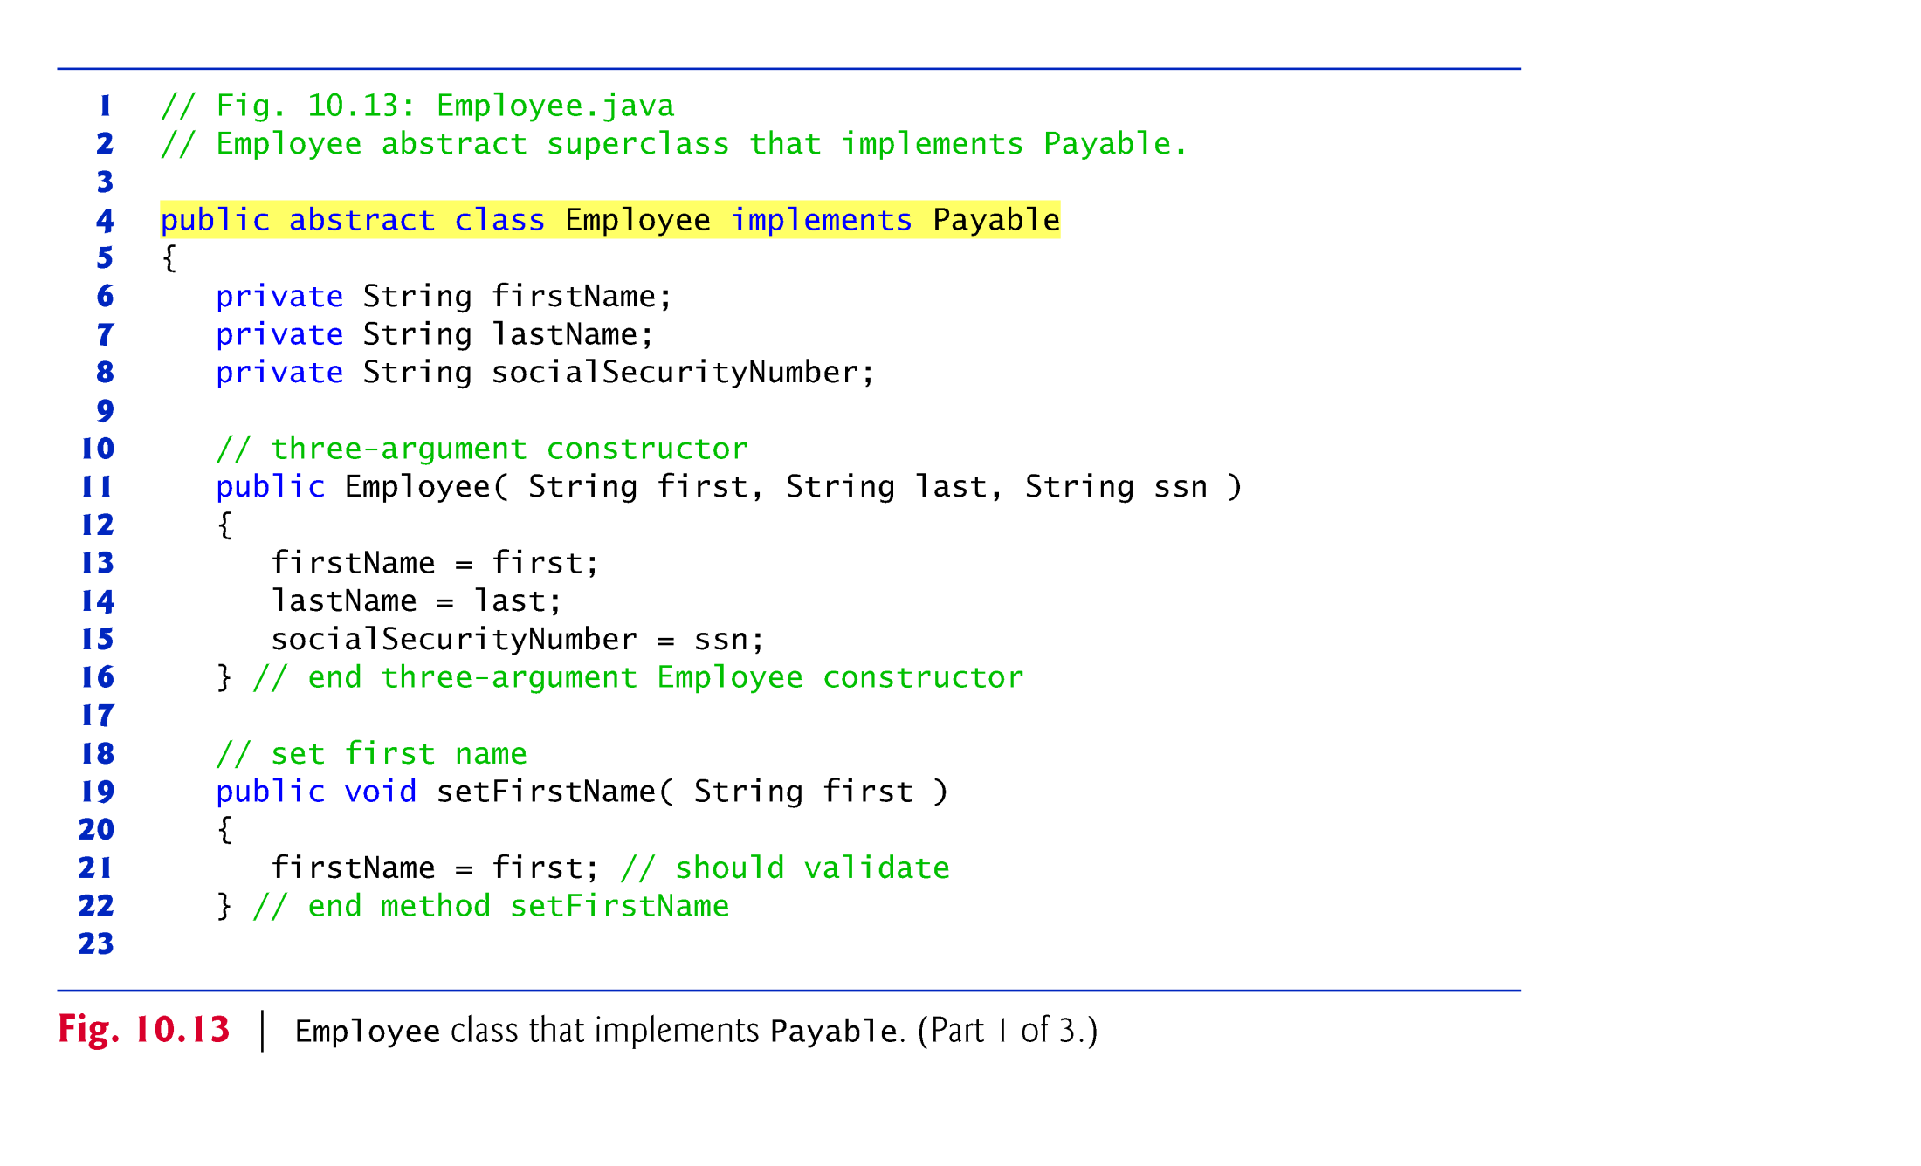

Slide 83
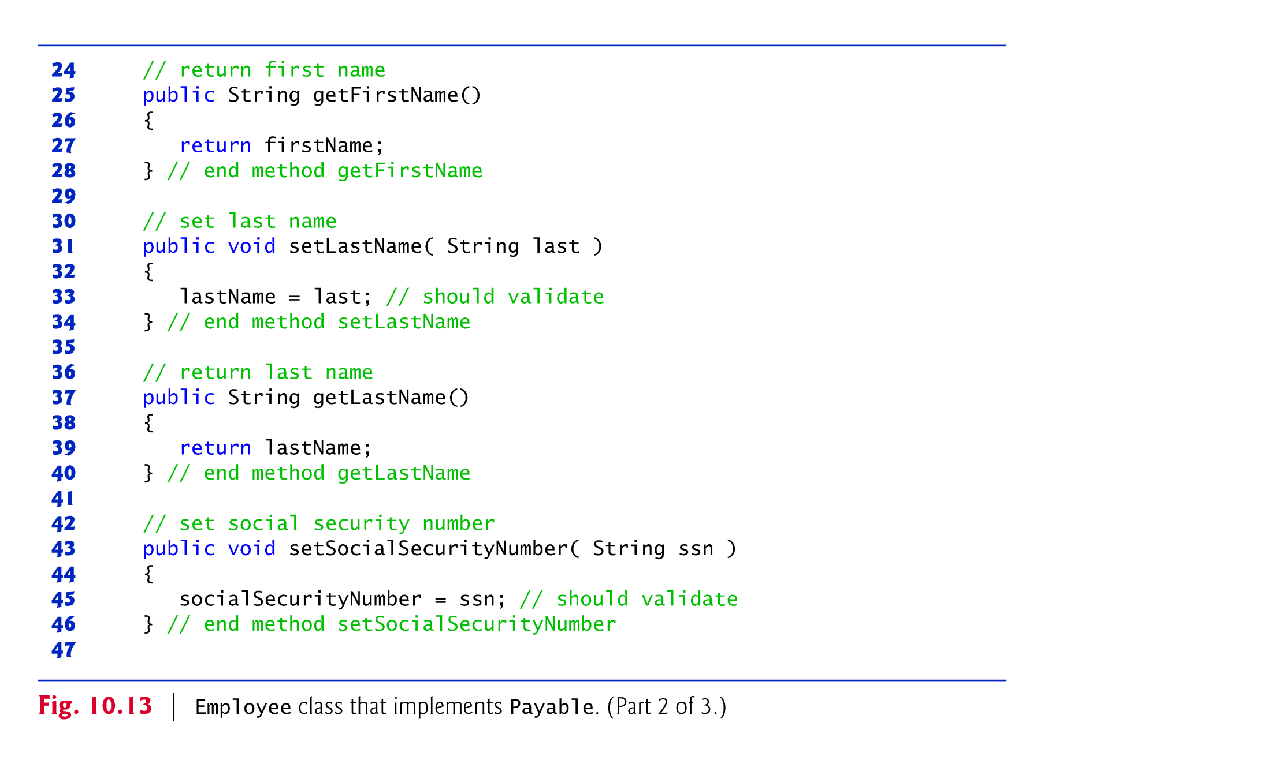

Slide 84
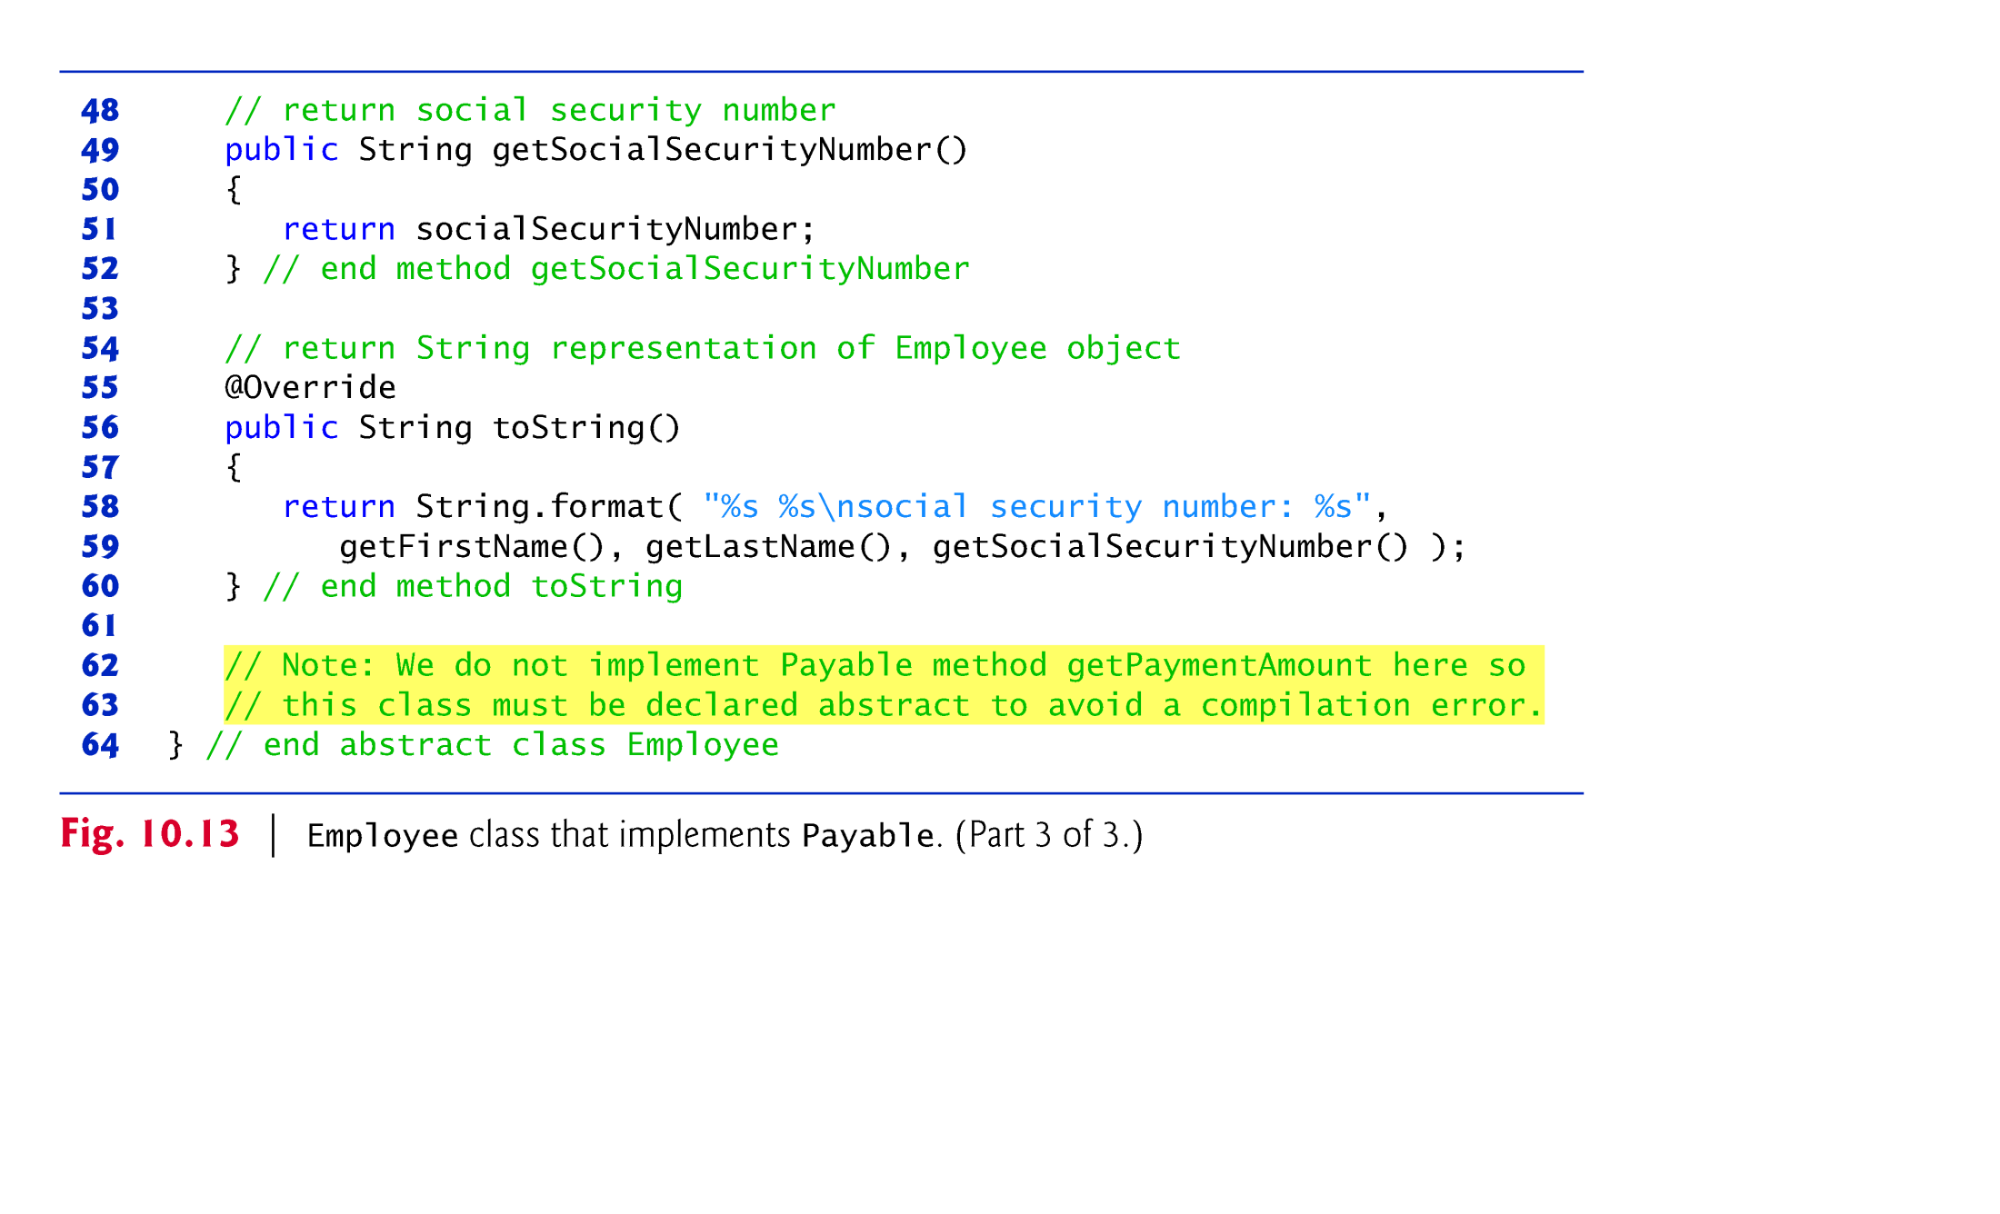

Slide 85
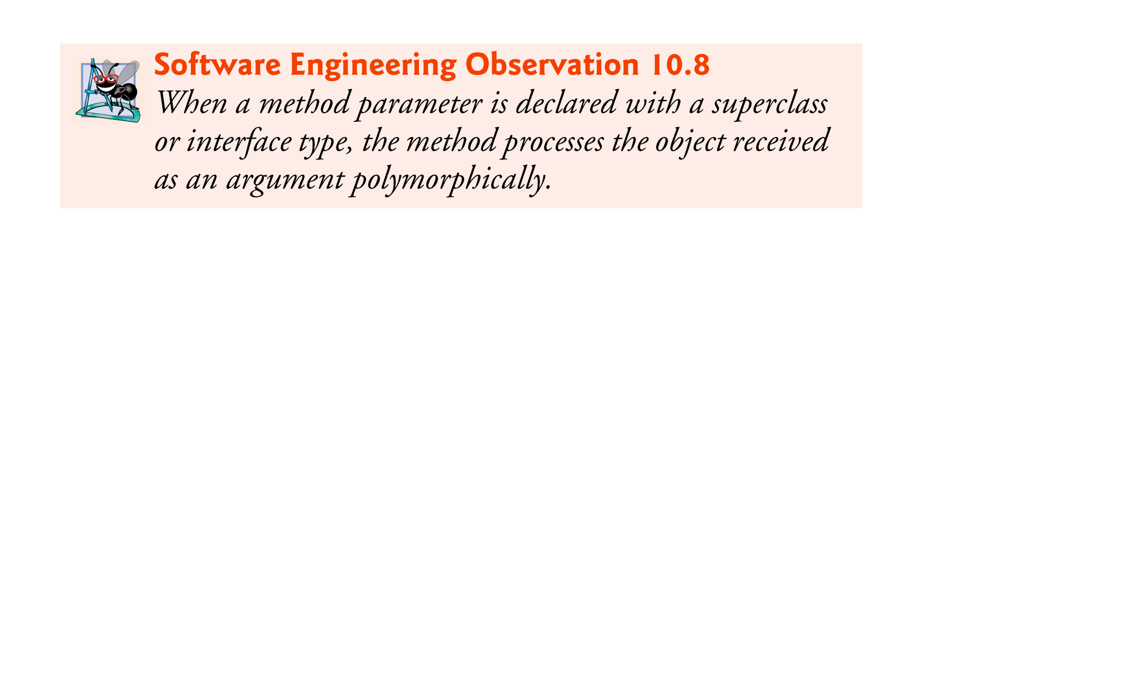

Slide 86
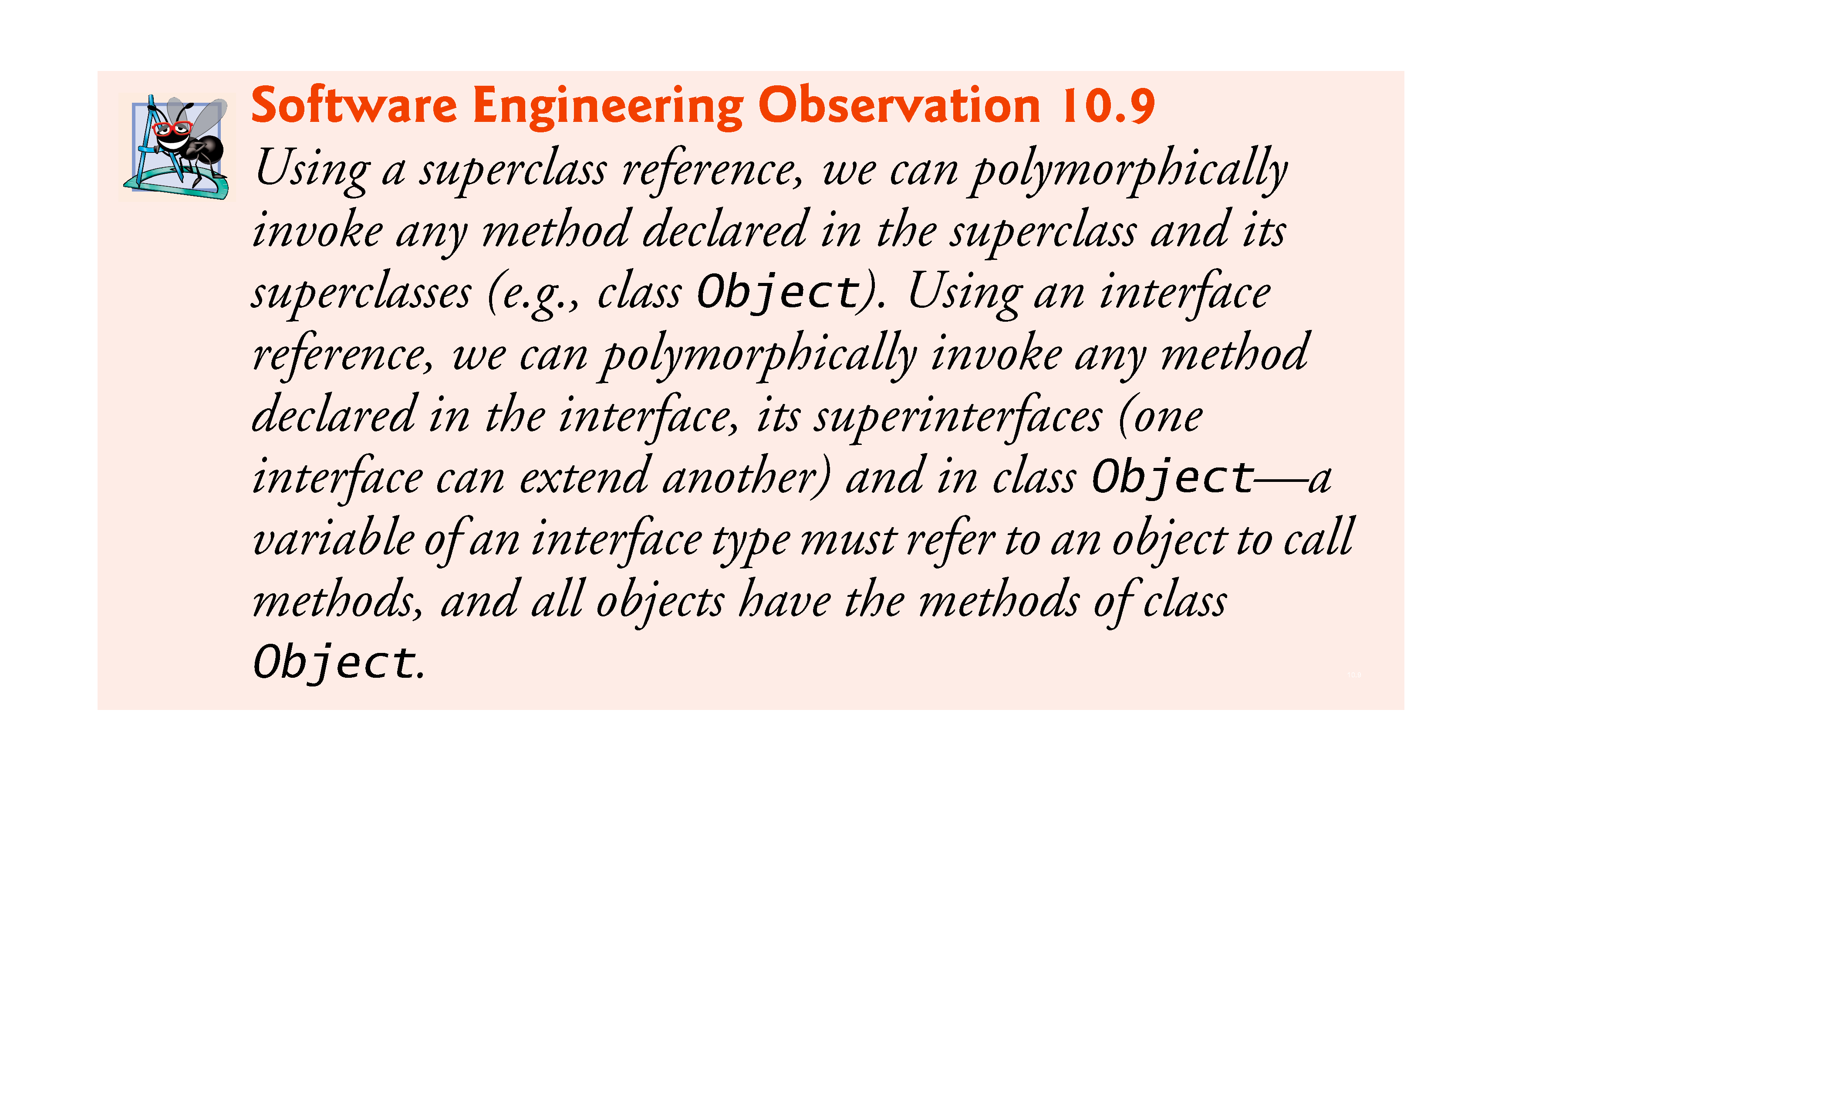

Slide 87
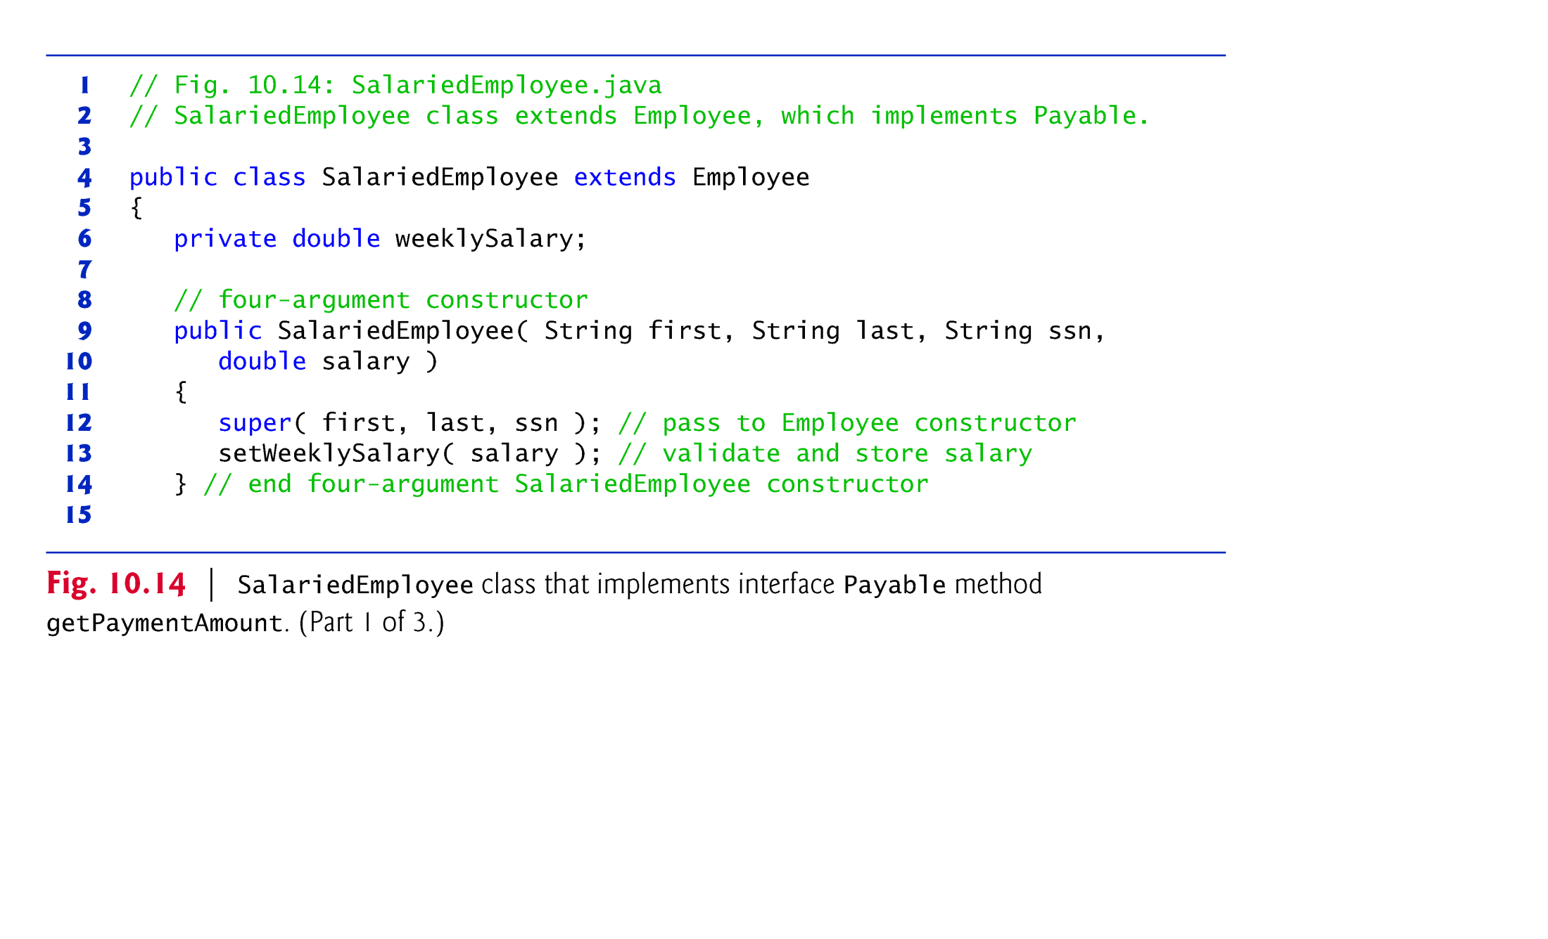

Slide 88


Slide 89


Slide 90
10.7.5 Modifying Class SalariedEmployee for Use in the Payable Hierarchy (Cont.)
Objects of any subclasses of a class that implements an interface can also be thought of as objects of the interface type.
Thus, just as we can assign the reference of a SalariedEmployee object to a superclass Employee variable, we can assign the reference of a SalariedEmployee object to an interface Payable variable.
Invoice implements Payable, so an Invoice object also is a Payable object, and we can assign the reference of an Invoice object to a Payable variable.

Slide 91


Slide 92


Slide 93


Slide 94
10.7.7 Common Interfaces of the Java API
The Java API’s interfaces enable you to use your own classes within the frameworks provided by Java, such as comparing objects of your own types and creating tasks that can execute concurrently with other tasks in the same program.
Figure 10.16 presents a brief overview of a few of the more popular interfaces of the Java API that we use in Java How to Program, Ninth Edition.

Slide 95


Slide 96


Slide 97
10.8 Java SE 8 Interface Enhancements(Cont.)
default Interface Methods
As of Java SE 8, interfaces also may contain public default methods with concrete default implementations that specify how operations are performed when an implementing class does not override the methods.

Slide 98
10.8 Java SE 8 Interface Enhancements(Cont.)
static Interface Methods
As of Java SE 8, interfaces also may contain static methods with concrete default implementations
Functional Interface
any interface containing only one abstract method is known as a functional interface

Slide 99


Slide 100
10.8 Java SE 8 Interface Enhancements(Cont.)
Java SE 9 private Interface Methods
As of Java SE 9, you can declare helper methods in interfaces via private interface methods.
An interface’s private instance methods can be called directly (i.e., without an object reference) only by the interface’s other instance methods

Slide 101


Slide 102
10.10 private Constructors
Preventing object instantiation
Sharing initialization code in constructors
Factory methods
Force client code to use so-called “factory methods” to create objects.

Slide 103
10.11 Program to an Interface, Not an Implementation
Implementation inheritance is best for small numbers of tightly coupled classes
Interface inheritance is best for flexibility

Slide 104


10.12 (Optional) GUI and Graphics Case Study: Drawing with Polymorphism

